Slide 1
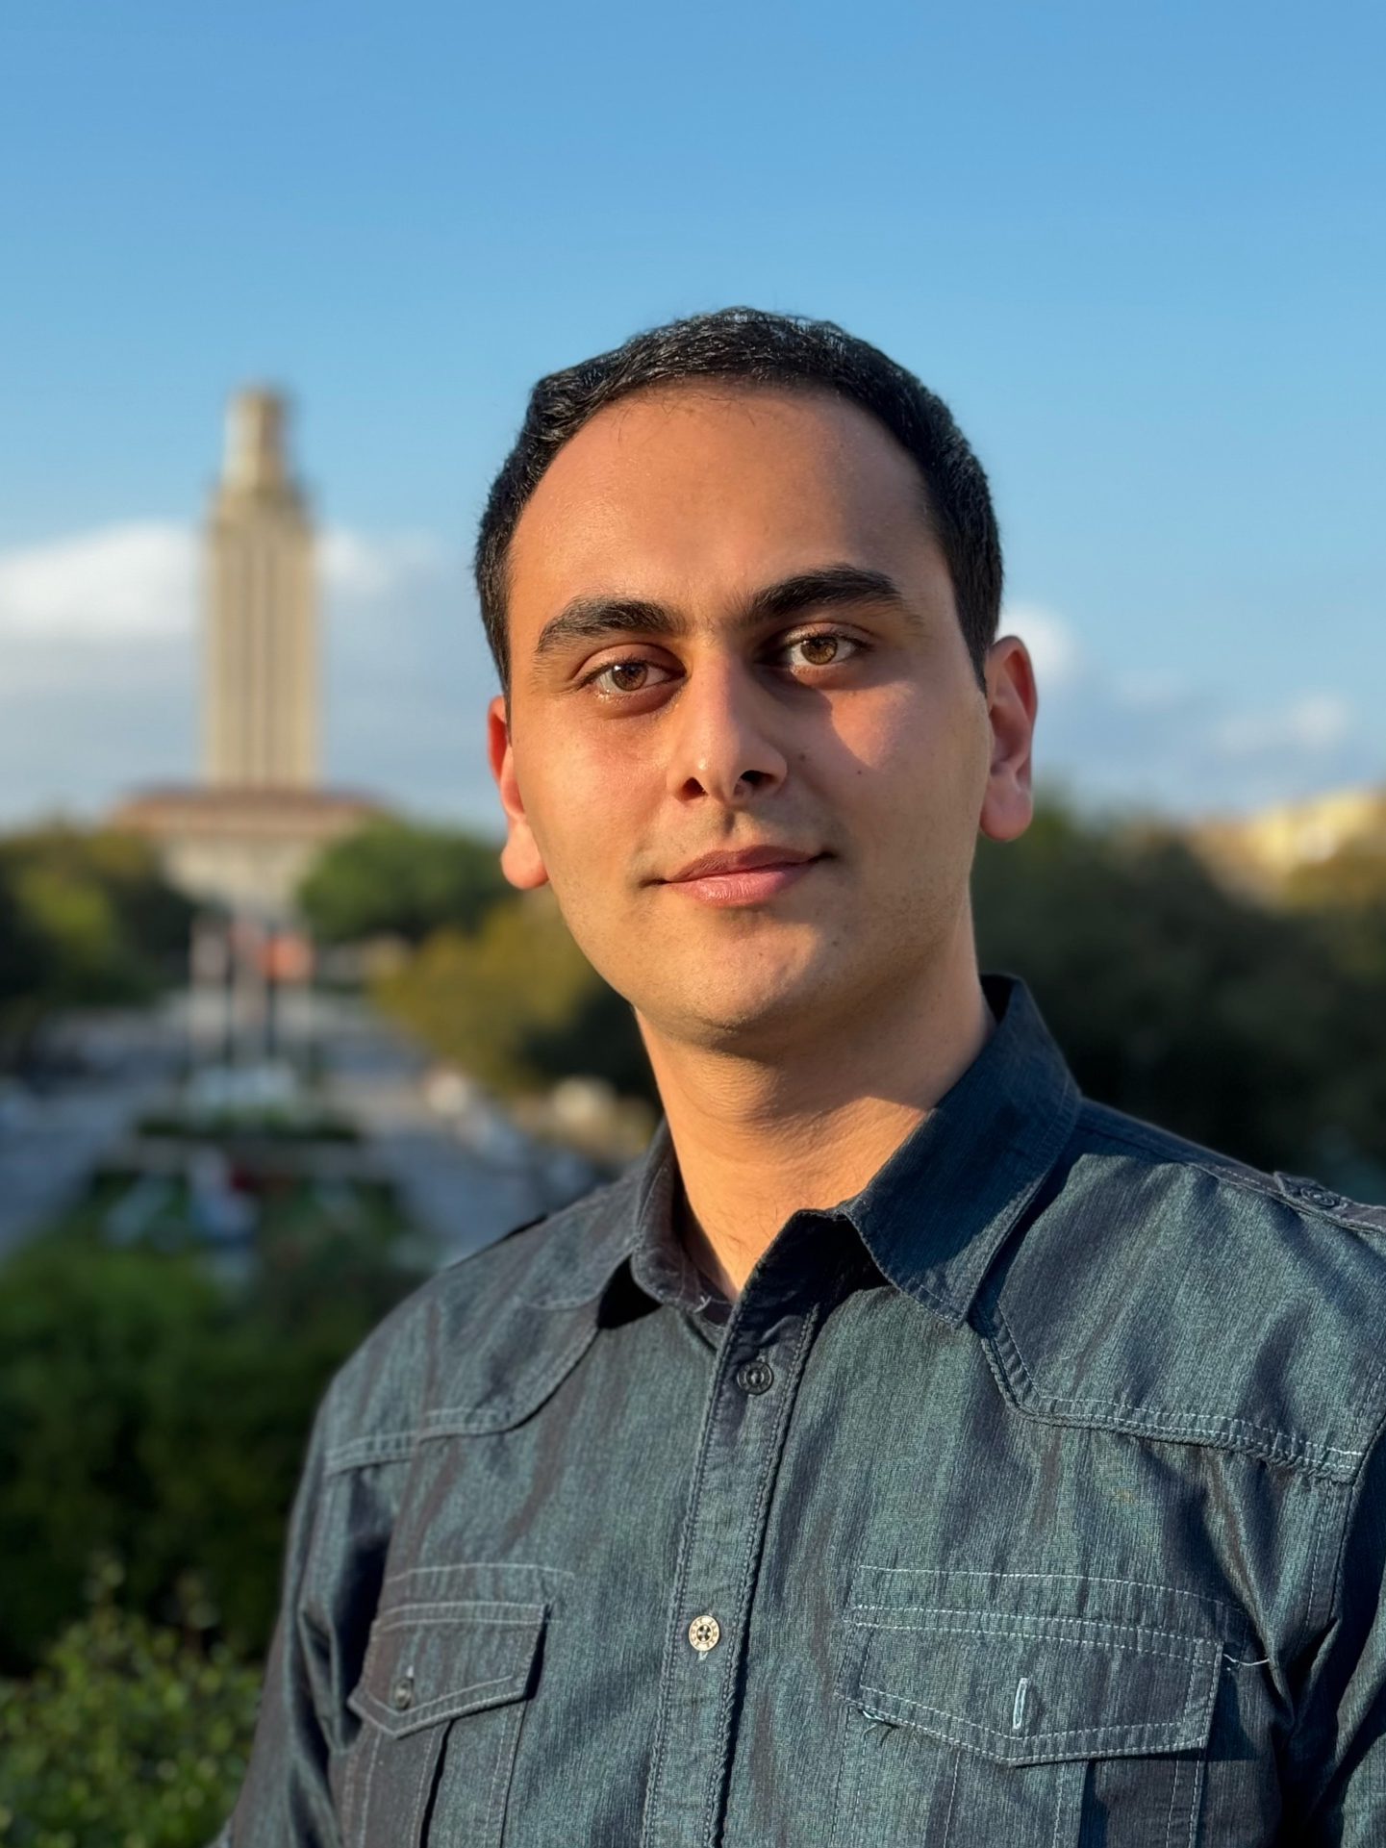
Ilgar Baghisov (/ɪlˈɡɑːr bɑˈɡɪʃɒf/)
DFT, AI in Chemistry
Heriot-Watt University, now at UT Austin
Languages: Azerbaijani, Russian, Turkish, English
Favorite Holiday: Christmas
Hobbies: Exploring National Parks, board games

