Slide 1
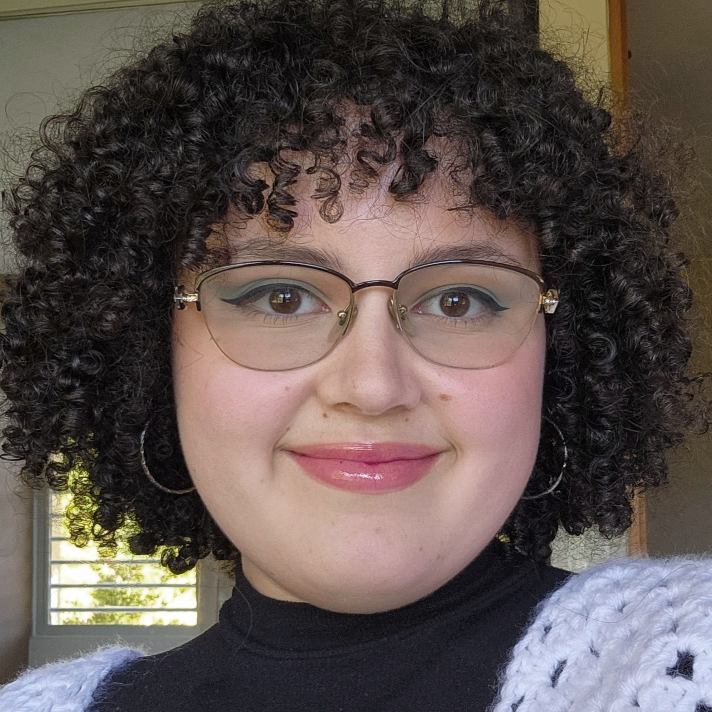
Karla Pérez (ˈkɑrlə ˈpɛrɛz)
Technical Expertise: Inorganic Synthesis, Characterization
Undergraduate Institution/Graduate Institution: University of Puerto Rico at Cayey (BS)
Languages Spoken: Spanish, English
Favorite Holiday and Date: Christmas, Dec 25
Hobbies/Other Interests: Crocheting

