Slide 1
TEKS (Texas Essential Knowledge and Skills) Lesson Plan
3.5 (Scientific Investigation and Reasoning)
3.5(A): The student uses scientific methods during laboratory and field investigations.
This standard encourages students to use the scientific method to investigate, which includes making observations, asking questions, and using tools like microscopes to gather data.
3.5(B): The student conducts controlled investigations to test the effect of a variable on a dependent variable.
This can involve using microscopes to explore how different variables, such as temperature or light, affect tiny organisms or structures.
3.5(C): The student records and organizes data using pictures, numbers, and words.
This standard supports students in recording observations, which can include making detailed drawings or notes about things they see under a microscope.

Slide 2
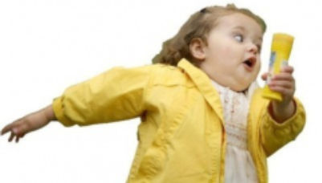
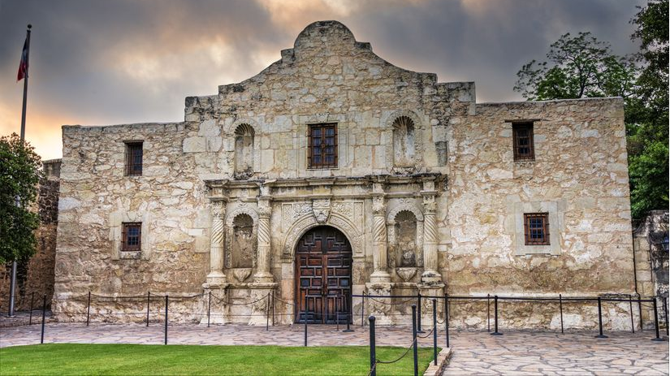
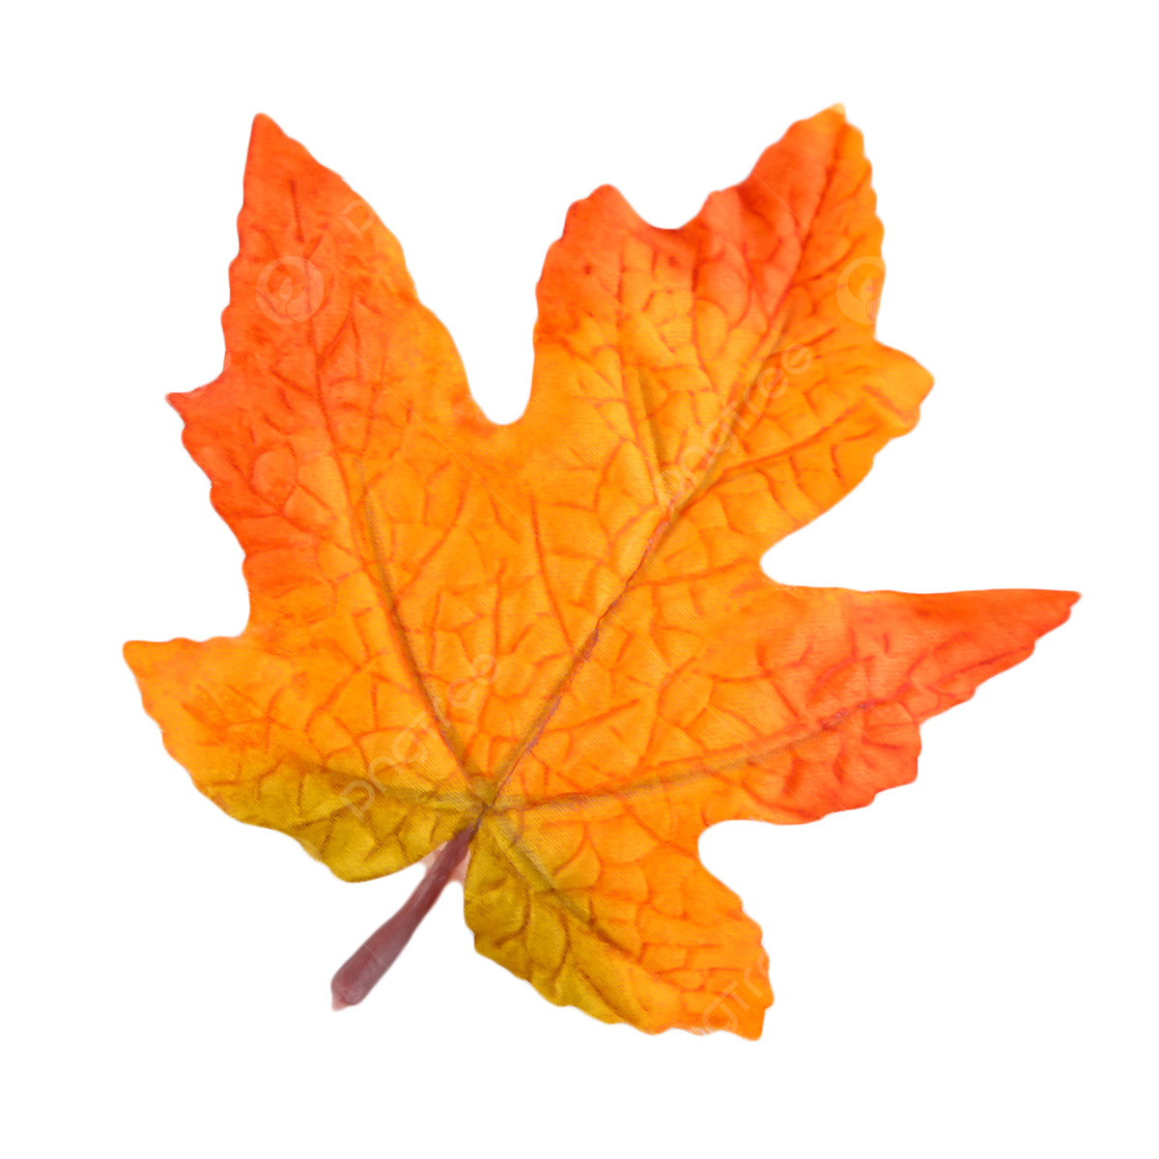
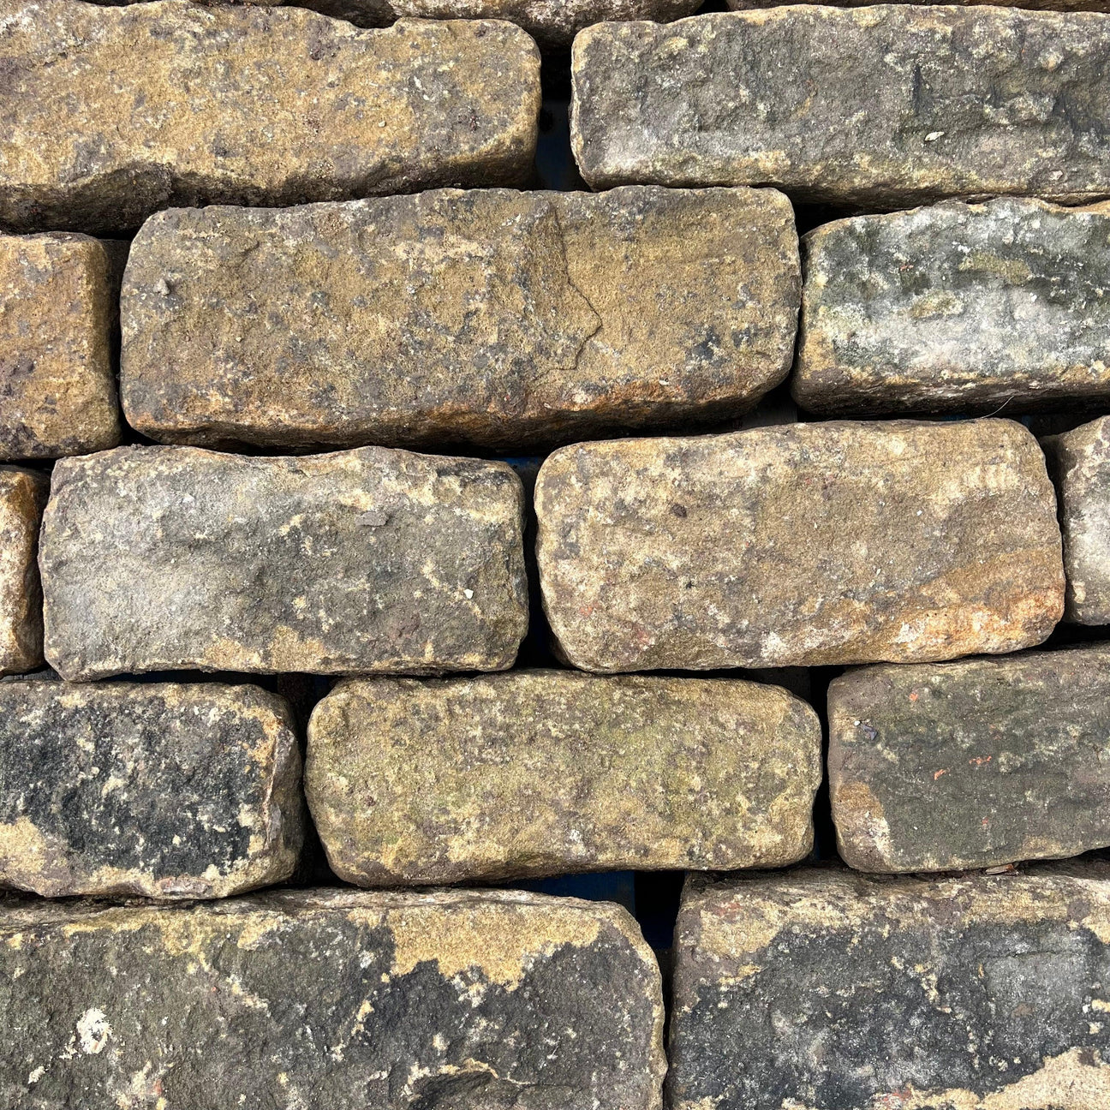
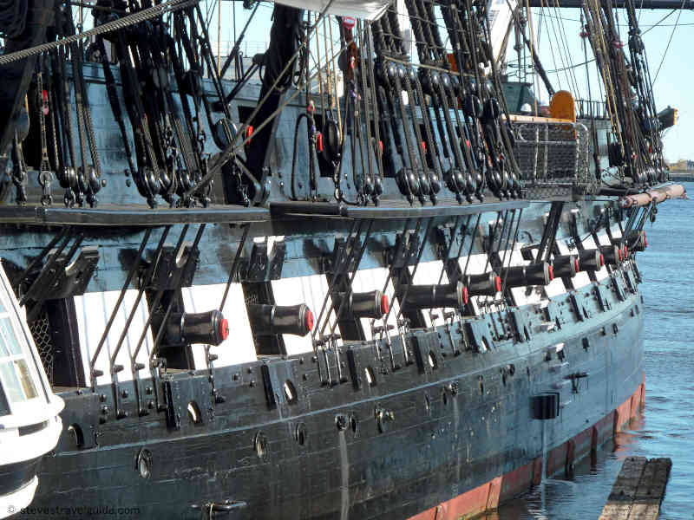
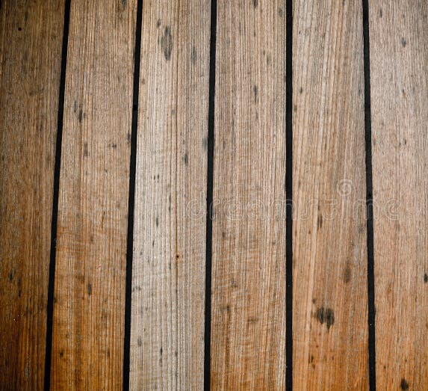
1
3
Zoom in on a wall, it’s made of bricks
Zoom in on a hull, it’s made of planks
Zoom in on a plant or on ourselves
?
We will find
4
Write some of your ideas here!
2

Slide 3
Look through the FoldScope at the fern rhizome (stem) Draw what you see below
What are you seeing?
How would you describe what you saw?
Write it down here!

Slide 4
Look through the MicroScope at the onion bulb epidermis Draw what you see below
What are you seeing?
How would you describe what you saw?
Write it down here!

Slide 5
If we look at a fresh piece of onion, will it look the same as the slides you saw before?
Is what you saw as expected? Are there differences between the fresh onion and the pre-made slides of onion and fern?

Slide 6
What do you think we’ll see if we put muddy water under the microscope?

Slide 7
What did we use today?
What did we look at today?
What’s some of the interesting things you see today that you want to share with a friend?

