Slide 1
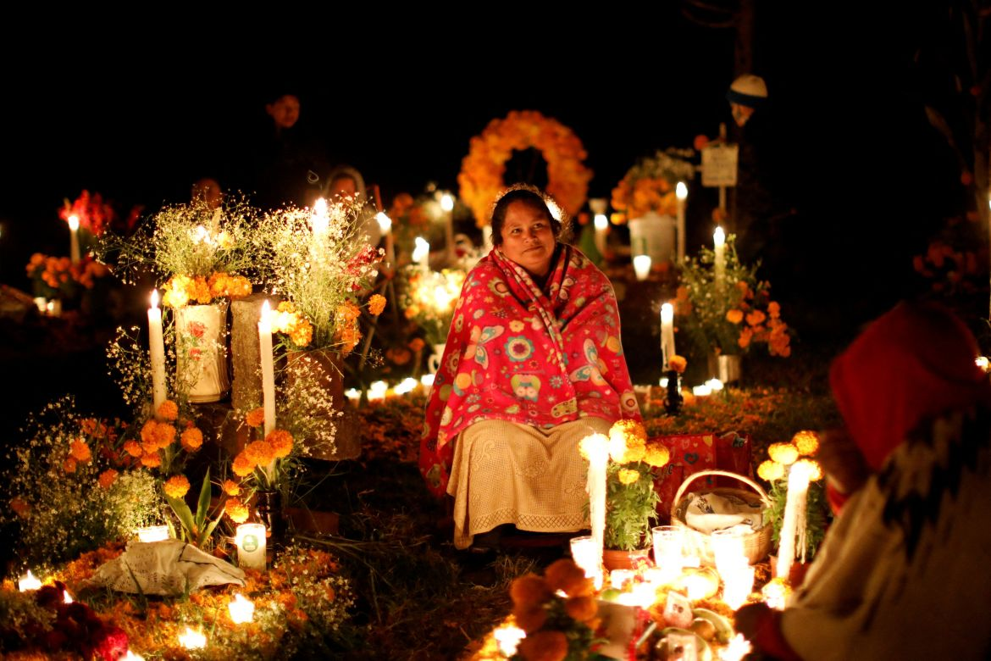
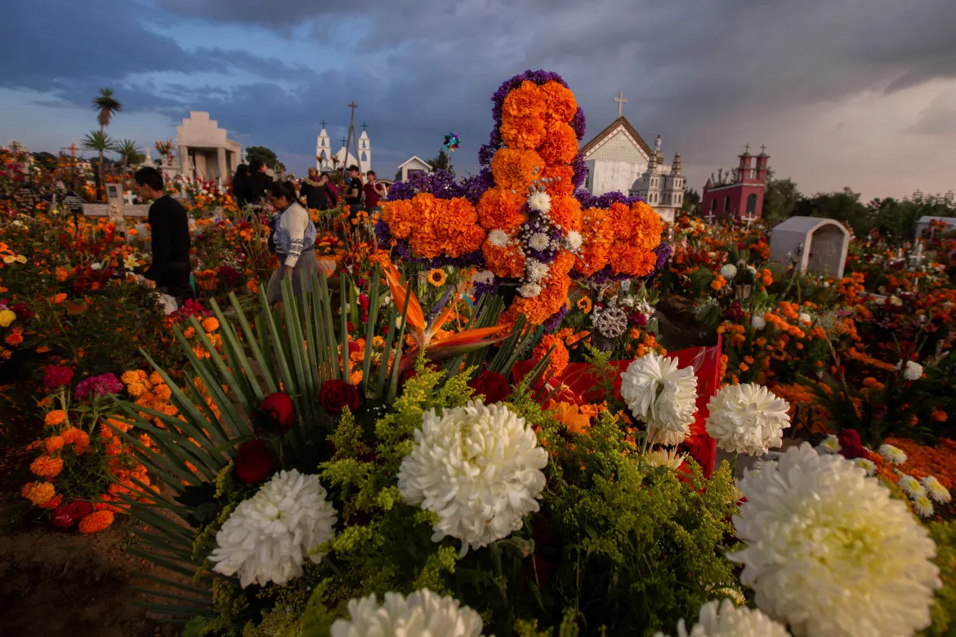
Día de los Muertos (“Day of the Dead”)
Celebrated on November 1st (Dia de los Inocentes) and 2nd (Dia de los Muertos)
A traditional Mexican holiday with indigenous and Catholic influences
Honors and remembers deceased loved ones
Families create altars (ofrendas) with offering like food, candles, and marigolds.
Celebrated in Mexico and by Mexican communities worldwide
Provide reference for photograph or Photo courtesy of Aljazeera.com
Created by: Josselyn De Leόn

Slide 2
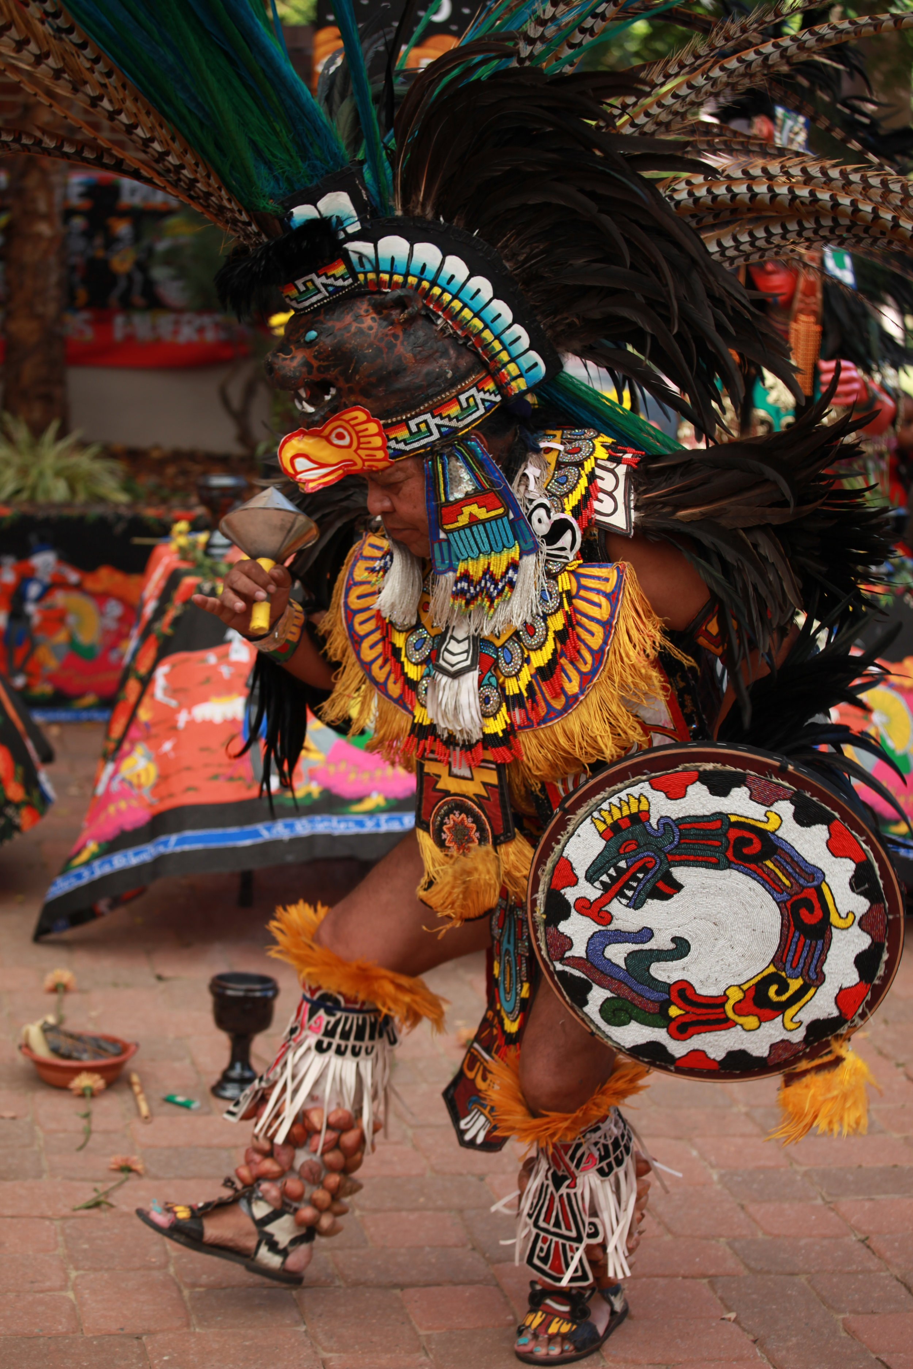
History of Día de los Muertos
Dates back thousands of years, originating from Indigenous Mesoamerican traditions.
Aztecs and other pre-Hispanic civilizations believed the spirits of the dead returned to visit the living.
Rituals included offerings of food, flowers, and personal items to honor deceased ancestors.

Slide 3
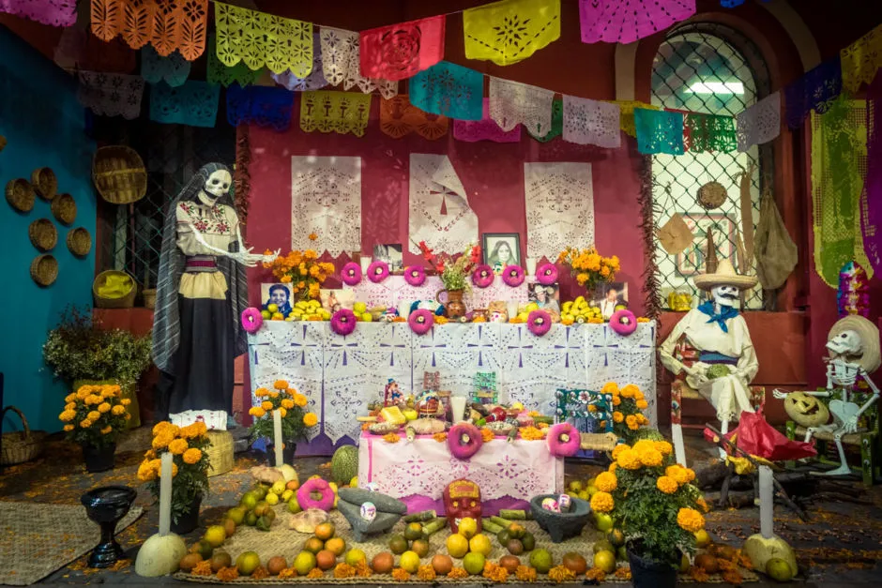
How Día de los Muertos is Celebrated
Families create ofrendas (alters) with photos, candles, marigolds, and favorite foods
Traditional foods include pan de Muerto, tamales, and sugar skulls
Cemeteries are visited to clean and decorate graves
Marigolds are used to guide spirit's home
Music, dance, and storytelling honor the deceased
Provide reference for photograph or Photo courtesy of Mariana Montes (Vibe adventures)

Slide 4
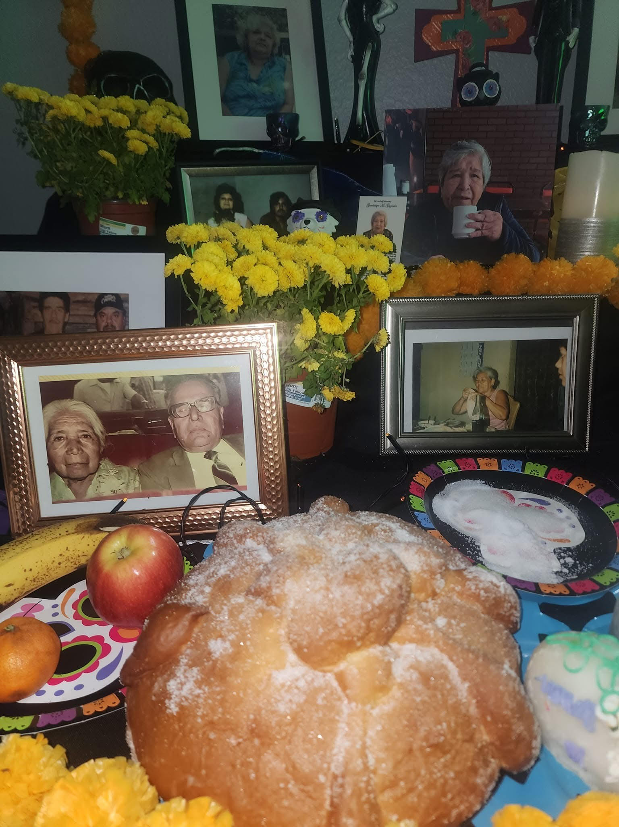
How Día de los Muertos is Celebrated
Families create ofrendas (alters) with photos, candles, marigolds, and favorite foods
Traditional foods include pan de Muerto, tamales, and sugar skulls
Cemeteries are visited to clean and decorate graves
Marigolds are used to guide spirit's home
Music, dance, and storytelling honor the deceased

