Slide 1
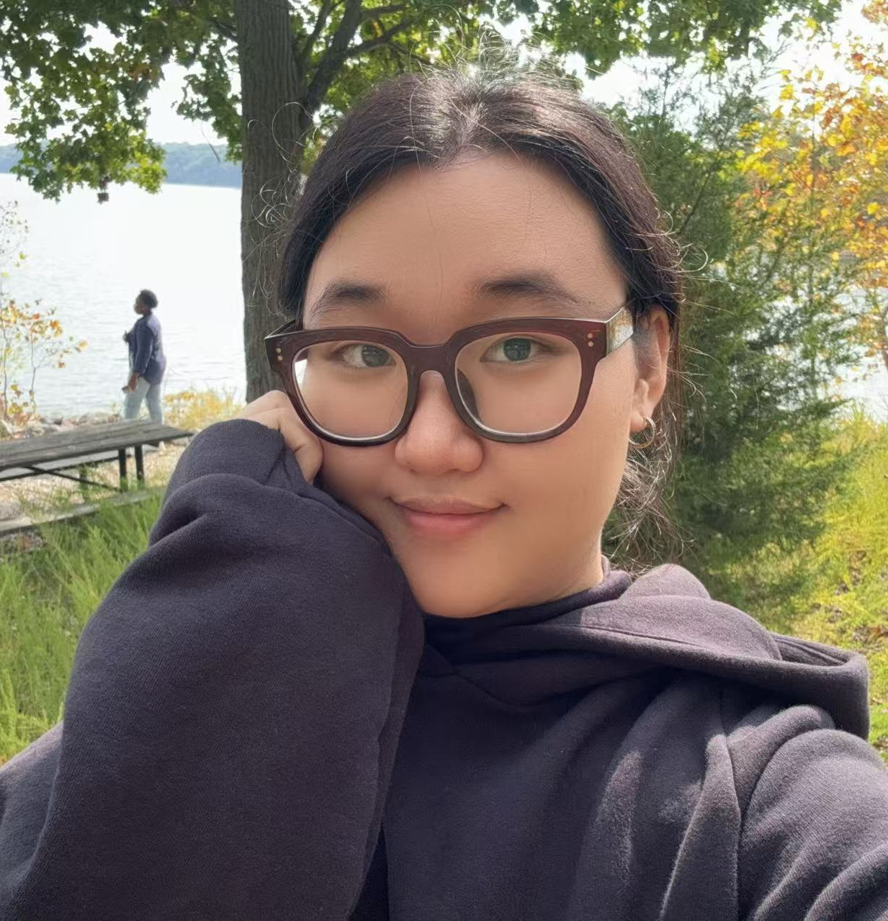

Huayu Guo (Hwah-yoo Gwoh)
In situ electrochemical techniques
Indiana University Bloomington
English, Chinese
Dragon boat festival
Singing, cooking, playing chess, playing cards

