Slide 1
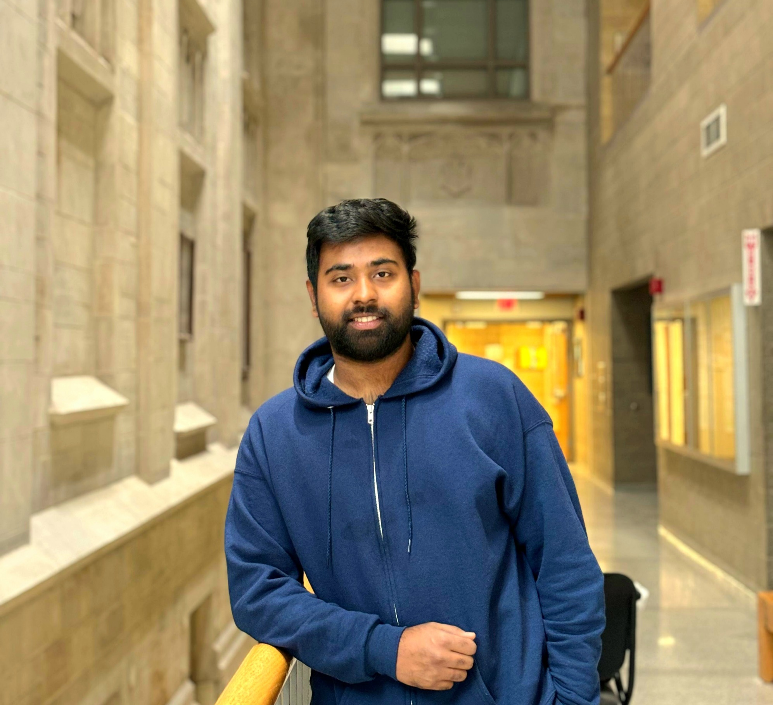

Hrittik Ghosh (Rit-wik Ghosh)
Technical Expertise: Electrochemical synthesis of nanoparticles, Electron microscopy
M.S. at IIT Bombay, India
B.S. at University of Kalyani, India
Languages Spoken: English, Hindi, Bengali
Favorite Holiday and Date: Durga Puja (Sep/Oct)
Hobbies/Other Interests: Reading books, playing cricket, cooking

