Slide 1
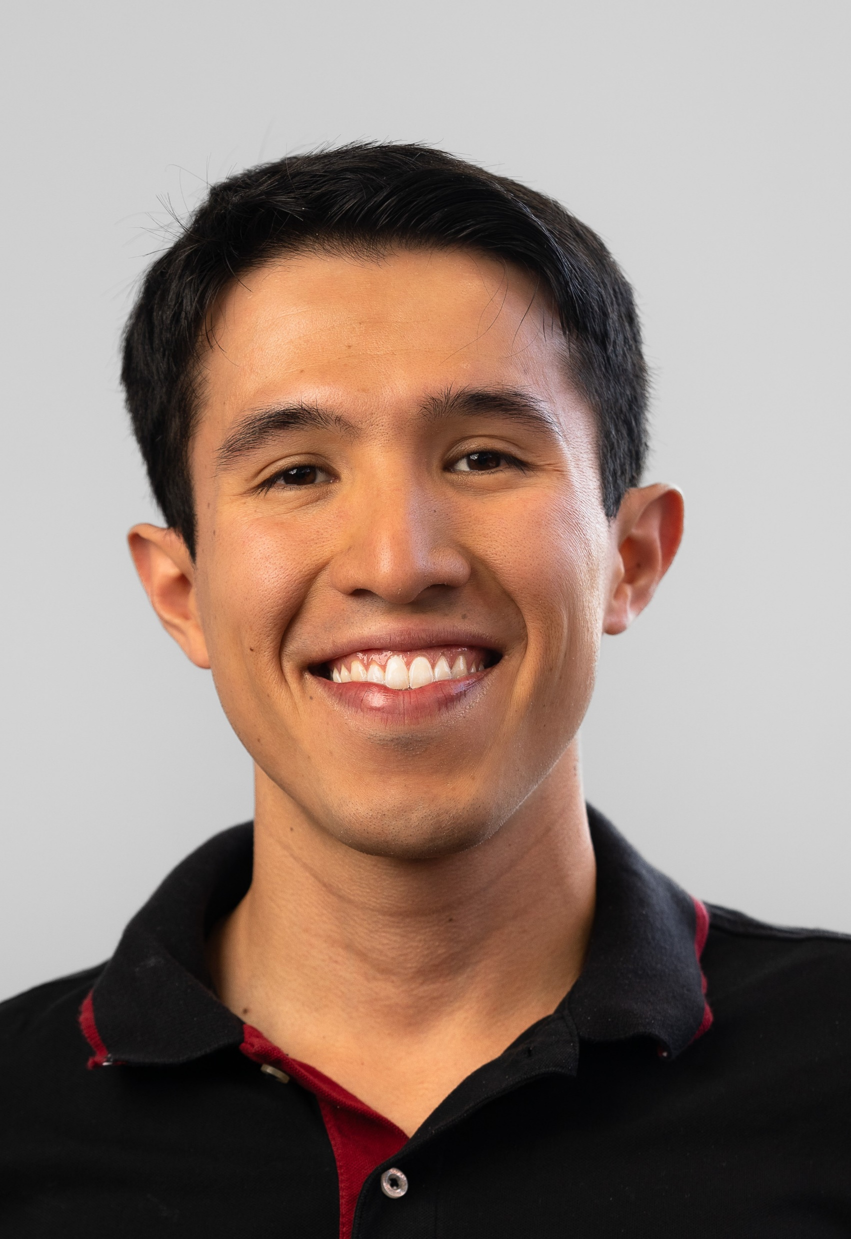
Hugo Samayoa
Background: Mass spectrometry, ion chemistry.
PhD from Purdue University.
Languages Spoken: Spanish, English, and Portuguese
Favorite Holiday: New year
Hobbies: Running, indoor bouldering, and chess.

