Slide 1
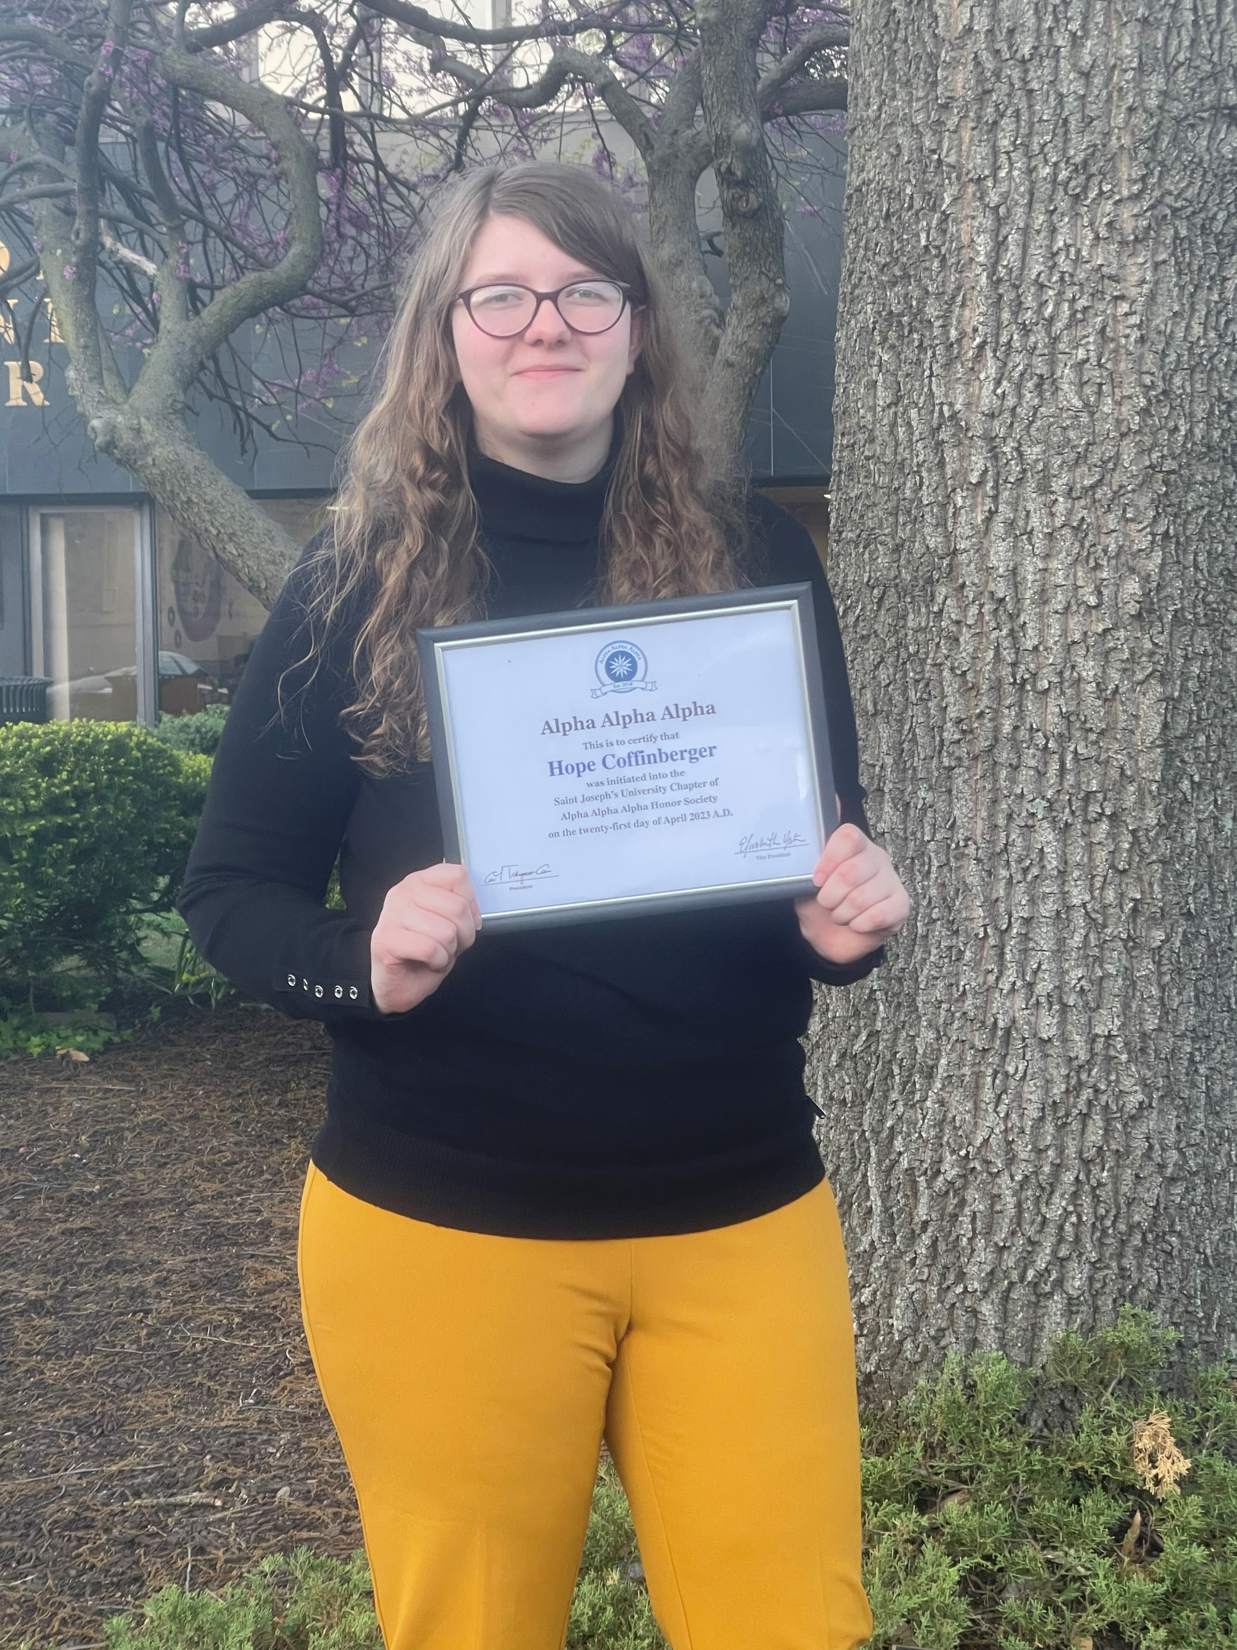
Hope Coffinberger (Hope Coffin-burger)
Technical expertise: Mass Spectrometry, Proteomics, Novel Ionization
Saint Joesph’s University/Texas A&M University
English
Halloween, October 31
Baking/Gaming

