Slide 1
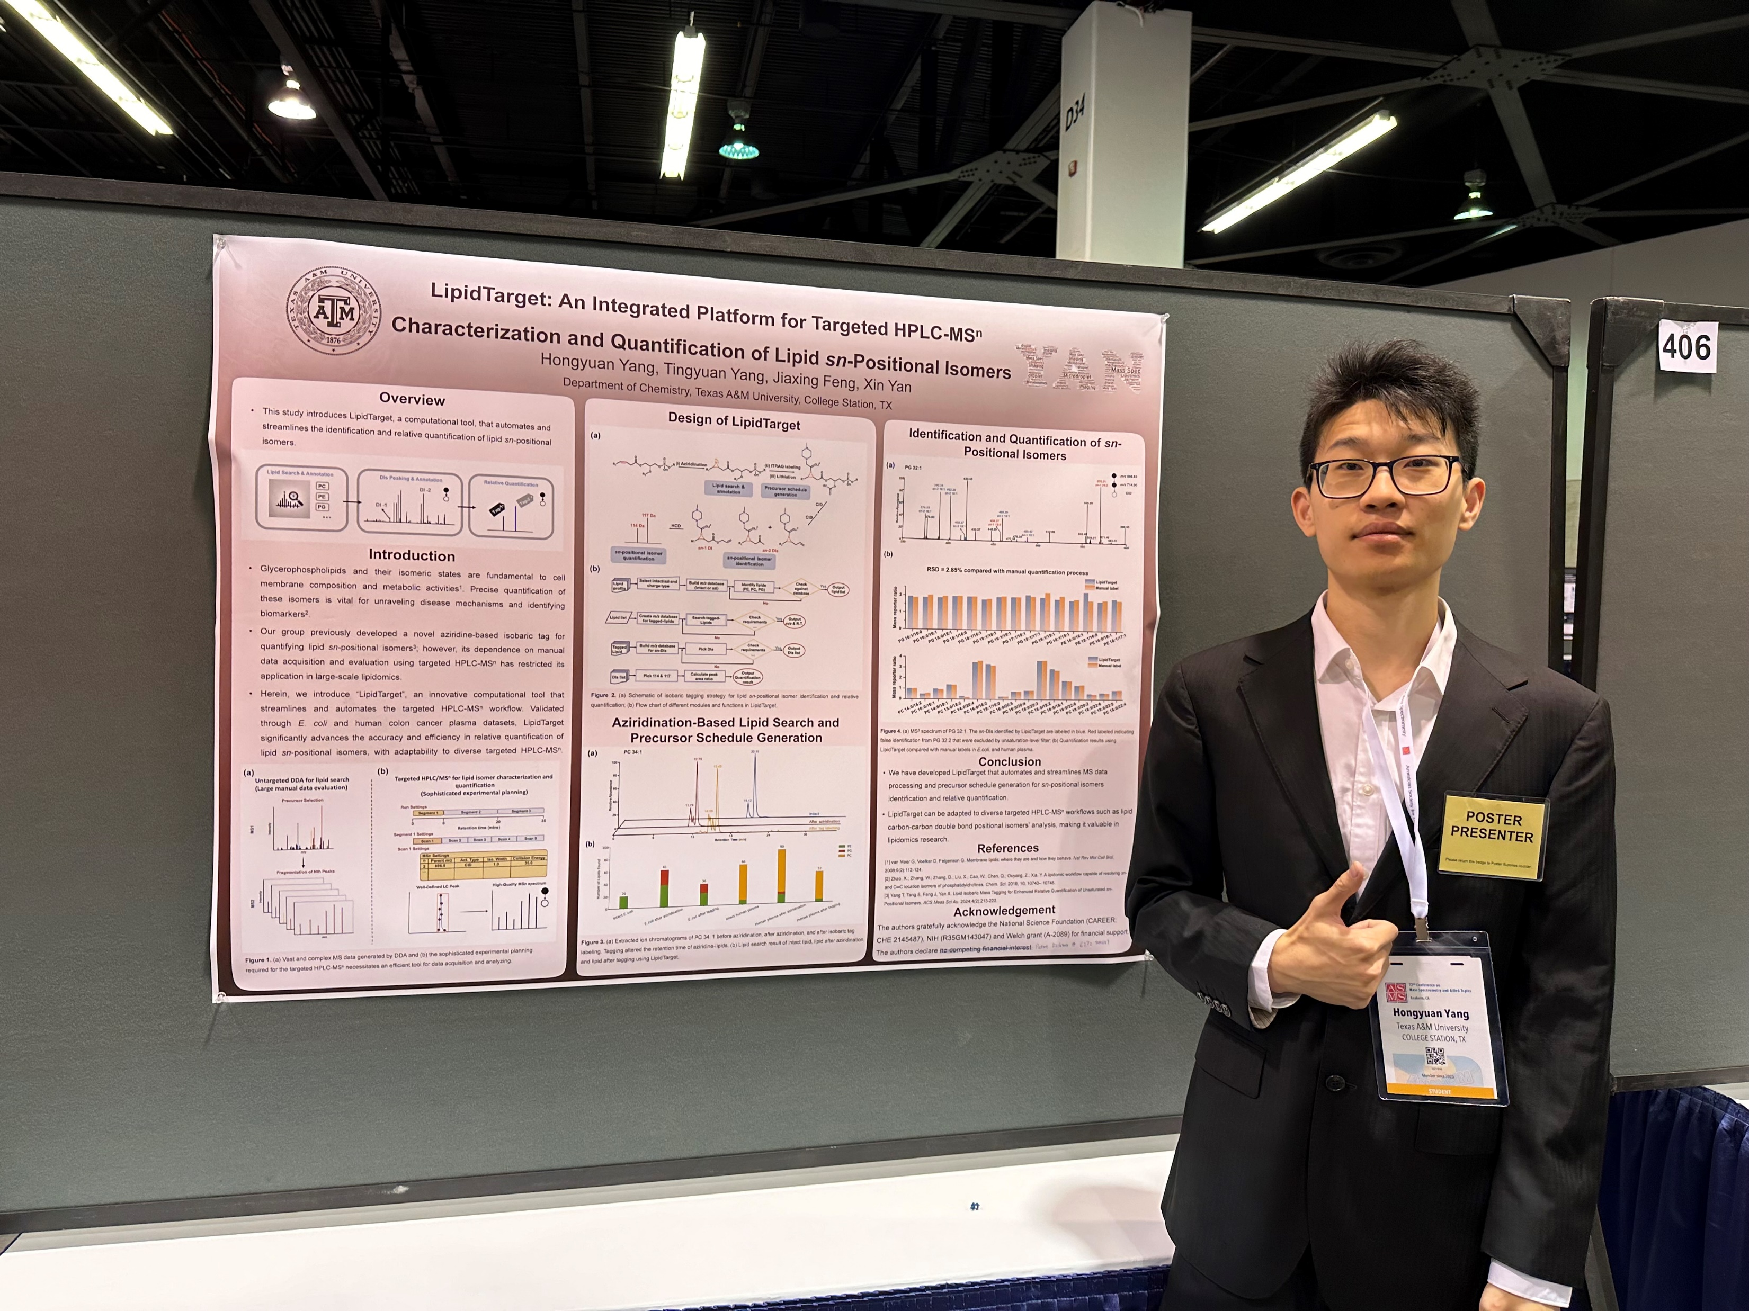
Hongyuan Yang (Hon-yuan)
Technical Expertise: Mass spectrometry, lipids, bioinformatics, cell culture
Northeastern University (China)/ Texas A&M University
English, Chinese
Chinese new year (around the end of January)
Video games/hiking

