Slide 1
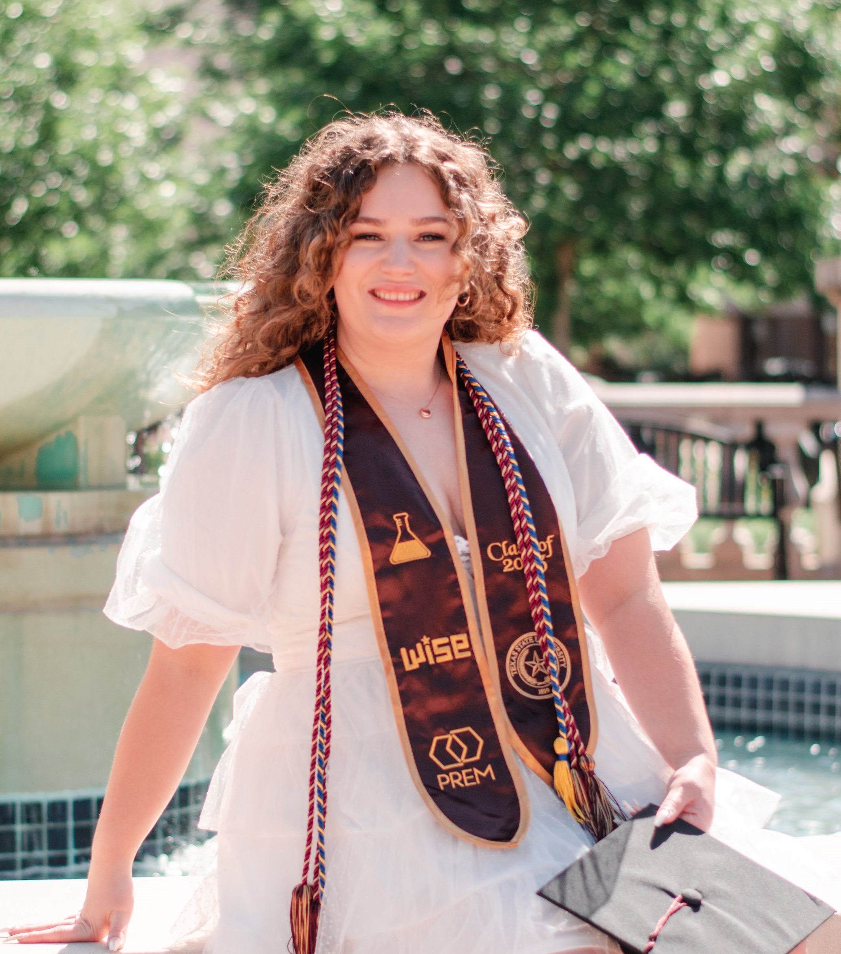
Kathleen Bailey (kath-leen)
Technical Expertise: Scanning electrochemical cell microscopy, electrospray deposition
Undergrad/Grad Institution: Texas State University/ Texas A&M University
Language Spoken: English
Fav Holiday: Halloween (October 31st)
Hobbies: baking & doing nails

