Slide 1
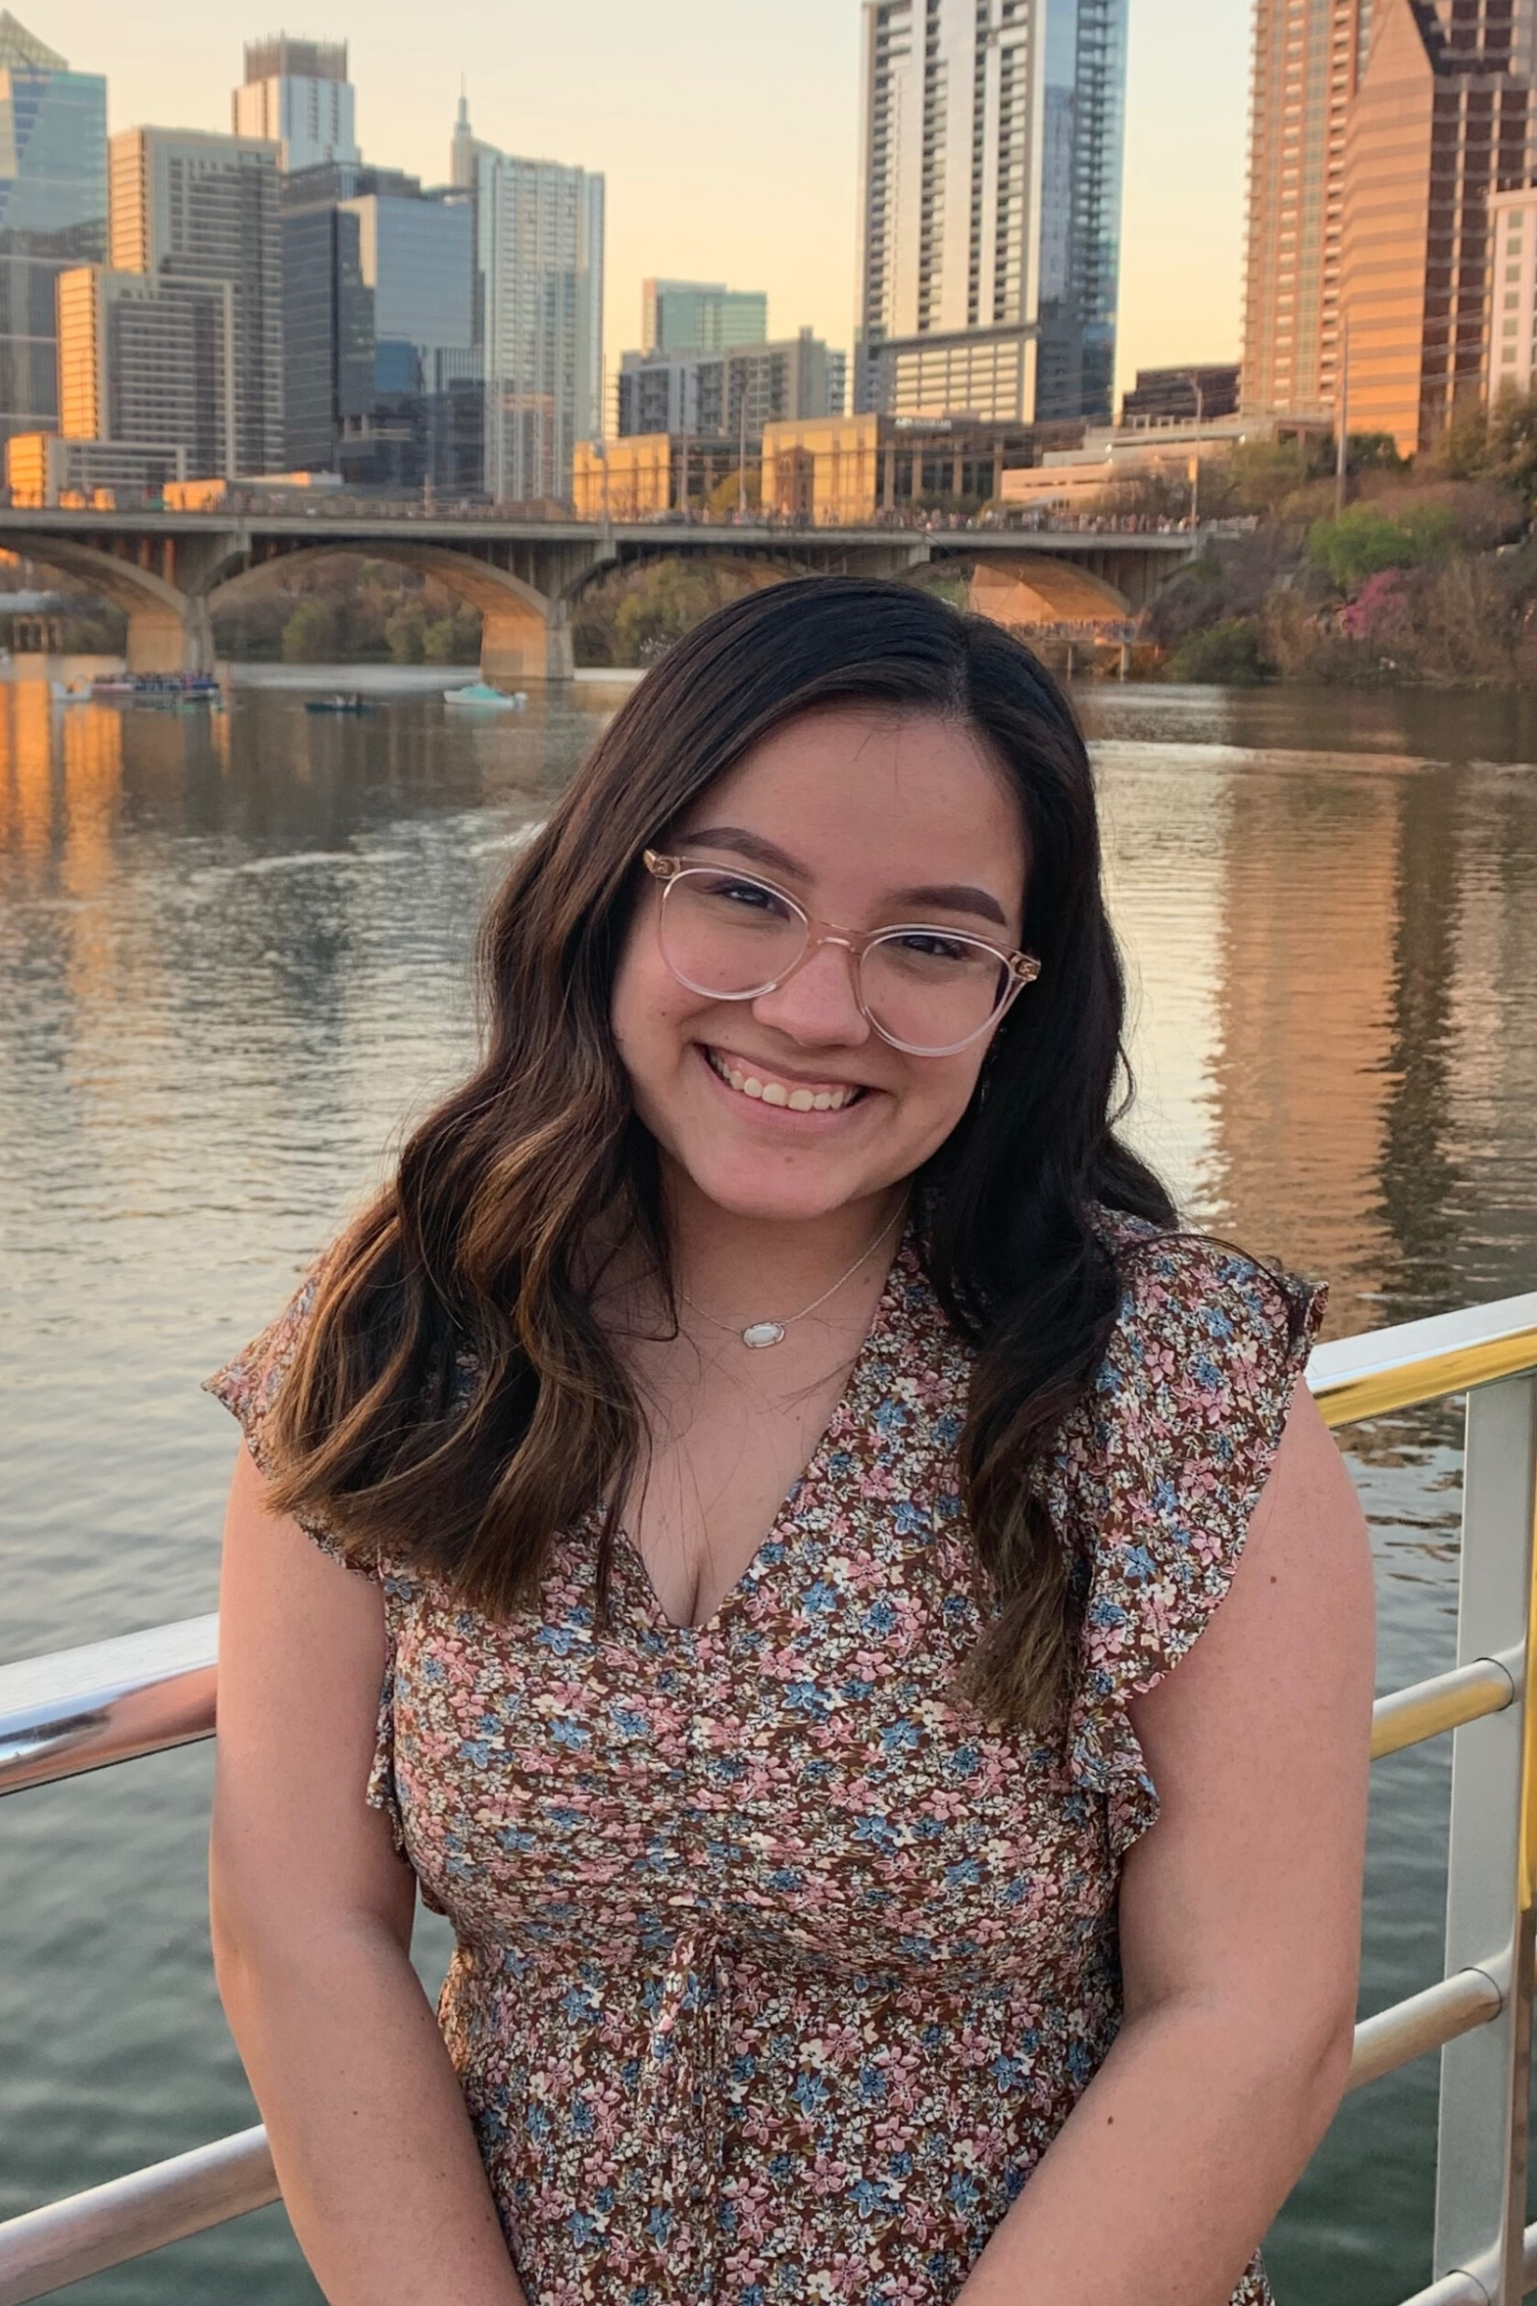
Josselyn De León (Joss-uh-lyn Deh Leh-Yon)
Undergraduate Institution: UT Austin
Graduate Institution: Texas A&M University
Languages Spoken: English & Spanish
Dia de los Muertos (Nov. 1 & 2)

