Slide 1
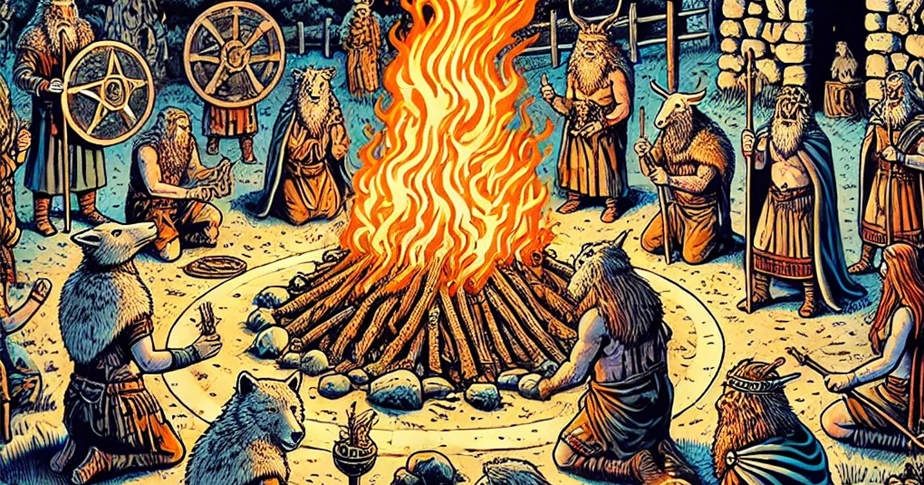
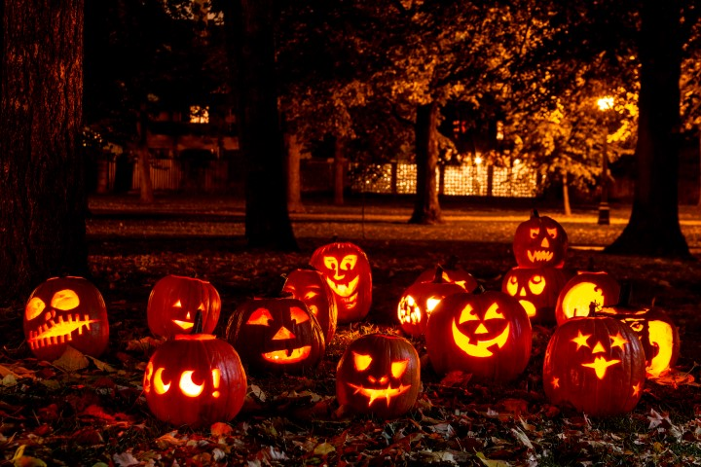
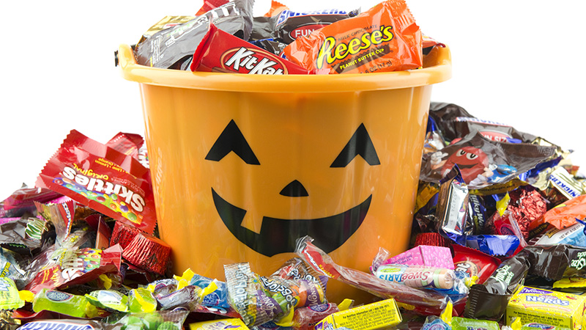
Halloween (October 31st)
Dates back 2,000 years, originating as a Celtic festival called Samhain (pronounced sow-in)
Celts believed that the day before their New Year (aka October 31st) ghosts could easily enter the human world
Ghosts were warded off with large bonfires and costumes
https://historicalinsights.info
https://www.knowltondental.com
https://www.abc27.com
https://www.history.com/topics/halloween/history-of-halloween
Created by: Megan Knobeloch

Slide 2
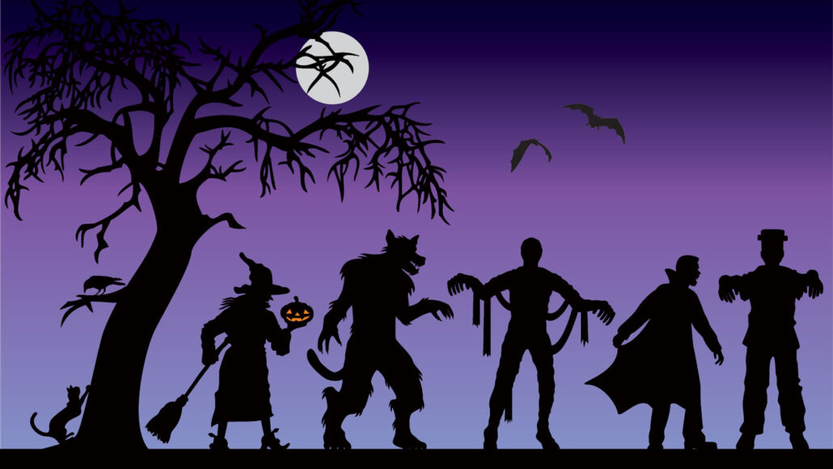
Halloween (October 31st)
Really interesting folklore and history related to the characters (like witches and vampires) that are associated with Halloween
→ Salem witch trials!
https://www.snexplores.org
Created by: Megan Knobeloch

Slide 3
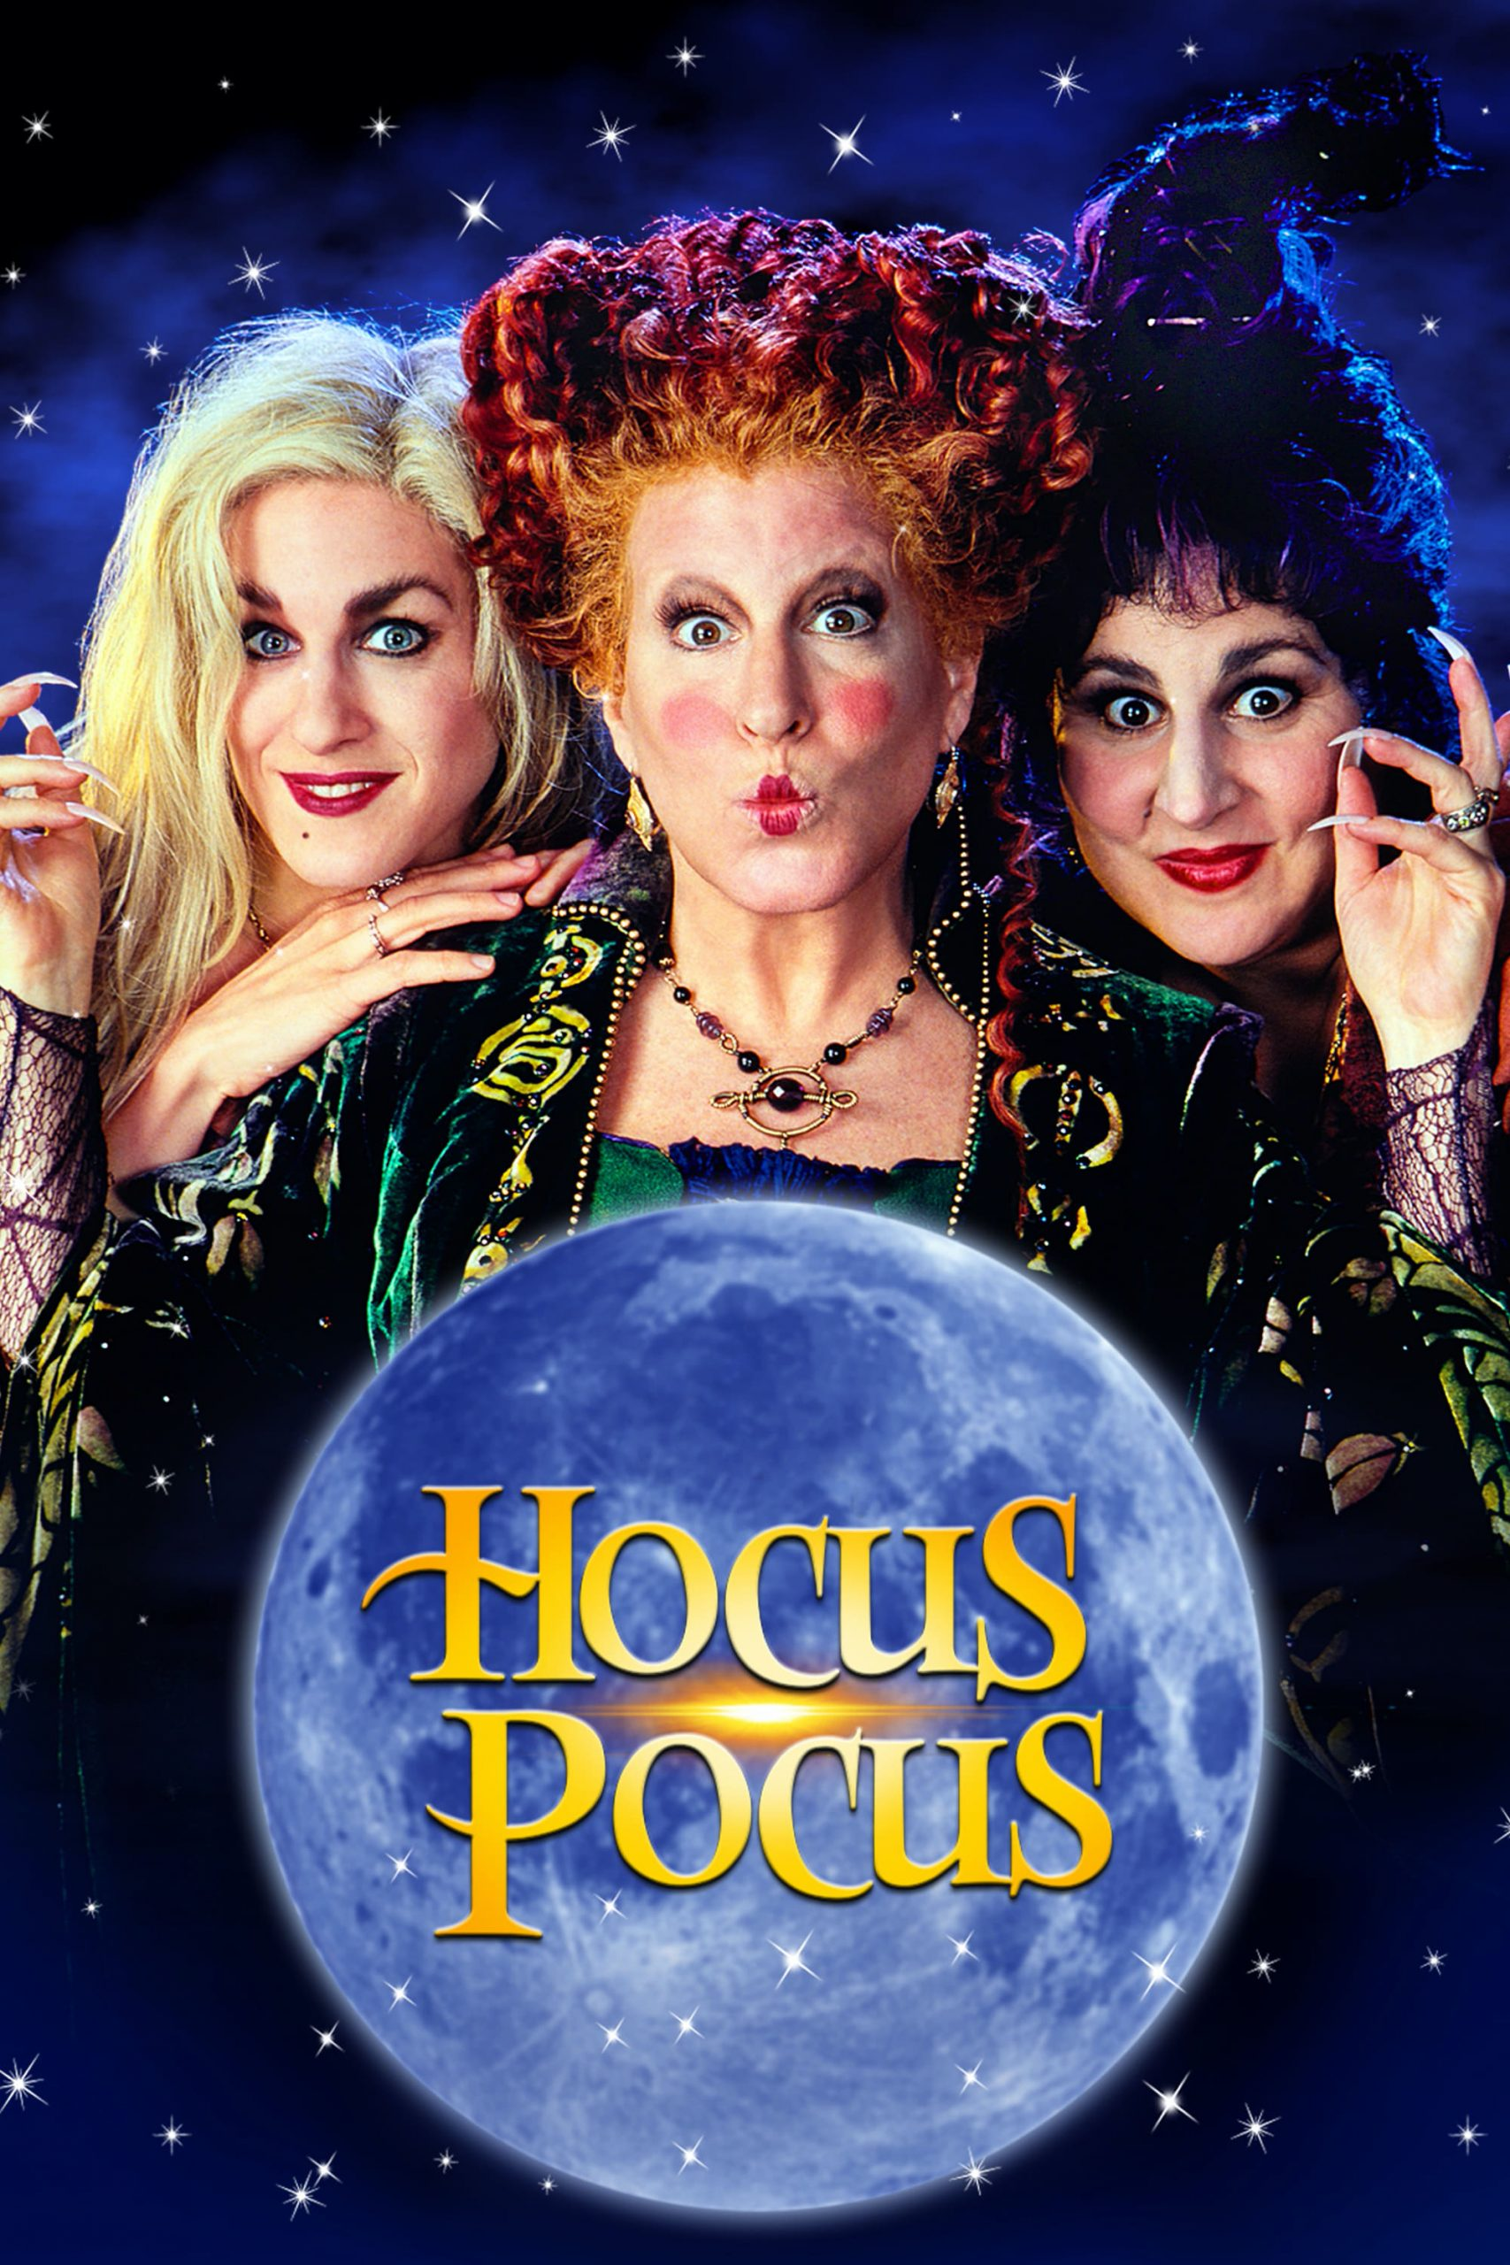
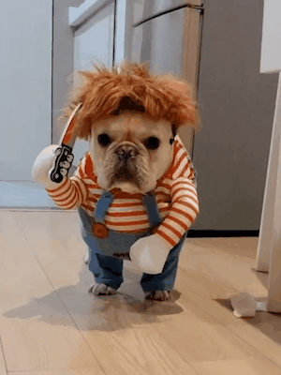
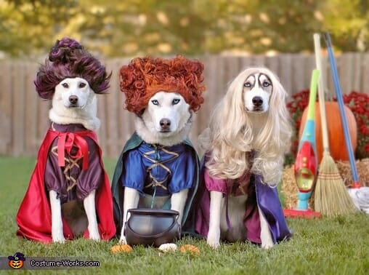
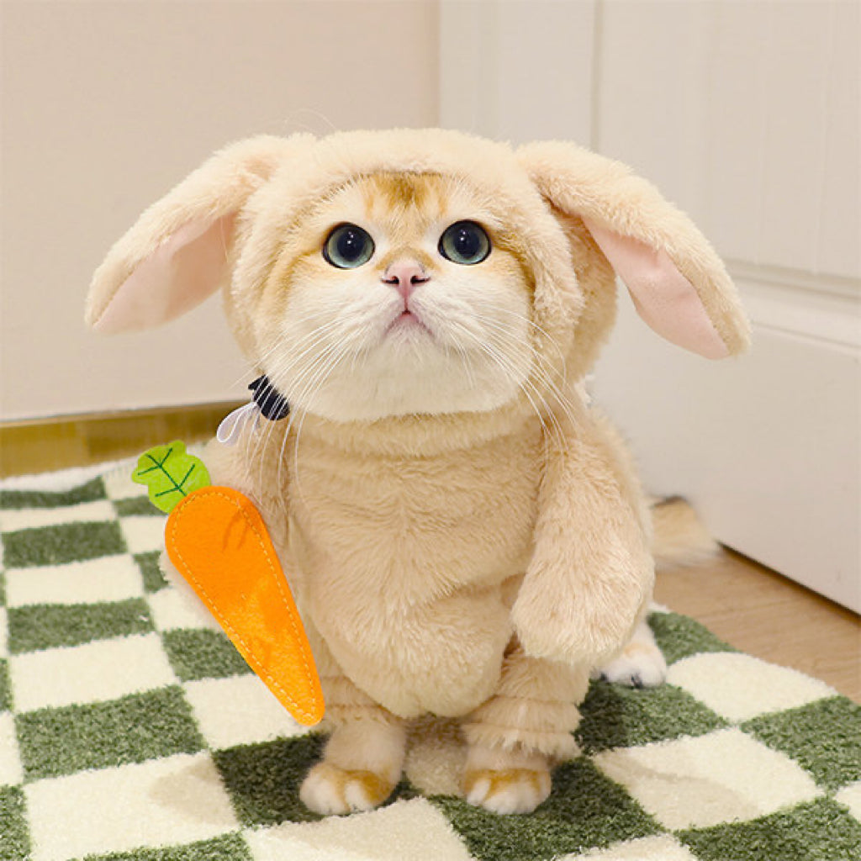
Halloween (October 31st)
Really interesting folklore and history related to the characters (like witches and vampires) that are associated with Halloween
→ Salem witch trials!
https://www.snexplores.org
https://vidiotsfoundation.org
https://whatthepup.spotandtango.com
https://lilwildpets.com
https://www.aiitle.com
Created by: Megan Knobeloch

