Slide 1
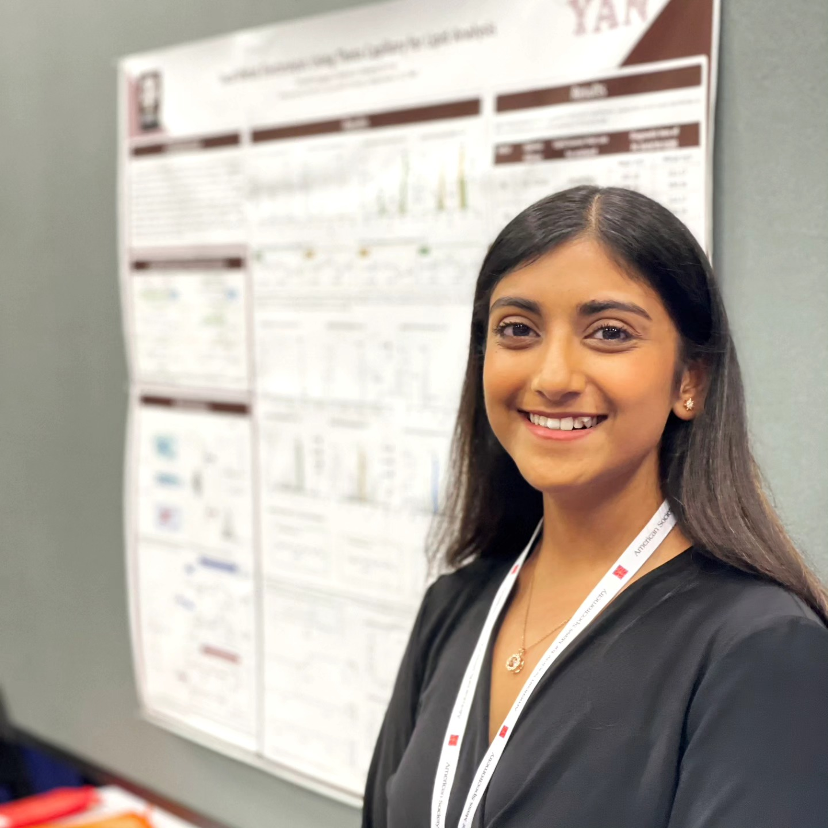
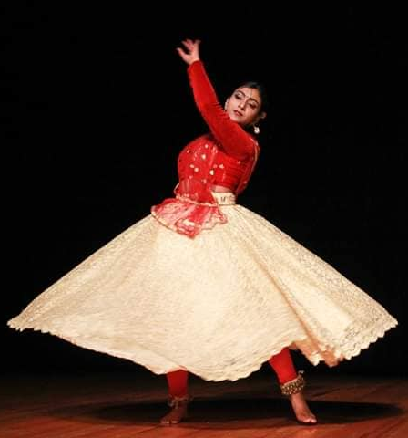
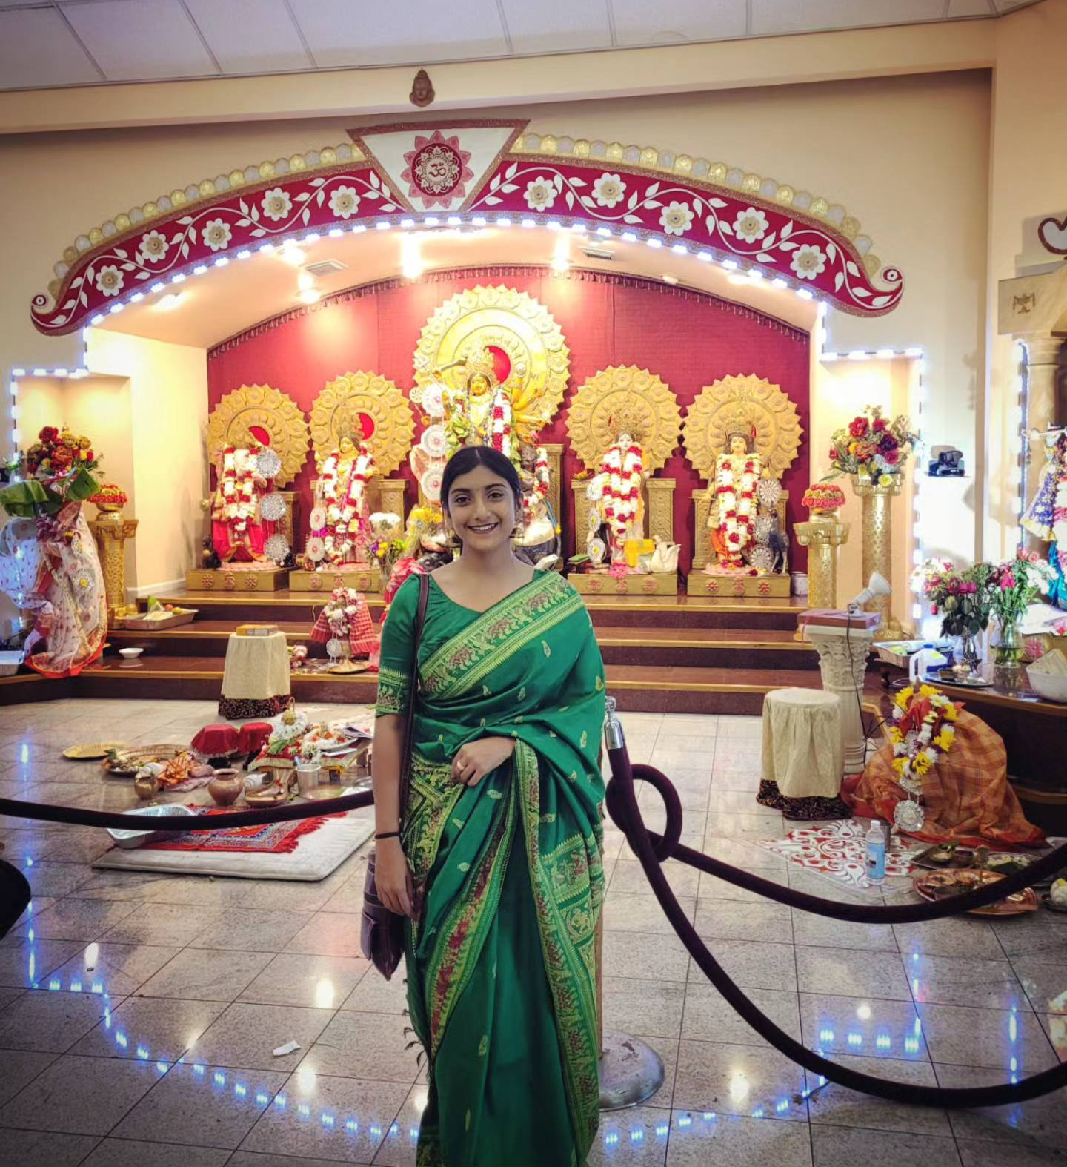
Annesha Sengupta (Onn-ne-sha)
Expertise: Transition metal catalysis study, lipid structure characterization using mass spectrometric techniques
Graduate Institution: Texas A&M University
Languages Spoken: English, Bengali, Hindi
Favorite Holiday and Date: Durga Puja (around October)
Hobbies/Other Interests: Choreography/Dancing and painting

