Slide 1
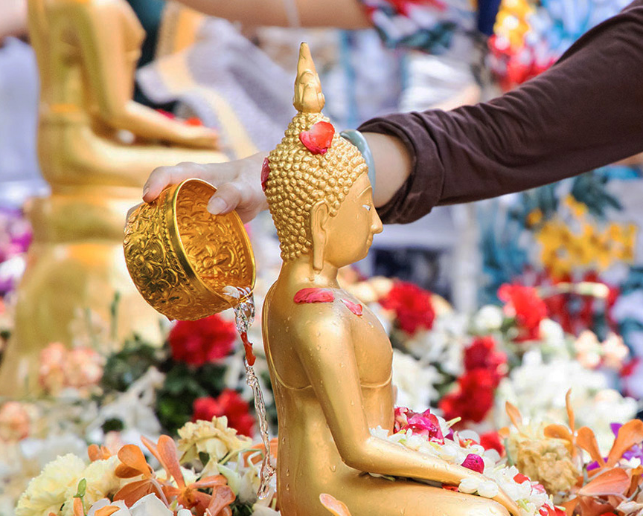
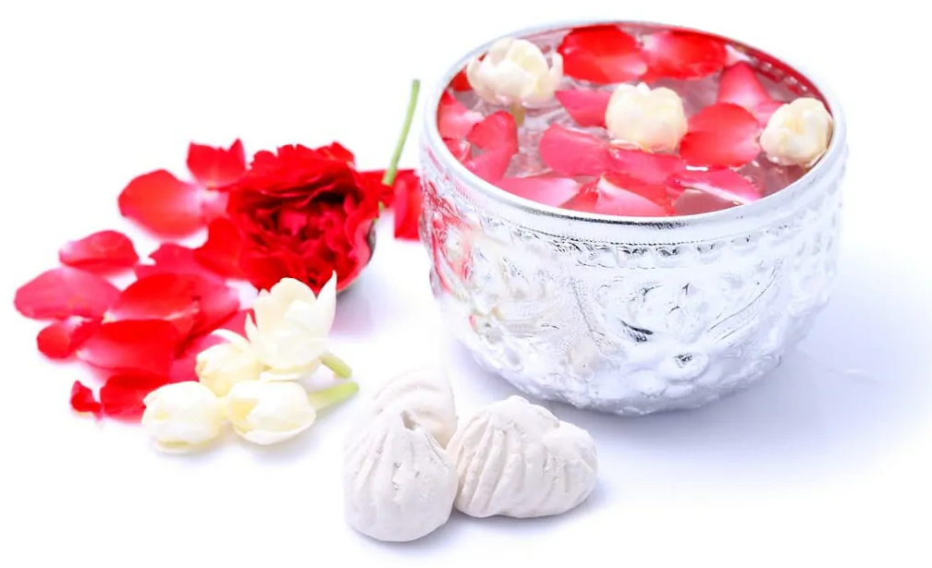
Songkran Holiday “วันสงกรานต์”
Date: April 13-15 every year
Holiday significance:
Thai New Year’s National Holidays
New Year based on Buddhist and Hindu calendars
April 13: last day of old year
April 14: transitional day
April 15: New Year’s day
https://www.globe.co.th/news/bangkok/bma-imposes-strict-covid-19-restrictions-during-songkran
https://www.nanitalk.com/interesting-story/important-day/3823
Created by: Mint Pungsrisai
Notes:
Lunisolar calendar, primary used in Tibet, Cambodia, Laos, Myanmar, India, Sri Lanka, Thailand and Vietnam as well as in Malaysia and Singapore and by Chinese populations

Slide 2
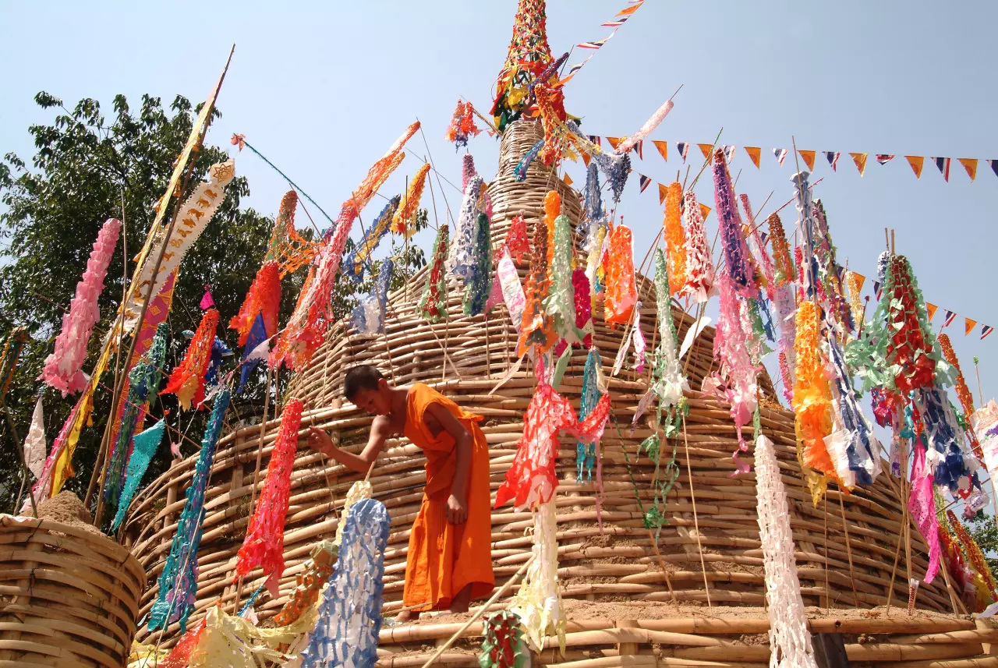
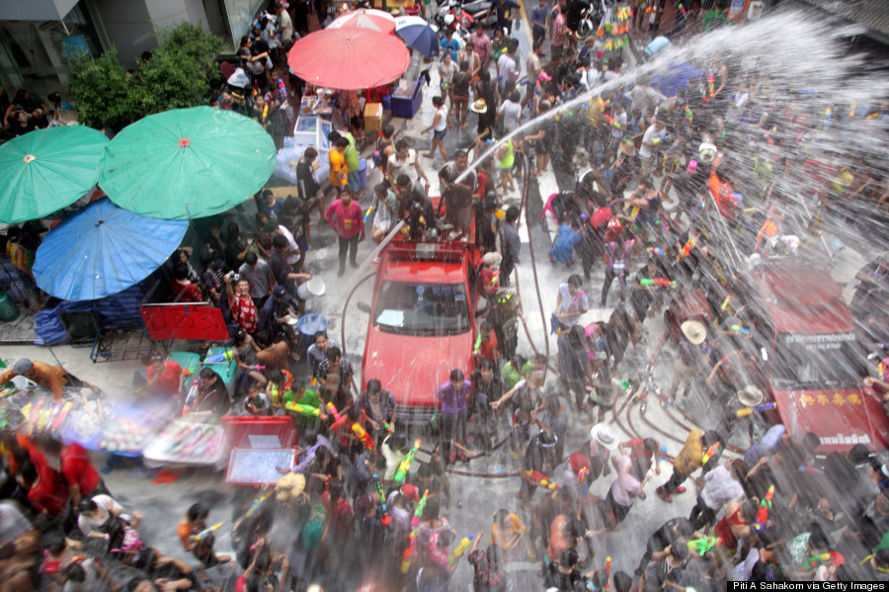
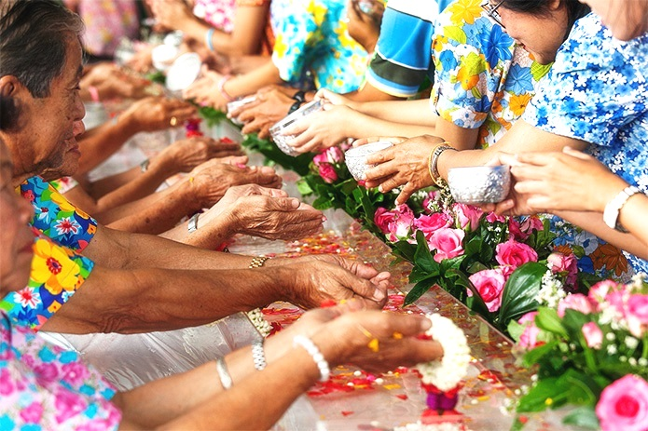
How people celebrate Songkran Holiday
Go to a temple for merit-making
food and clothes offering for monks
listening to monk’s preaching
Sand stupas building
Water splashing
Visiting family
https://www.thairath.co.th/lifestyle/culture/2675896
https://www.huffpost.com/archive/ca/entry/songkran-2014-when-does-thailands-new-year-festival-start-ph_n_5133587
Songkran Greetings สุขสันต์วันสงกรานต์ – Nalanda Buddhist Society

