Slide 1
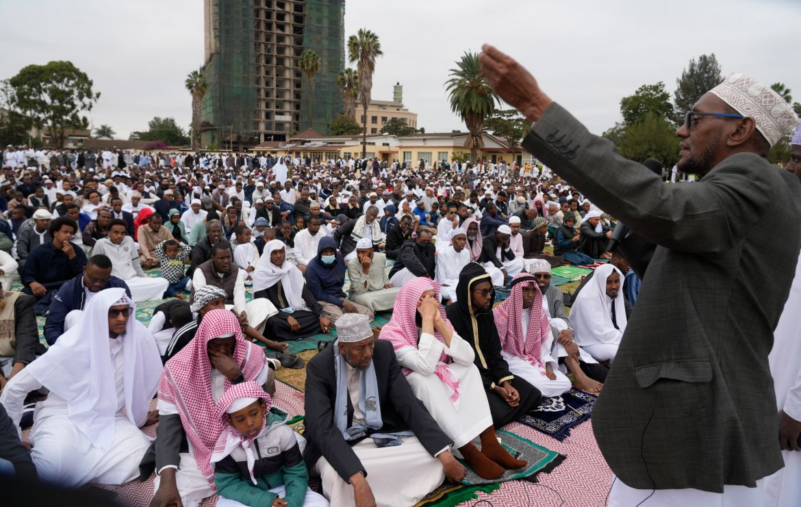
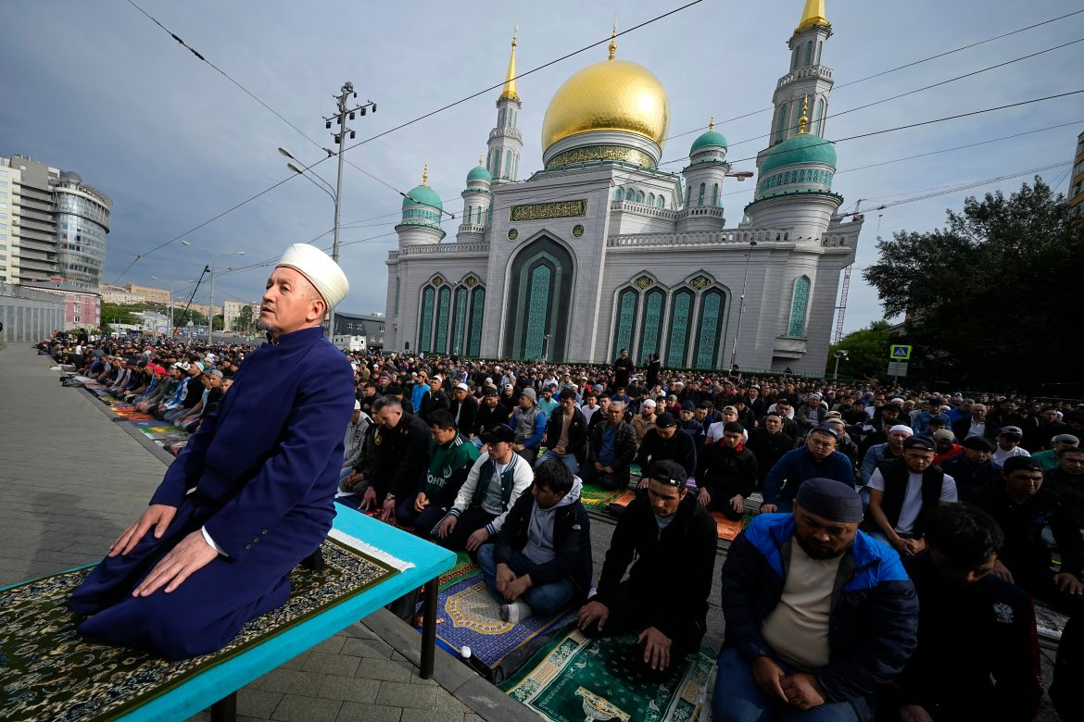
Eid al-Adha (“Festival of Sacrifice”)
10th day of Dhu-al-Hijjah (Islamic lunar calendar)
One of the two Muslim festivals
Commemorates a legacy of Prophet Ibrahim (Abraham), may peace be upon him.
Marks the culmination of the Hajj (pilgrimage)
Celebrated by Muslims all over the world.
Click link to source
Created by Abdoulie A Jallow

Slide 2
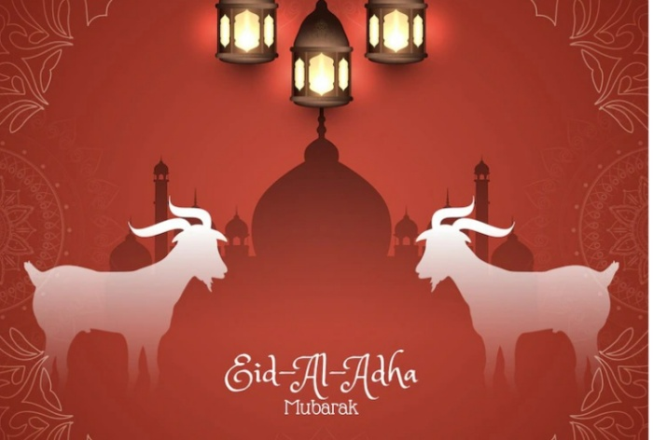
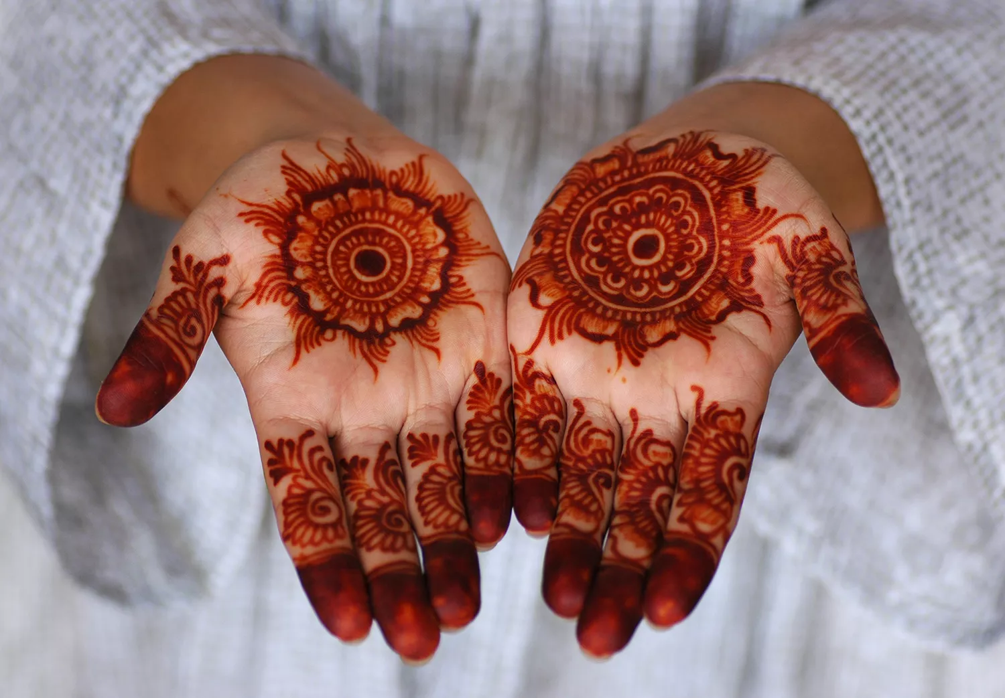
How Eid al-Adha is Celebrated
Gather and offer a communal prayer during the day.
Sacrifice an animal (sheep, lamb, goat, cow, bull, camel) and divide the meat into three parts: one part for family, one part for friends, and one part for the poor.
Visit friends, family and exchange gifts.
Click the link to source
Created by Abdoulie A Jallow

