Slide 1
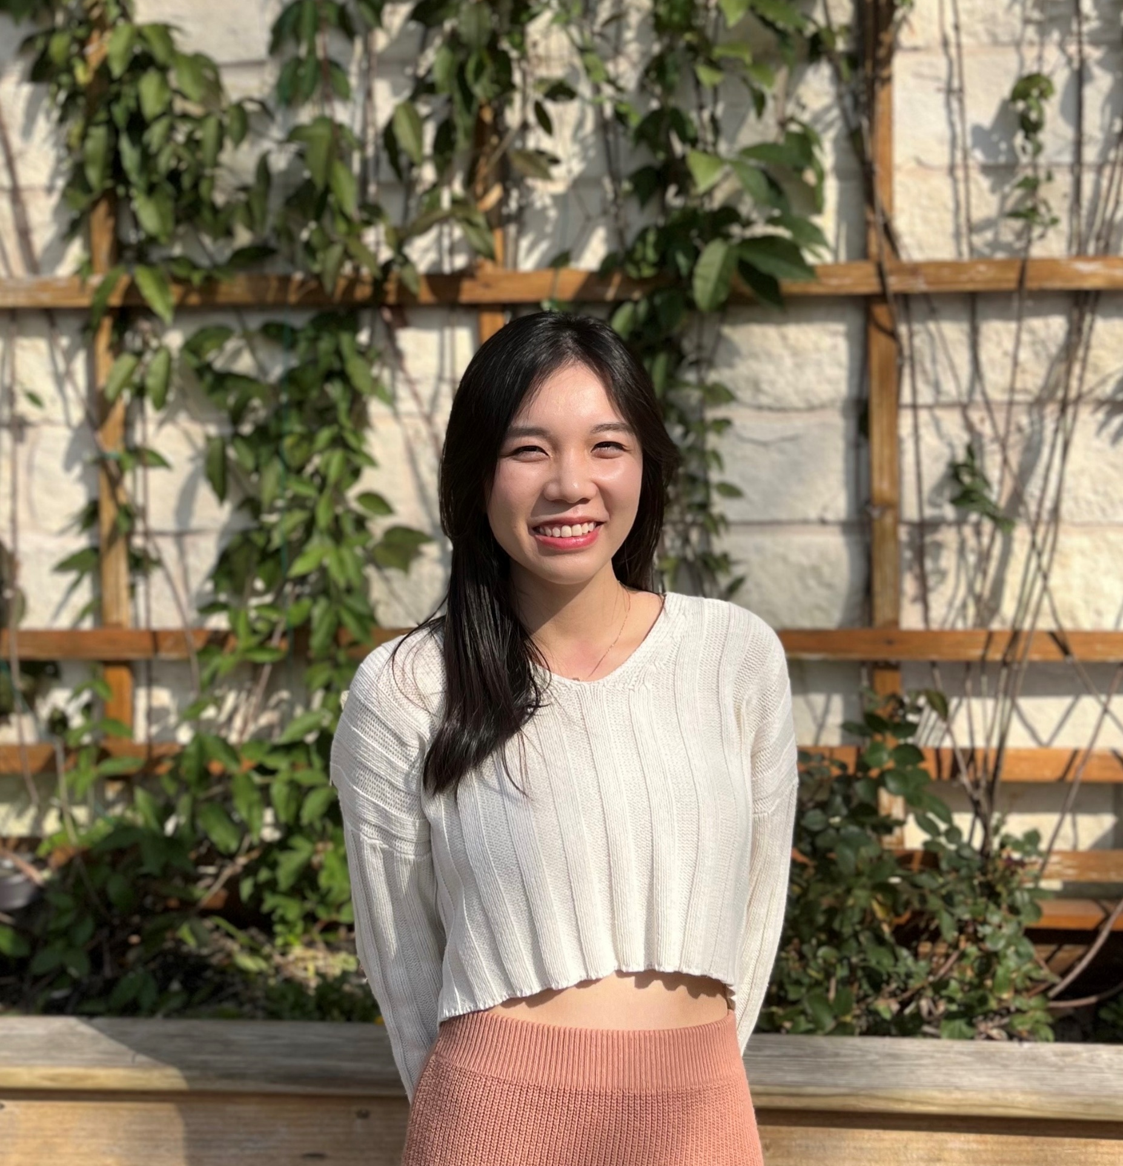
Mai Nguyen
DFT, Data analysis, battery materials, surface reactions, ML-potential
BS Computational Chemistry and PhD candidate in Theoretical Chemistry at UT Austin
Vietnamese/English
Christmas & Tet holiday
Cat’s and keyboard lover
(My N-win)

