Slide 1
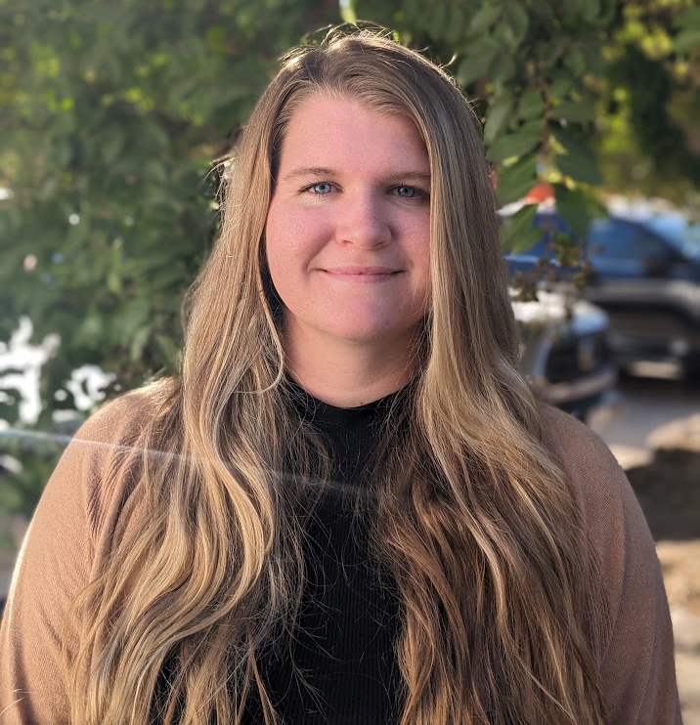
Kelly Vernon (Keh · lee Vur · nuhn)
SPM, electroanalytical chemistry, nanoscale electrochemistry, microfabrication, surface chemistry
Shorter University / Texas A&M University
English
Halloween (Oct 31st) … and Christmas (Dec 25th)
Soccer, hockey (ice and roller), hiking, gaming

