Slide 1
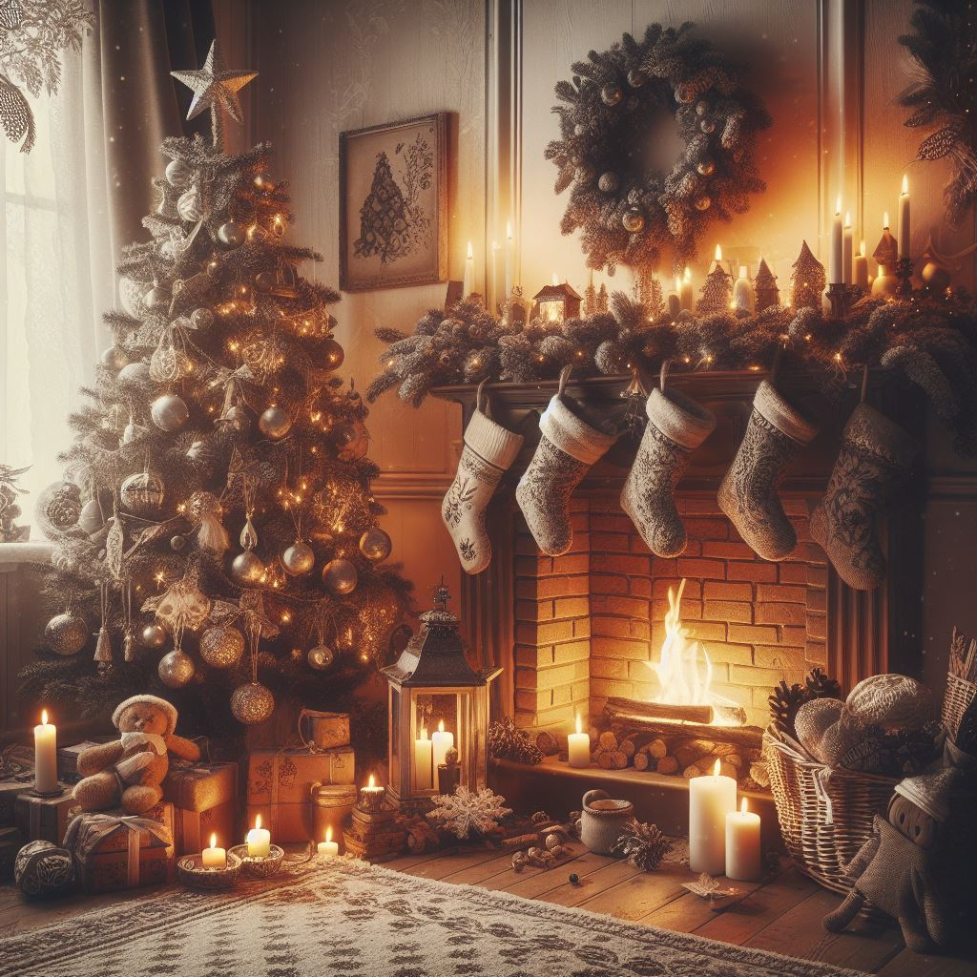
Christmas
Natale
Navidad
Noël
Celebrated: December 25
Sacred Religious Holiday and Commercial Phenomenon
Birth of Jesus (date not mentioned in the Bible)
Chosen to be Dec. 25th
Adopt and absorb pagan festivities
Increased embrace of Christmas
Information: History.com
Created by:
Madison Edwards
Photo generated by Bing AI

Slide 2
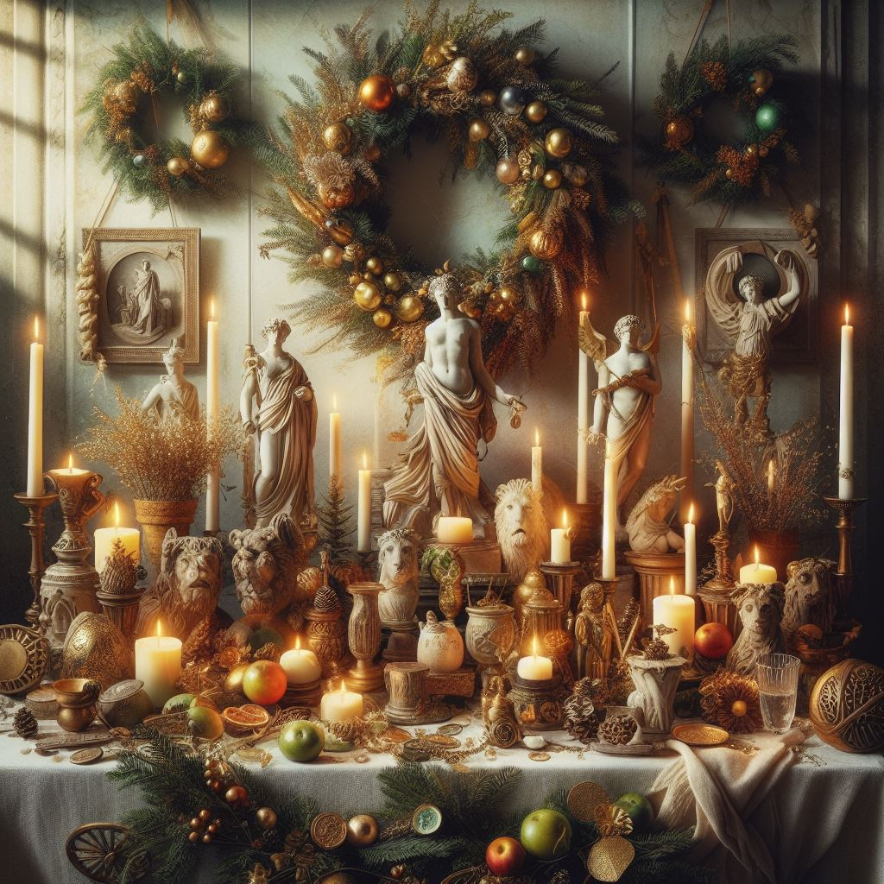
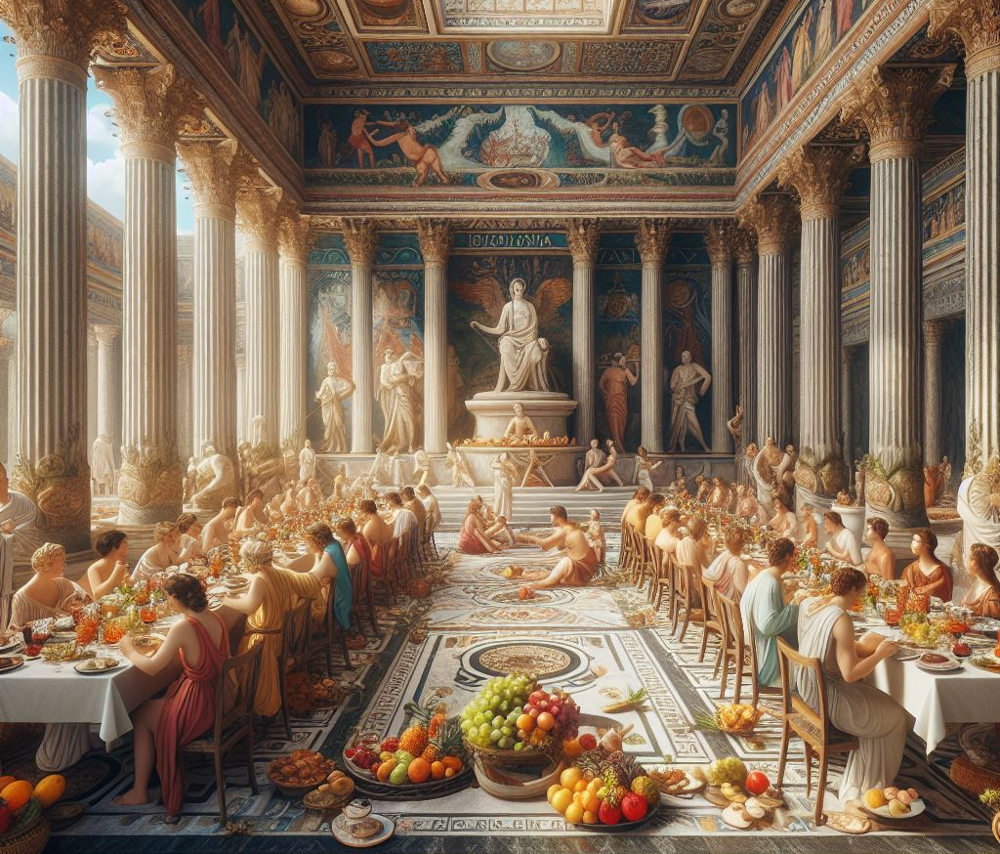
Previous Celebrations in Winter
Winter Solstice
Celebration of light and birth
Look forward to longer days and more hours of sunlight
Norse celebration “Yule” (Dec. 21)
Return of the sun
Germans honored Oden
Feast of the winter solstice
Saturnalia
Honor Saturn, god of agriculture
Business and schools closed
Enslaved people given freedom
Juvenalia (Dec. 25)
Feast honoring the children of Rome
Information: History.com
Photos generated by Bing AI

Slide 3
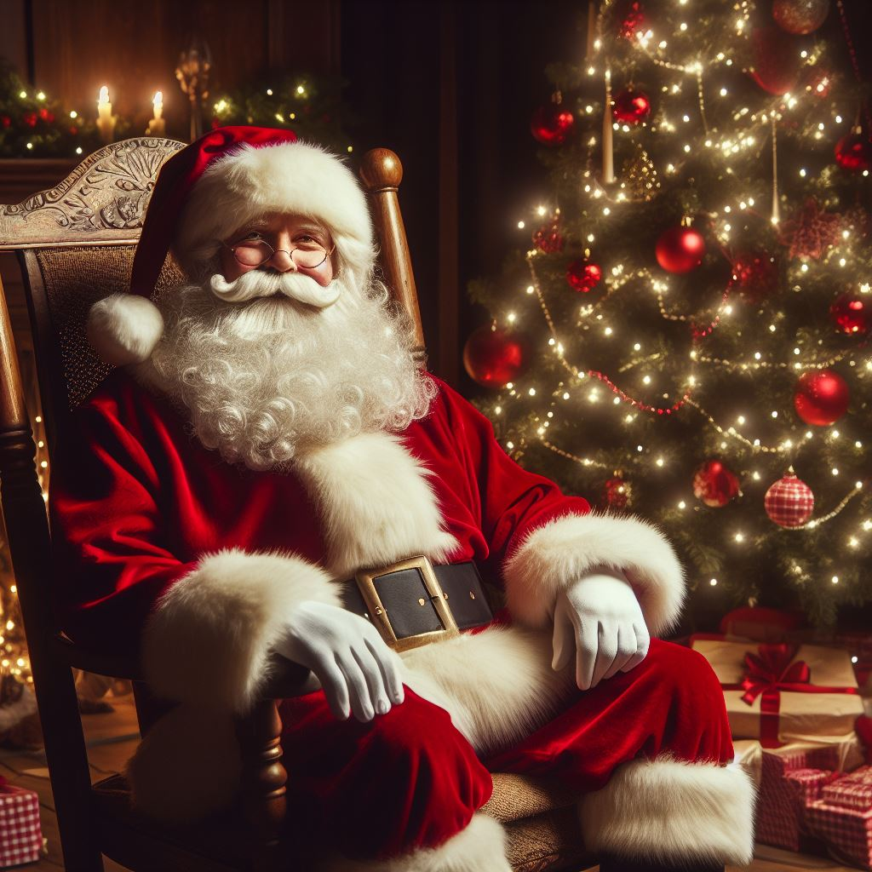
The Celebration (United States)
Family gatherings
Decorating trees
Sending holiday cards
Gift-giving (3 Magi gifts)
Religious celebrations
Midnight (evening) candlelight services
Santa Claus
St. Nicholas, Turkey, 280 AD
Gave everything away
Helped the sick and poor
Poem by Clement Clarke Moore depicted the Santa we know today
Information: History.com
Photo generated by Bing AI

