Slide 1
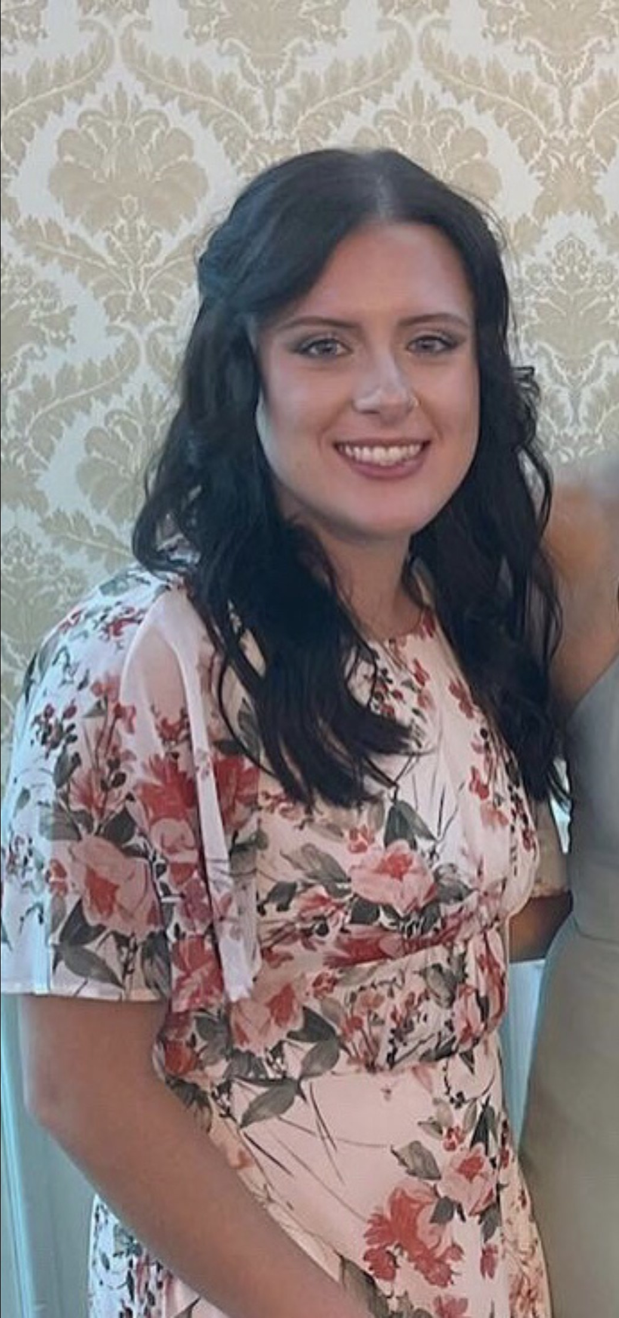
Bianca Paranzino (Bee-aan-kah Parr-aan-zee-noh)
Technical Expertise (nanomaterials synthesis, polarization-resolved optical characterization of nanomaterials, electron microscopy)
Rosemont College (undergraduate), Temple University (Doctorate)
Languages Spoken: English
Favorite Holiday and Date: Thanksgiving and Christmas
Hobbies/Other Interests: Running, singing, and playing with my cats

