Slide 1
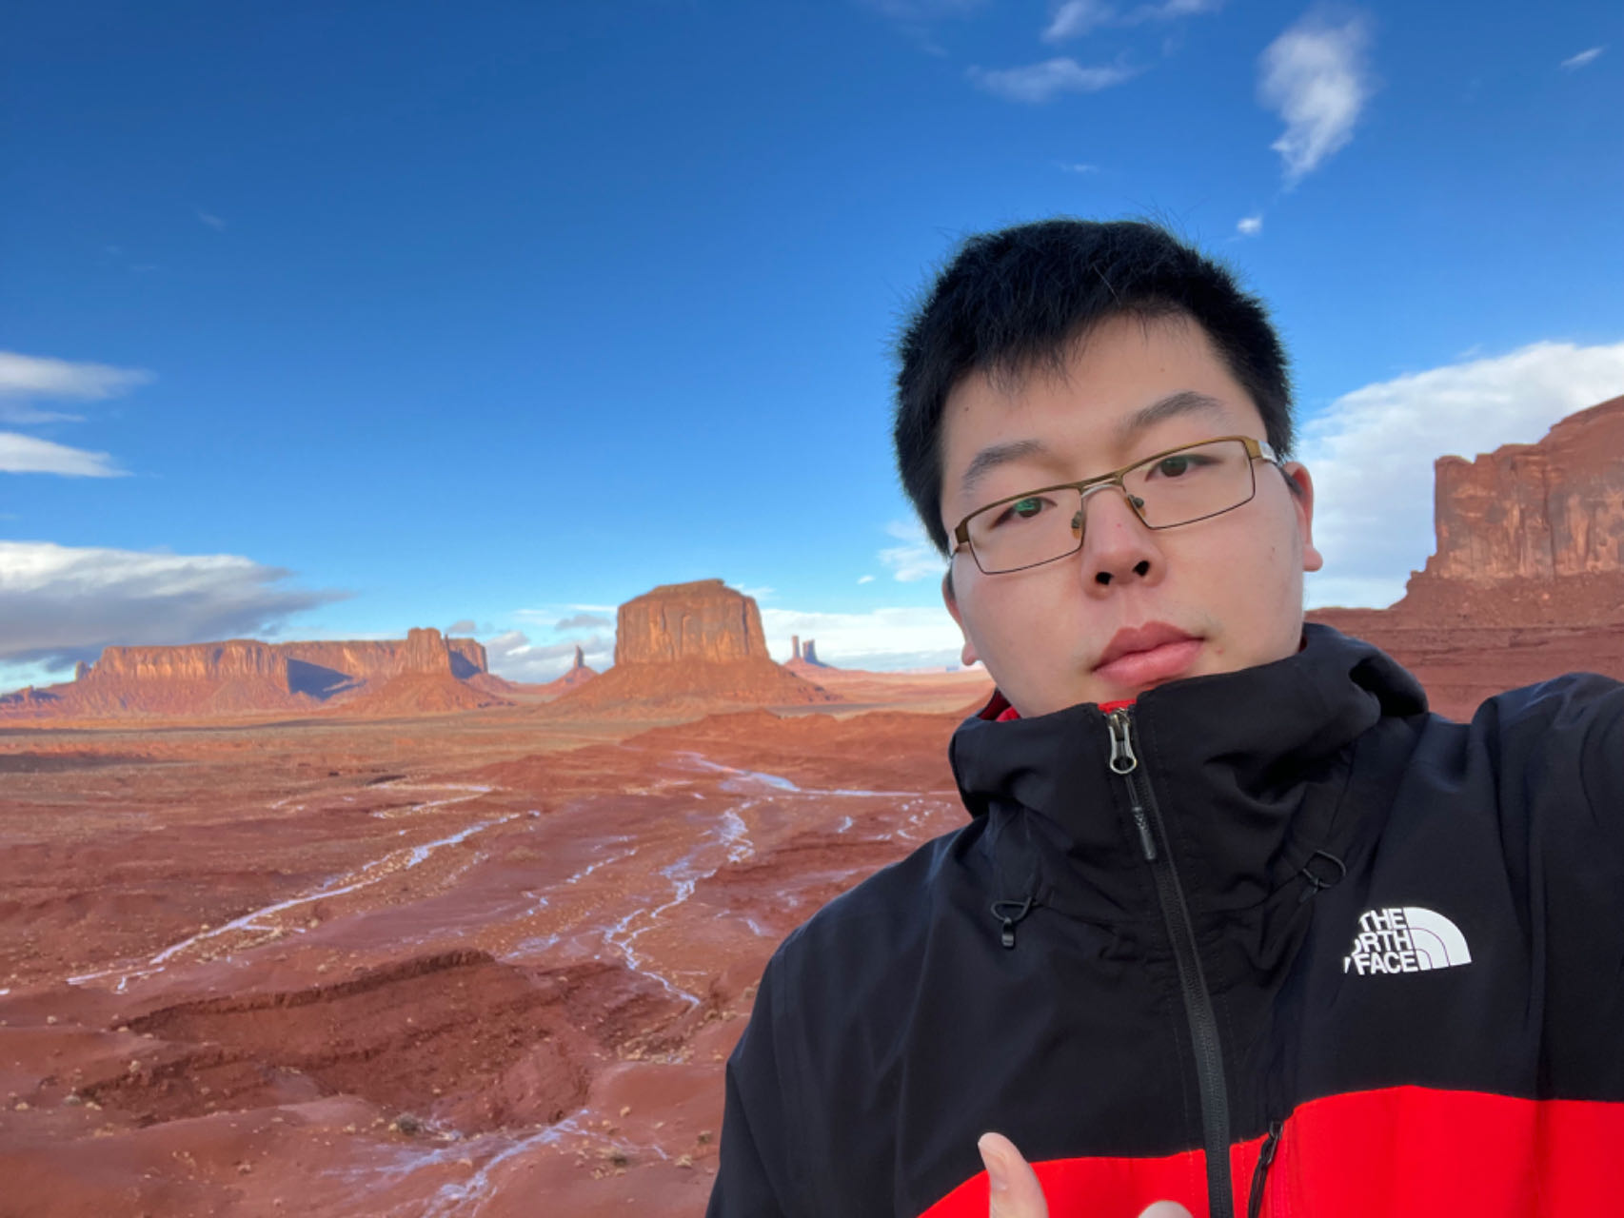
Baixu Zhu
Technical Expertise: Nanocrystal Synthesis, Nanocrystal Self-Assembly, Electrocatalysis
Undergraduate Institution: Fudan University, Shanghai, China
Languages Spoken: Mandarin, English
Favorite Holiday and Date: The Spring Festival (the first day on Lunar calendar)
Hobbies/Other Interests: Soccer, Cooking

