Slide 1
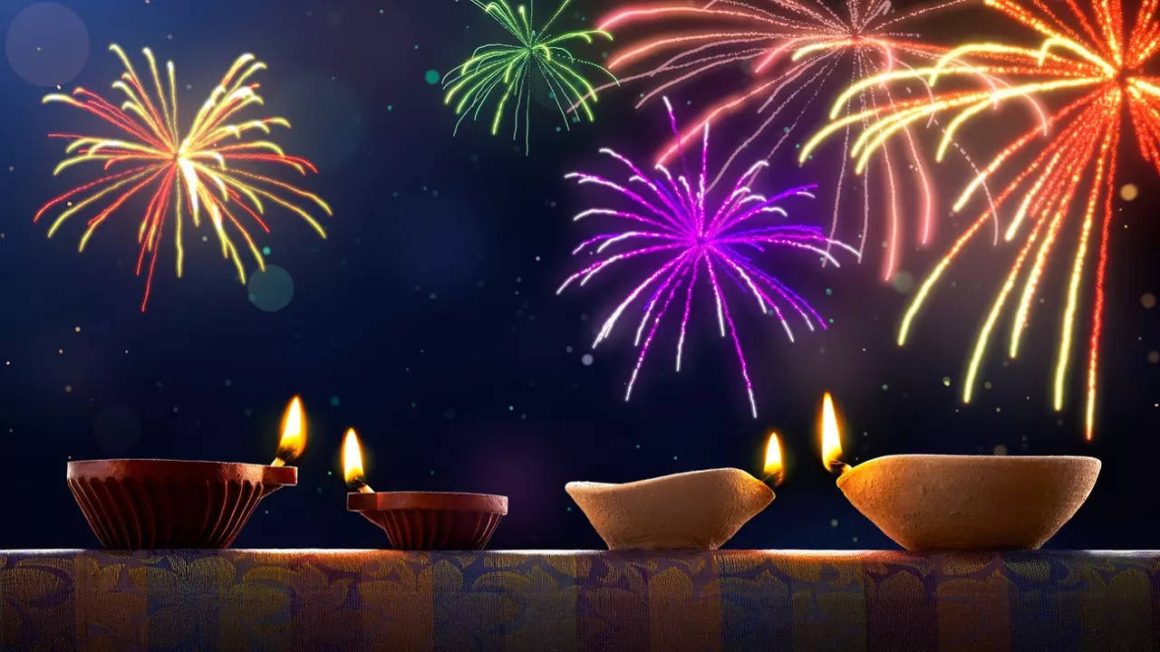
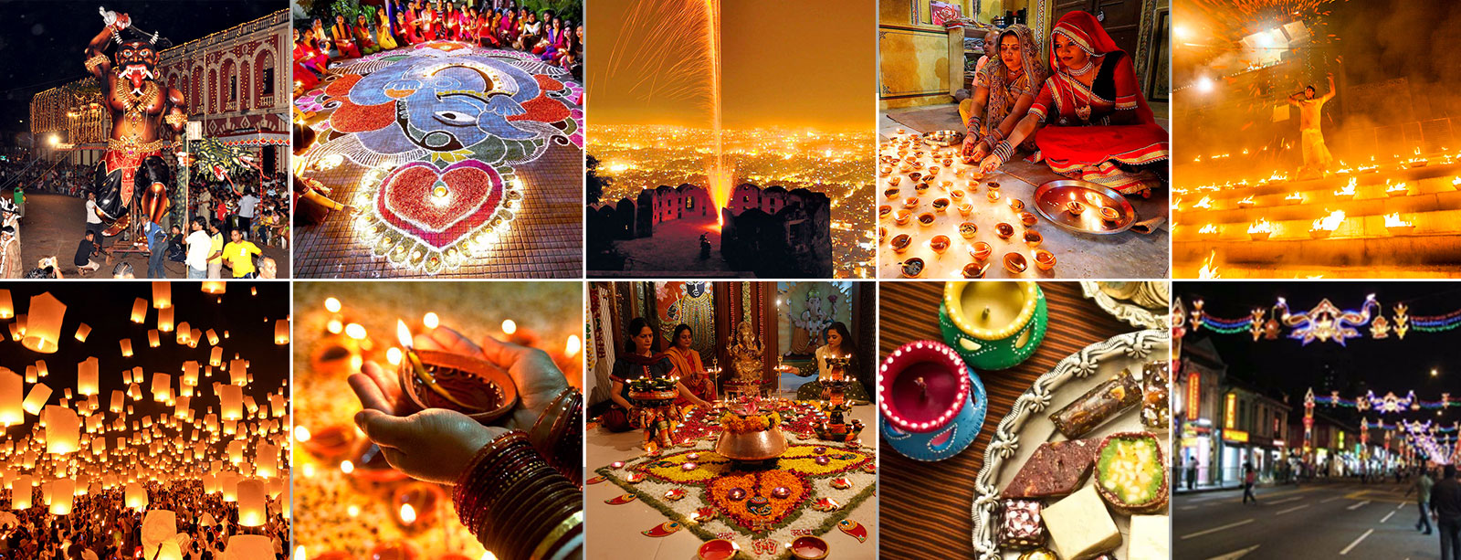
Diwali (Deepavali) – Festival of Lights
New moon of Kārtika month: late-Oct to early-Nov
November 12, 2023
Hindus, Sikhs, Jains, Buddhists
Hinduism: Celebrate return of King Rama from exile after defeating Demon King Ravana
Victory of good (light) over evil (darkness)
Sources 1, 2
Created by: Jagannath S.P. Mantha
Notes:
Celebrated by different Indian religions

Slide 2
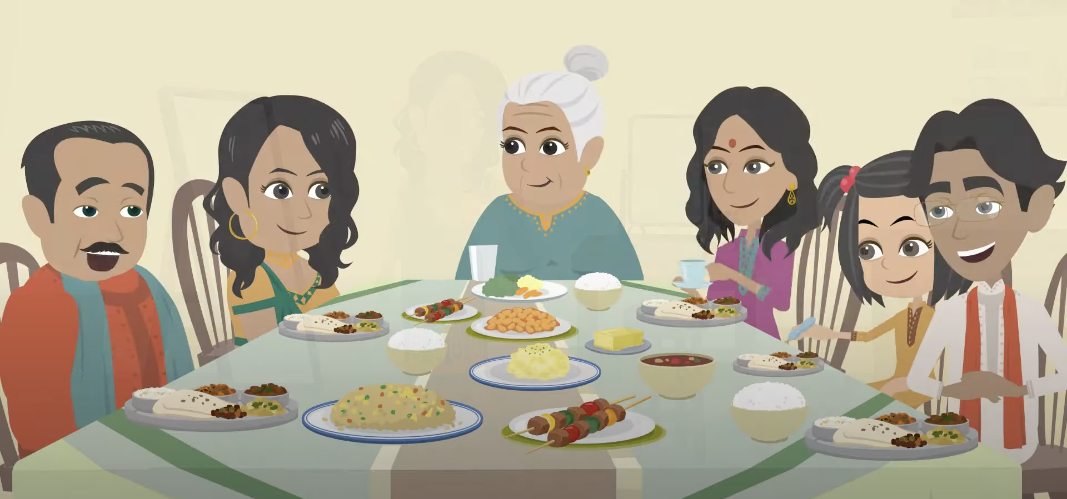
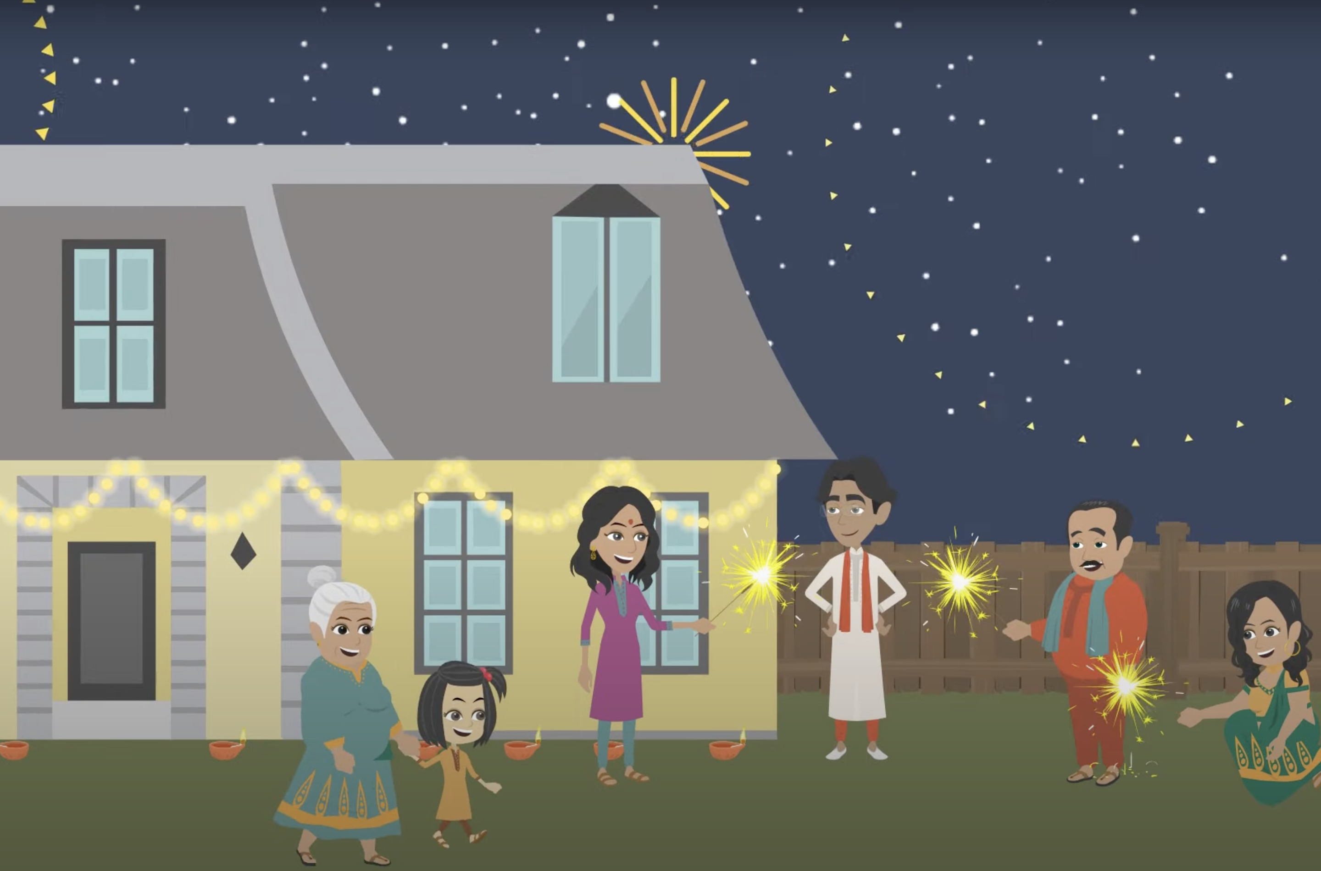
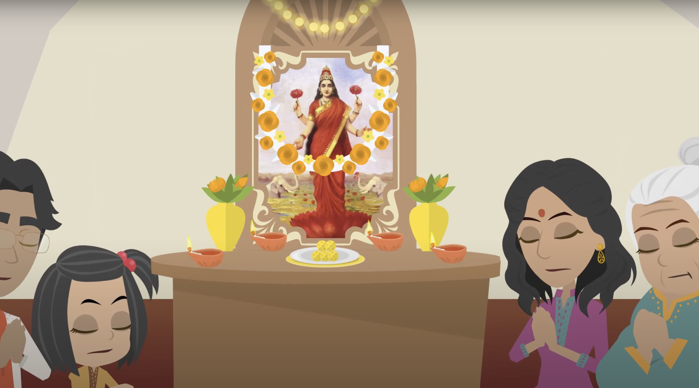
Diwali (Deepavali) – Festival of Lights
Celebrations/traditions
Good food, lights, fireworks, new clothes, Lakshimi worship (goddess of wealth), pay off debts
https://www.youtube.com/watch?v=cKrDJ3ipNYM
Notes:
https://www.youtube.com/watch?v=cKrDJ3ipNYM
https://www.youtube.com/watch?v=nV2P7xt2rCM

Slide 3
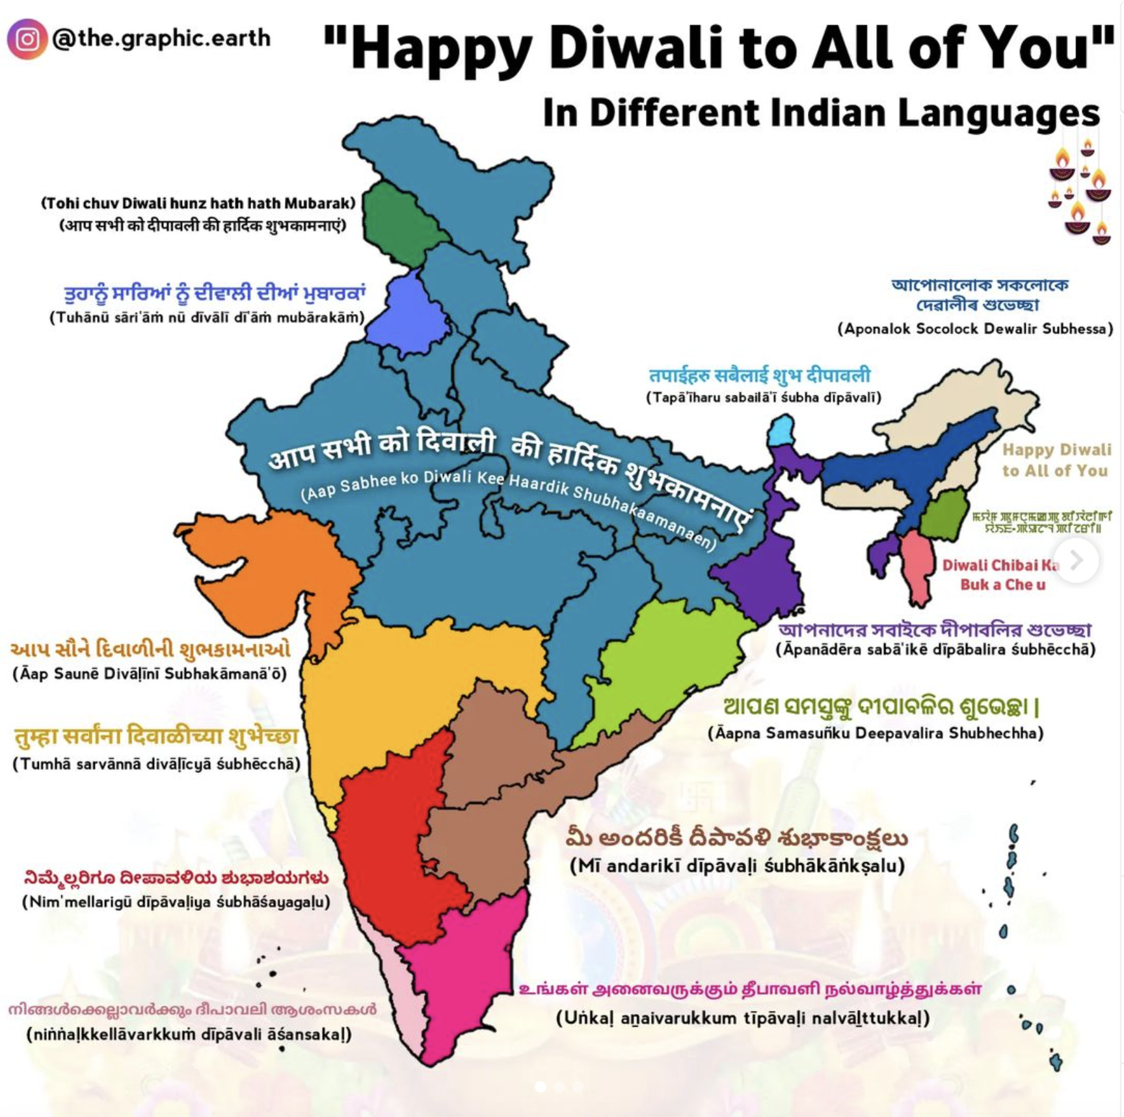
Diwali (Deepavali) – Festival of Lights
November 12, 2023

