Slide 1
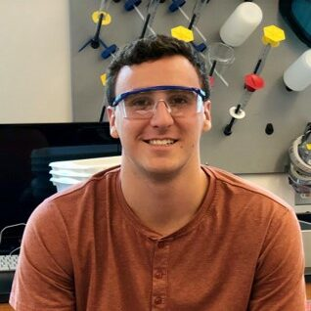
Zac O’Dell (ZAK O-DEL)
Dark-Field and Polarization-Resolved Microscopy, Electron Microscopy, Image Processing
Swarthmore College (PA)
English
Memorial Day (End of May)
Playing / watching sports, card games, board games

