Slide 1
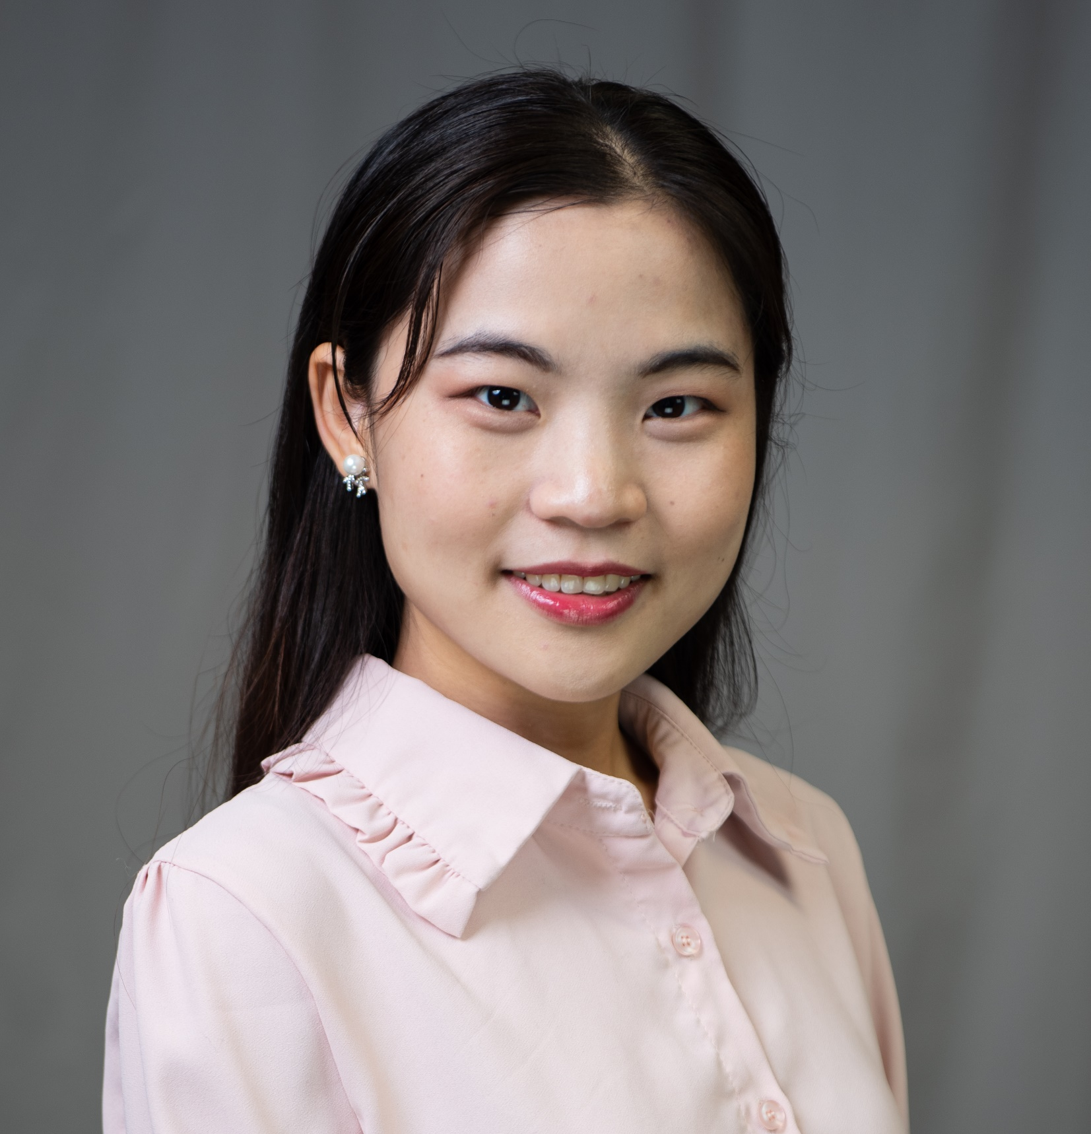
Tingyuan (Tiya) Yang (Tingyuan jæŋ)
Technical Expertise: MS, lipidomics, HPLC
Undergrad University: Beijing Normal University (2015-2019)
Graduate University: Texas A&M University (2019-present)
Languages Spoken: Mandarin, English
Favorite Holiday: New Year’s Eve
Hobbies/Other Interests: Running, dancing, and making plans

