Slide 1
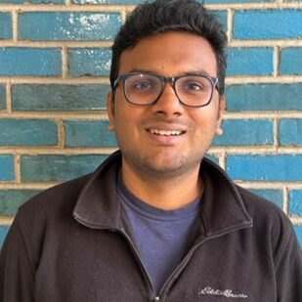
Sanjay Sridhar (Sun-jay Shree – dhu r)
Insert photograph(s) here
Insert recording of you saying your name
Single-entity electrochemistry, Darkfield Microscopy, Interference Microscopy
Institute of Chemical Technology, Mumbai, India
Tamil, English, Hindi
Diwali (differs year to year – usually end of October/Start of November)
Watching movies, writing/producing short plays, playing/watching sports

