Slide 1
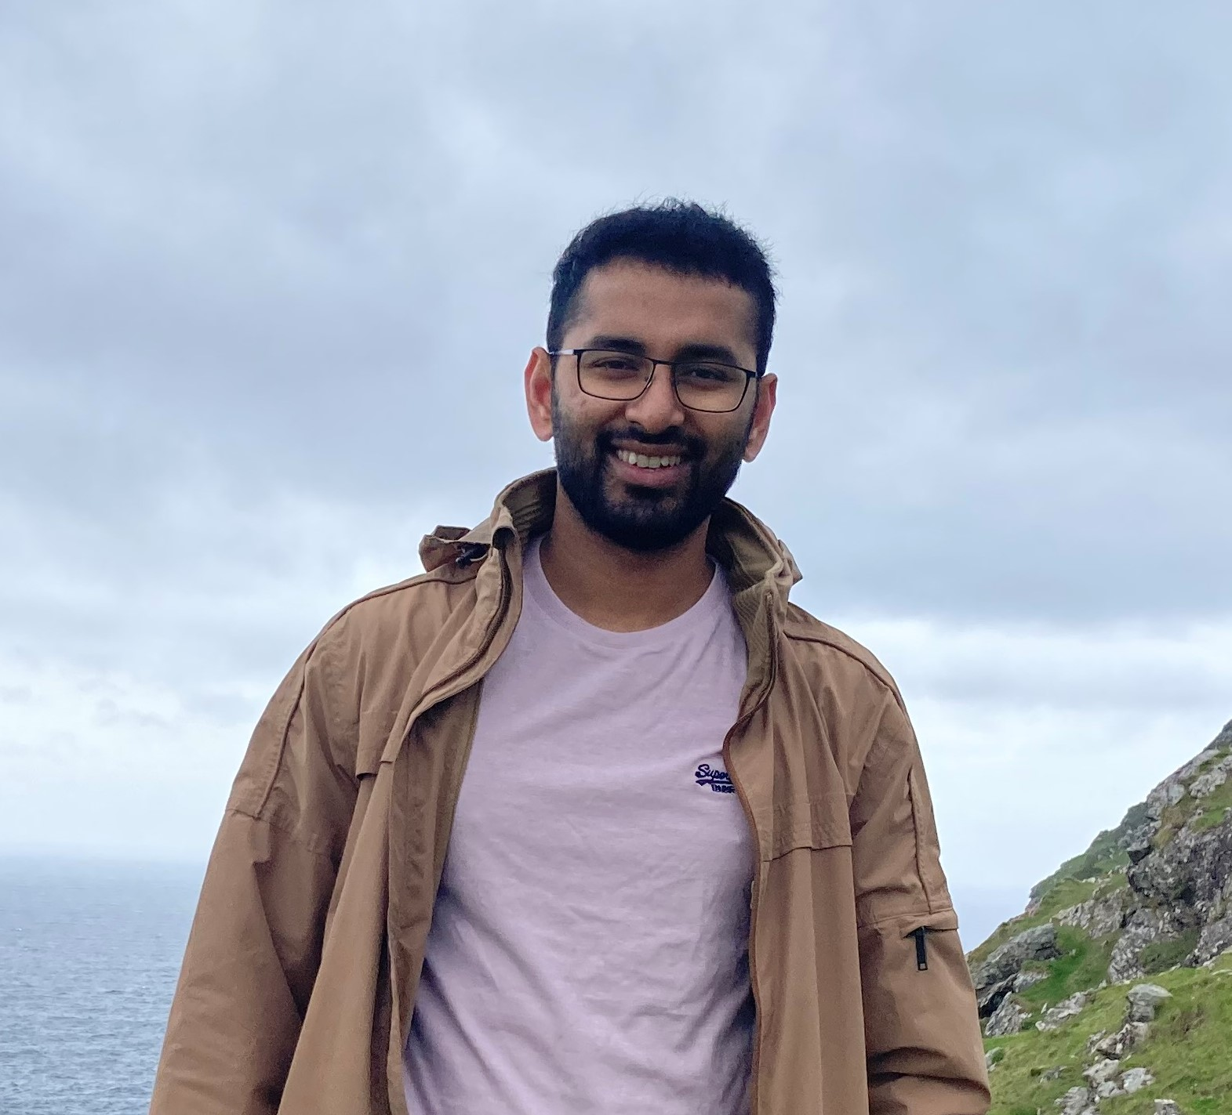

Nilotpal Kapuria (Nee-lot-paul Ka-pu-ria)
Technical Expertise: Colloidal and electrochemical synthesis of nanocrystals, electron microscopy
Undergraduate Institution/Graduate Institution: IISER Bhopal (BS-MS), University of Limerick (PhD)
Languages Spoken: English, Bengali, Hindi
Favorite Holiday and Date: Durga Puja (Sept/ Oct)
Hobbies/Other Interests: Cooking, Arts-crafts, Playing sports/physical activities

