Slide 1
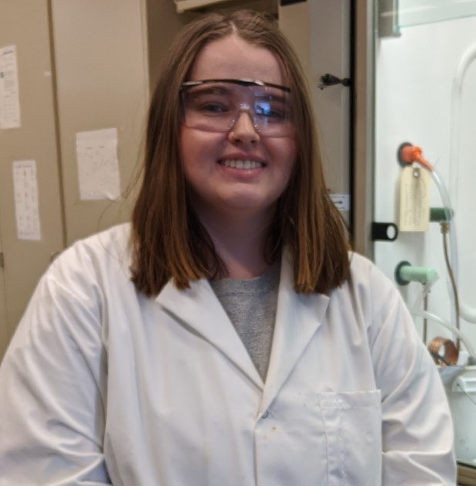
Megan Knobeloch (Meg-en Kuh-no-block)
Name pronunciation:
Technical Expertise: nanoparticle synthesis, electrosynthesis, finite-difference time-domain simulation
B.S. at Iowa State University; currently at Indiana University
Speaks English
Favorite holiday: Halloween
Interests: Cats!

