Slide 1
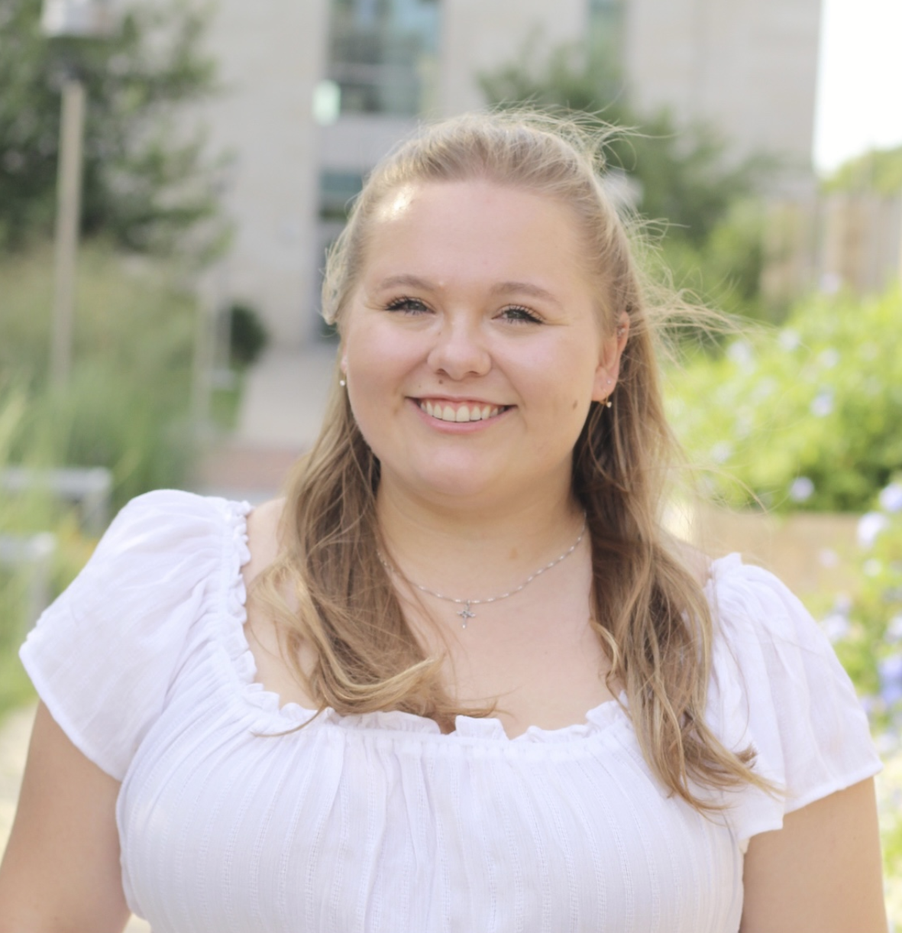
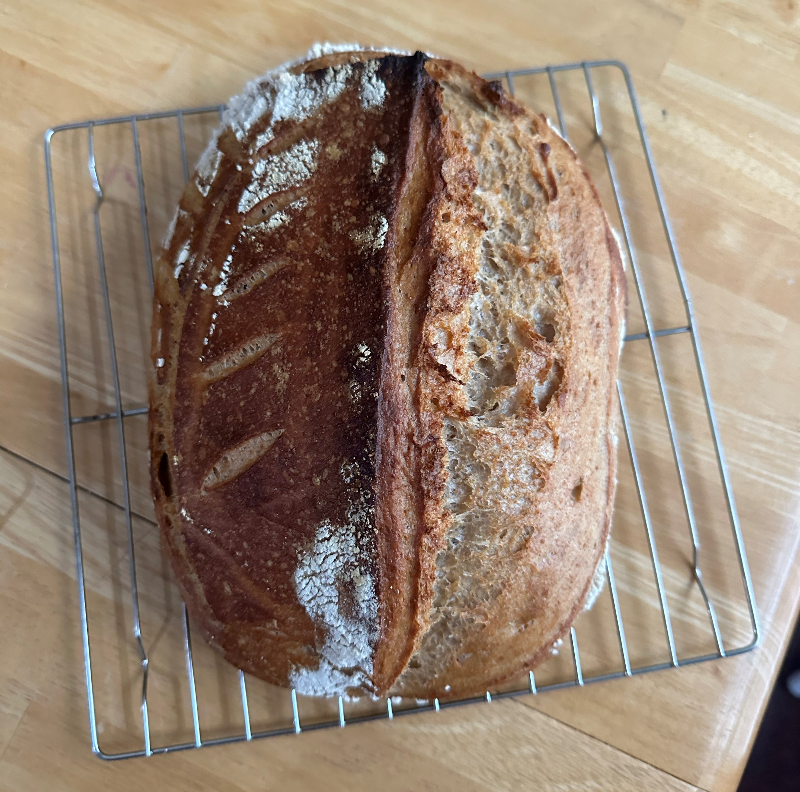
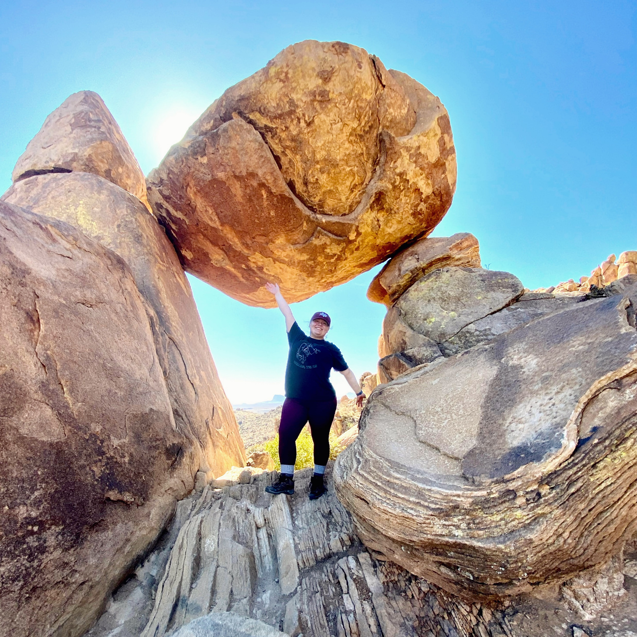
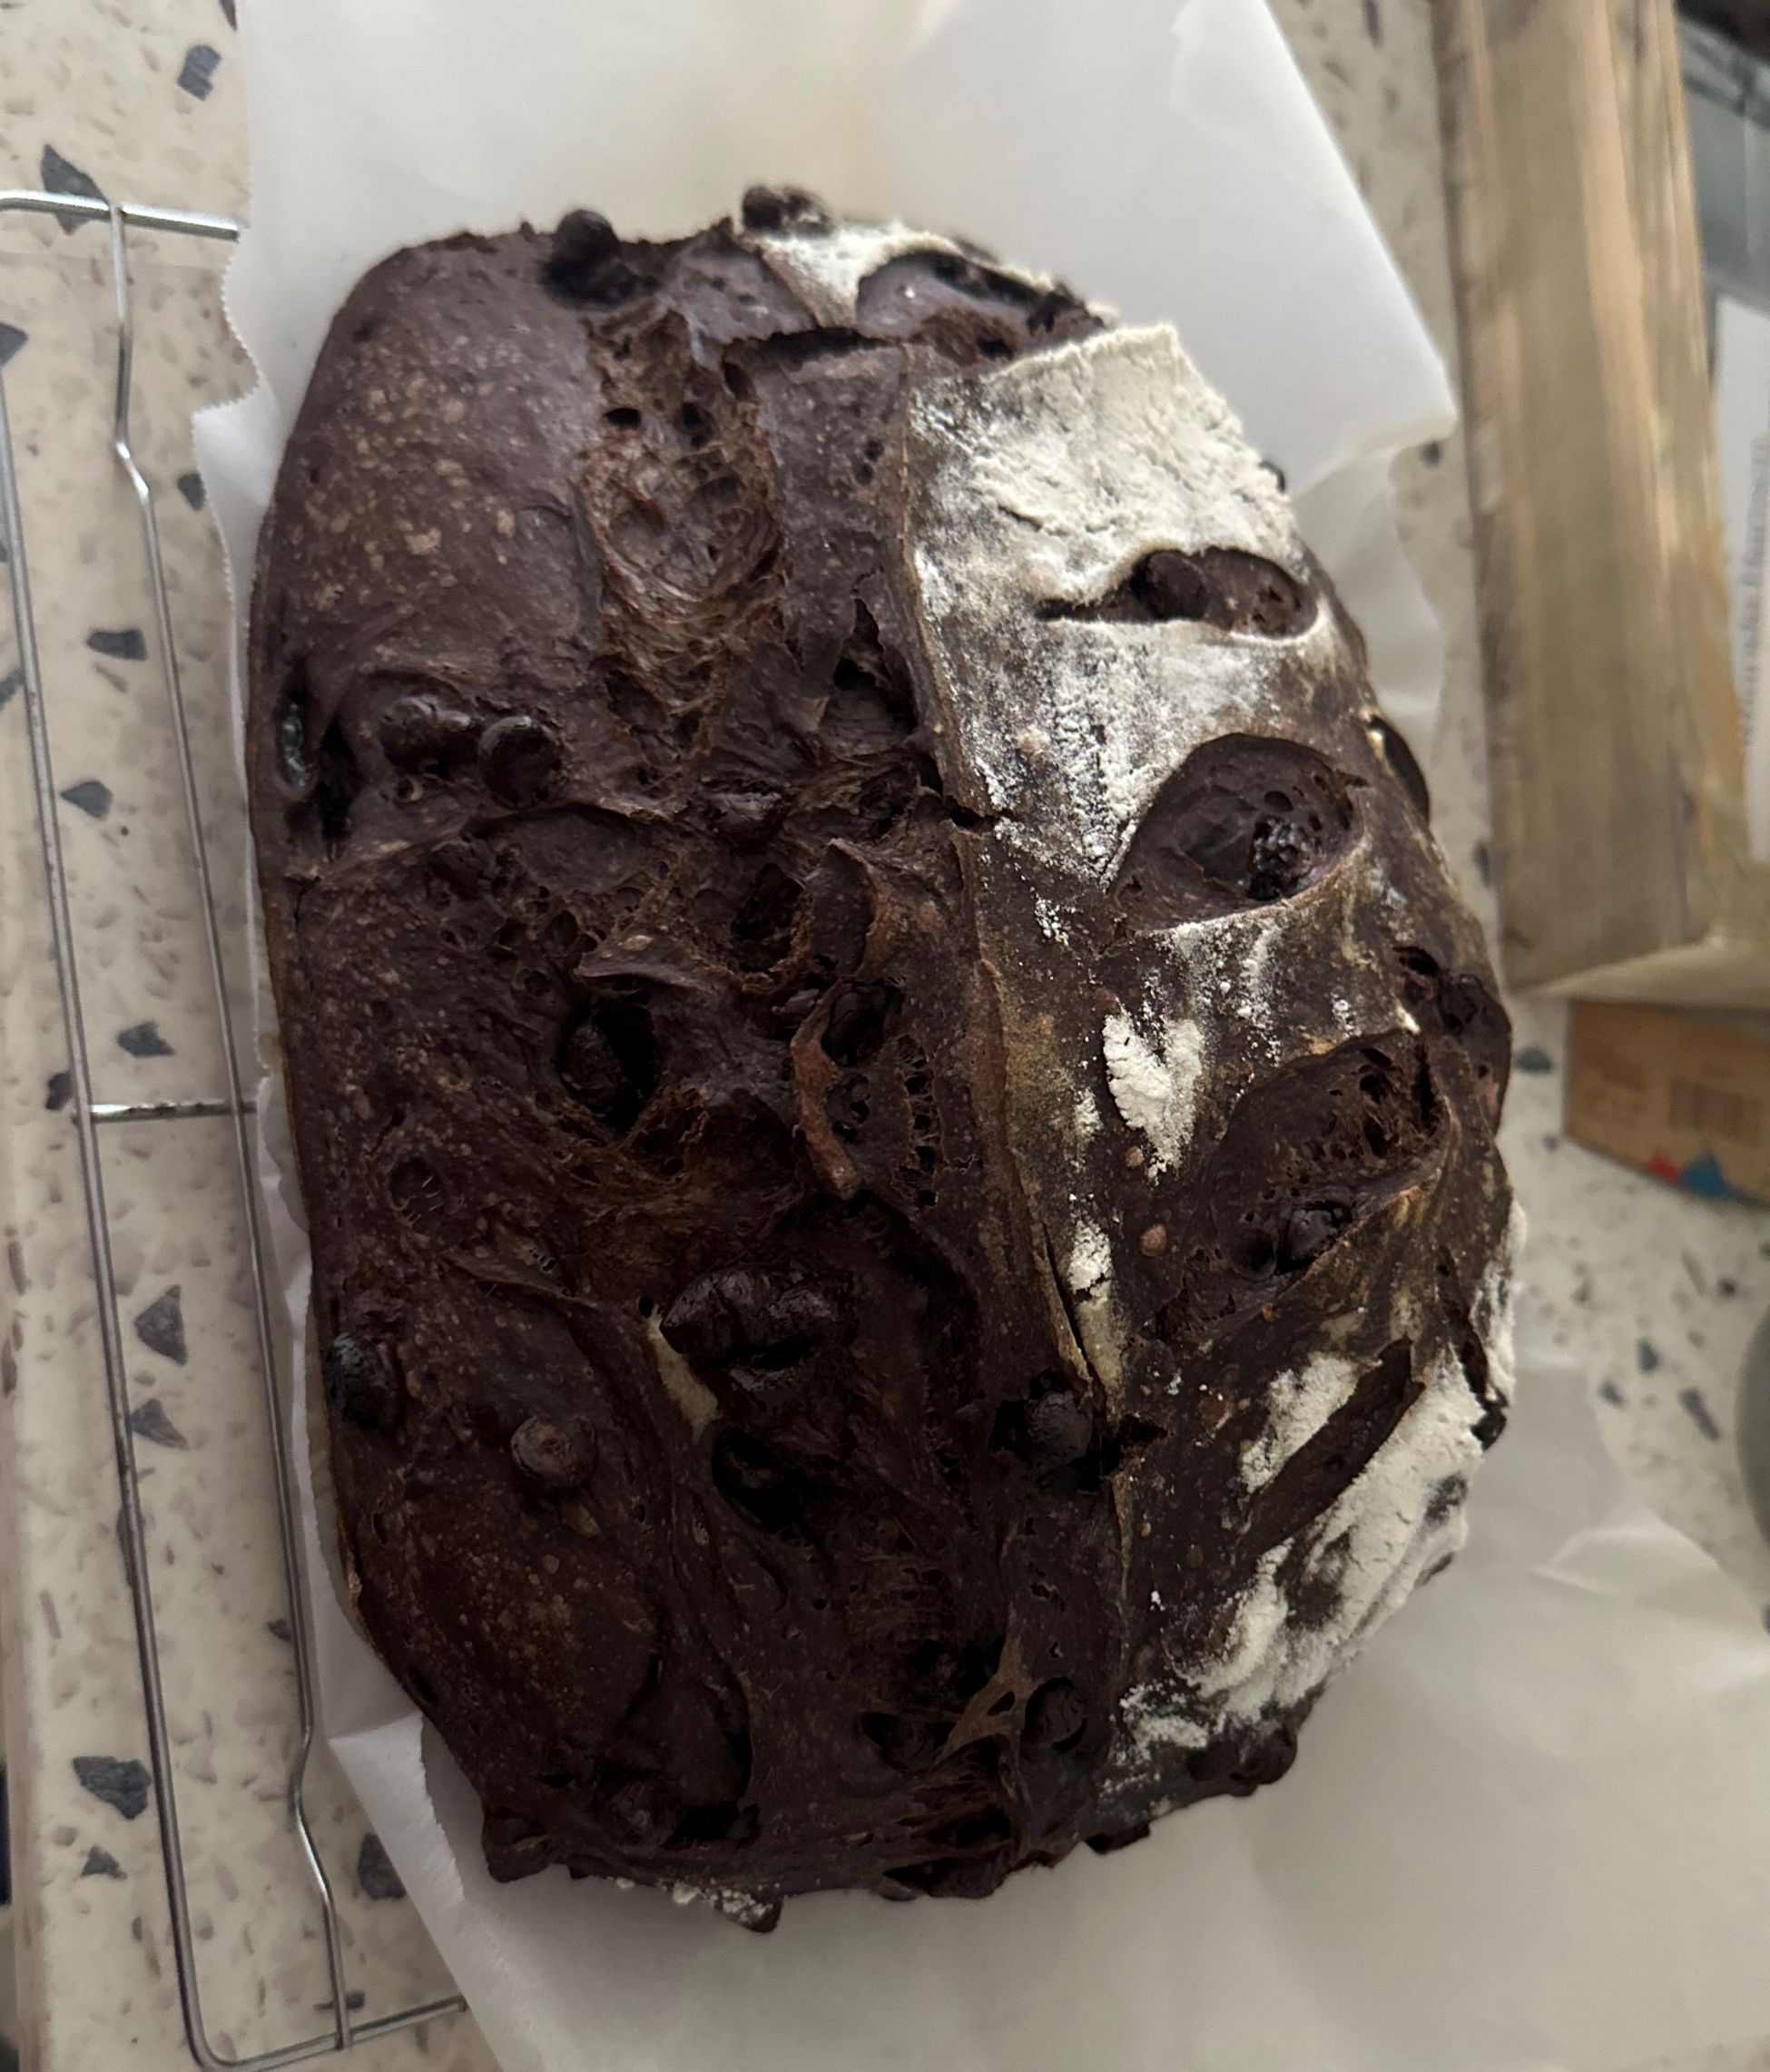
[MAD] + [UH] + [SUHN] [ED] + [WUHDZ]
I work with method development for mass spectrometry
Purdue / Texas A&M
English, and a little Latin
Christmas (Dec. 25)
Baking and exploring
Madison Edwards

