Slide 1
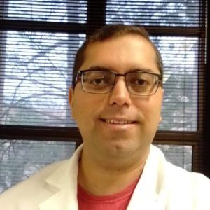
Luan Felipe Campos Oliveira (lʊˈwɑn fɛˈlipeɪ kɑmpəsˌɑːlɪˈveɪrə)
Mass Spectrometry, Ambient Ionization, Chemometrics, Development and Validation Quantification Methods
Undergrade in Chemistry, and PhD in Analytical Chemistry, Campinas University
Portuguese and English
Saint John Party, June 24th (Brazilian Party)
Anime and Manga (Shonen)

