Slide 1
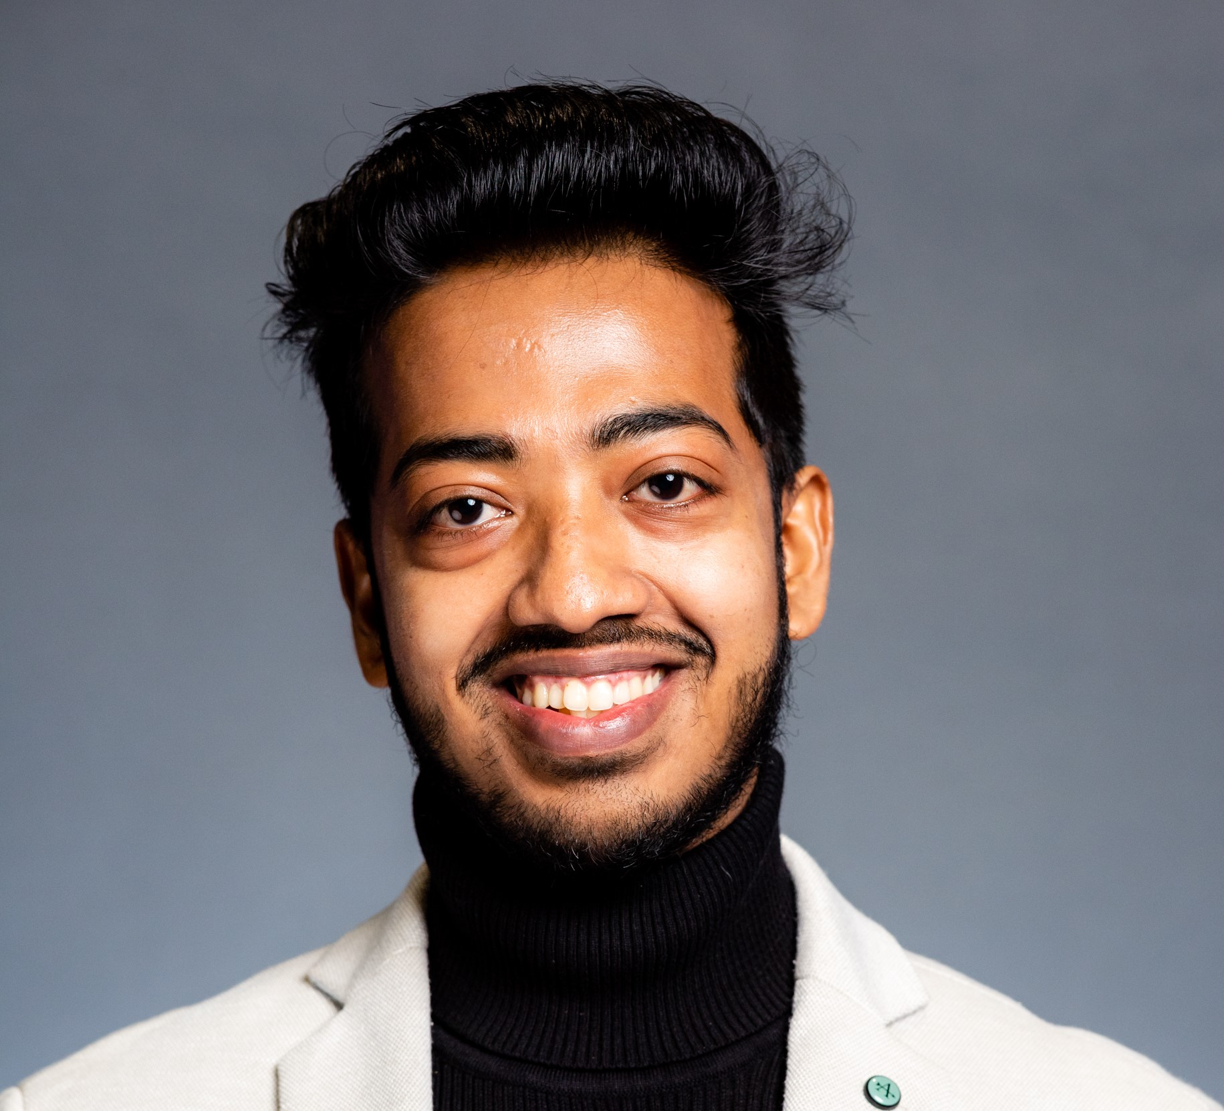
Nabojit Kar (Nobo-jeet Kor)
Insert photograph(s) here
High-entropy alloys, colloidal nanoparticles
IISER-Kolkata India/IU-B, USA
English, Bengali, Hindia
Durga Puja/Dussera in October each year
Painting, fine art, collecting gadgets and mobiles, driving my car

