Slide 1
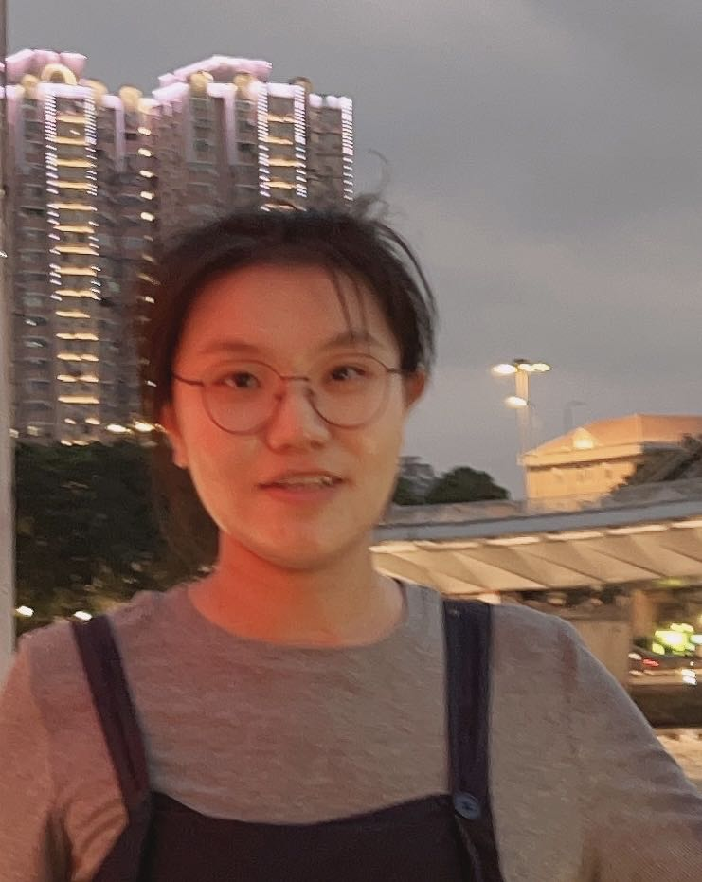
Jiawei Du (Jiā-wěɪ Duː)
Technical Expertise (electrocatalysis, nanomaterial synthesize, characterization)
China University of Petroleum(Undergraduate Institution)/Indiana University(Graduate Institution)
Languages Spoken: Mandarin, English
Favorite Holiday and Date: Spring Festival
Hobbies/Other Interests: Traveling

