Slide 1
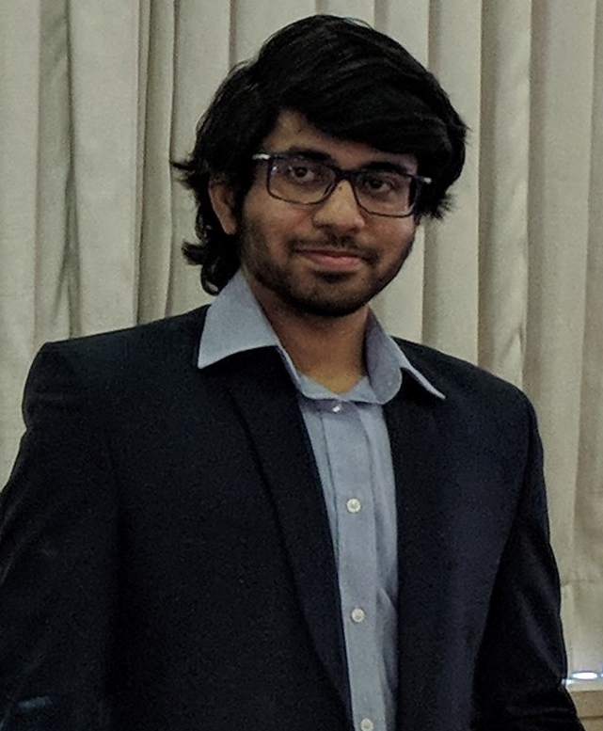
Jagannath Mantha (Jah-gah-nahth Mahn-thah)
Technical Expertise: DFT, MD, computational catalysis
Undergraduate Institution/Graduate Institution: NIT Warangal & IIT Bombay (currently UT Austin)
Languages Spoken: English, Telugu, Hindi
Favorite Holiday and Date: Diwali
Hobbies/Other Interests: Video games, kayaking, badminton/squash

