Slide 1
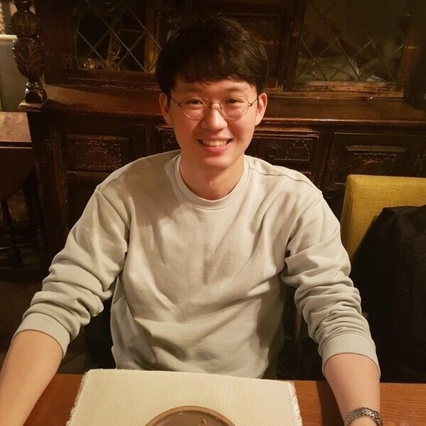
Jaeyoung Cho (Jae-young Cho)
Technical Expertise - Density functional theory methods - Molecular dynamics simulation - Kinetic Monte Carlo simulation
Undergraduate/Graduate Institution - Yonsei University - University of Texas at Austin
Languages Spoken - English / Korean
Favorite Holiday and Date - Thanksgiving holiday
Hobbies/Other Interests - Bouldering / Tennis / Workouts at gym

