Slide 1
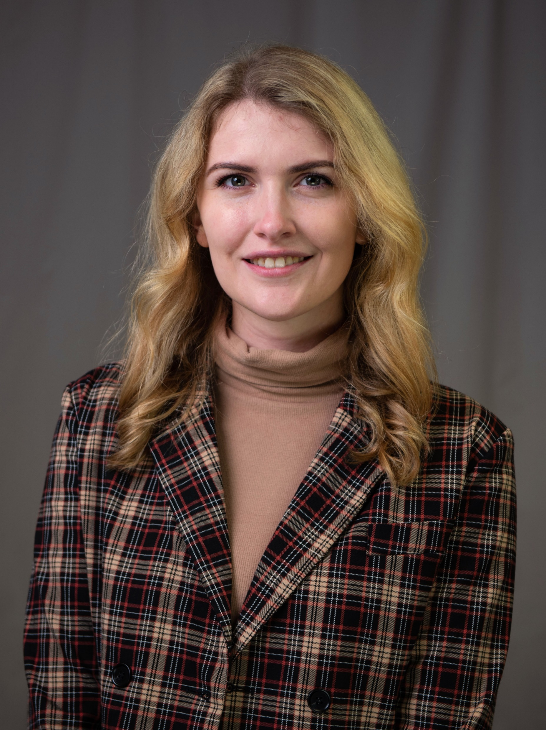
Erin Hirtzel (eh·ruhn hert·zuhl)
Mass spectrometry of nonpolar lipids
York College of Pennsylvania/Texas A&M
English & French
Thanksgiving (3rd Thursday in November)
Rock climbing, tabletop games, and digital art

