Slide 1
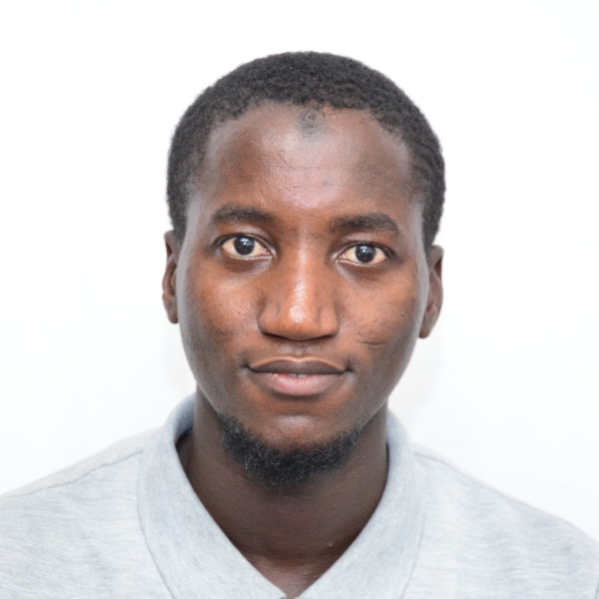
Abdoulie A Jallow (Ab-do-lie)
Insert photograph(s) here
Insert recording of you saying your name
Technical Expertise: Electrodeposition, Instrumental Analysis (CE, GC, HPLC, FTIR), Voltammetry
Graduate Institution: Indian Institute of Technology Bombay
Undergraduate Institution: University of The Gambia
Languages Spoken: English, Fula, Mandinka, & Wolof (Gambian local languages)
Favorite Holiday Date: Eid al-Adha (based on the Islamic lunar calendar)
Hobbies: playing/watching soccer & running

