Slide 1
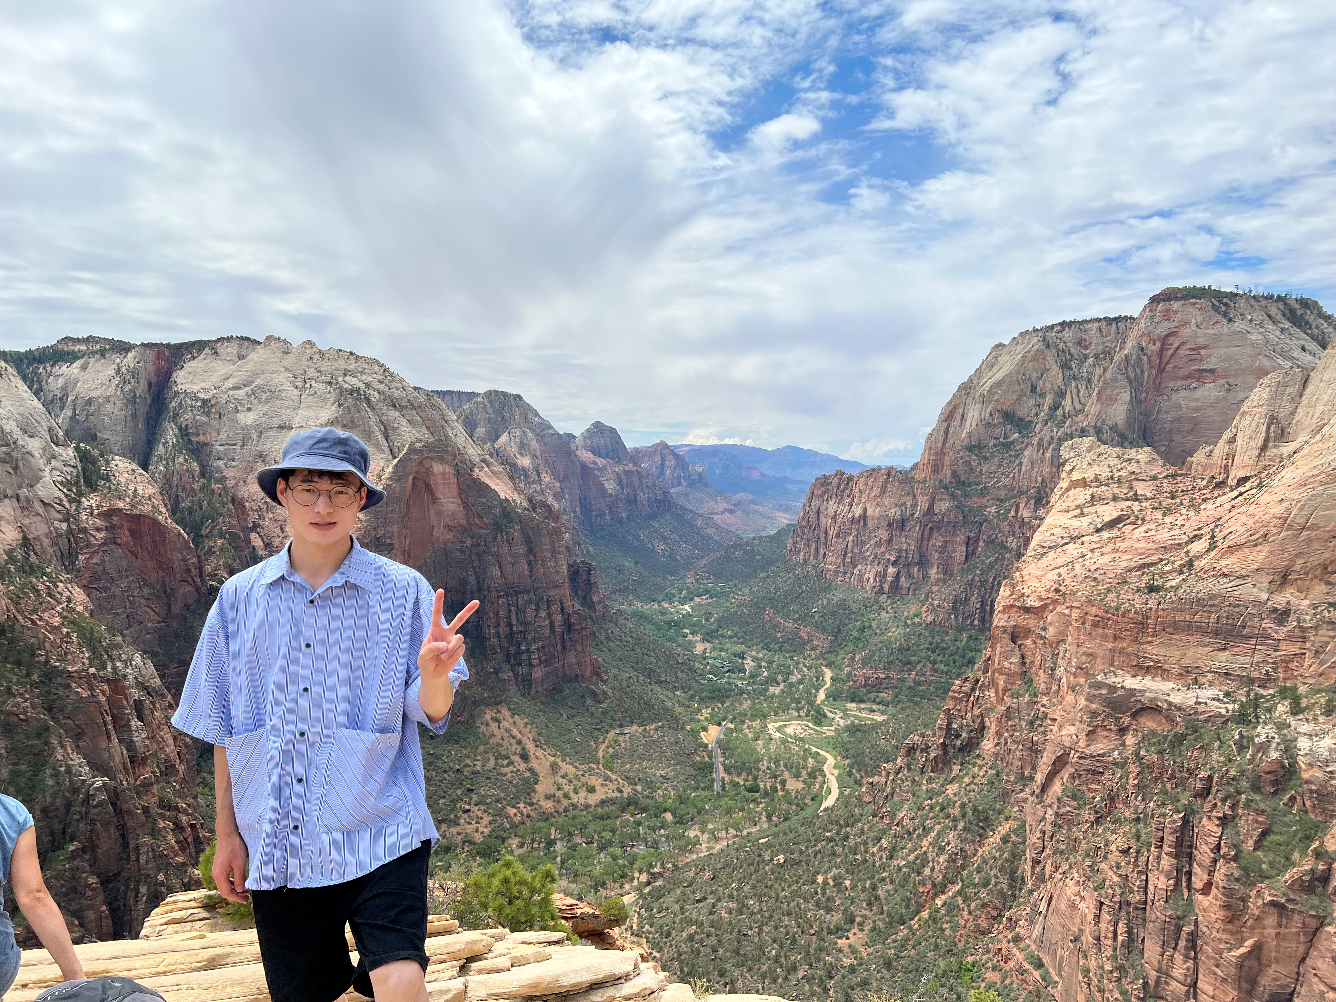

Chuanliang Huang (Chuanliang hwæŋ)
Technical Expertise (Electrochemistry, nanomaterials, catalyst)
Fuzhou University(Undergraduate Institution)/ Sichuan University(Master Institution)/ Indiana University (Graduate Institution)
Languages Spoken: Mandarin, English
Favorite Holiday and Date: Spring Festival, the beginning of a new year on the traditional lunisolar Chinese calendar.
Hobbies/Other Interests: Foodie, travelling, hwæŋ

