Slide 1
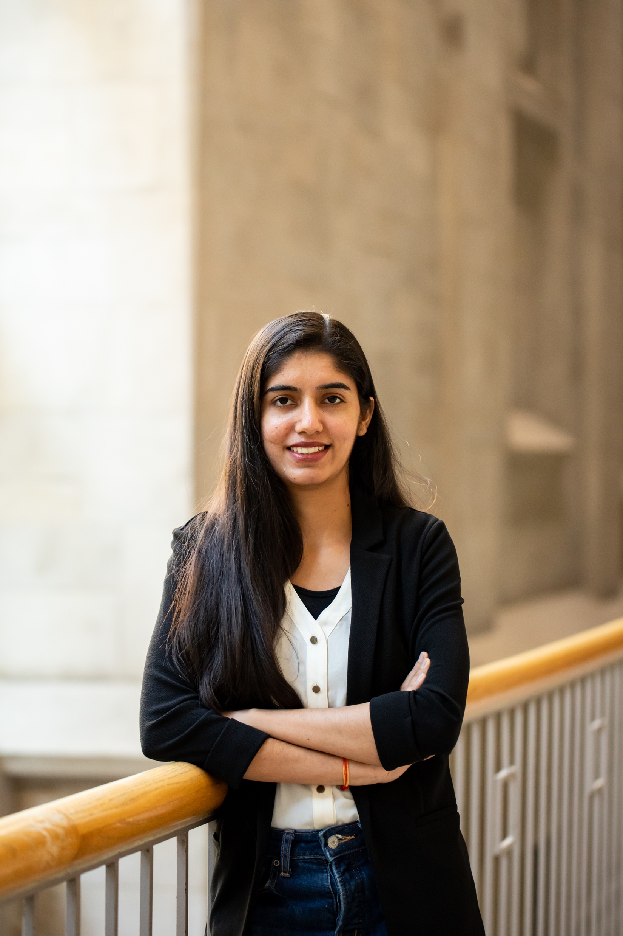
Ekta Verma (ai k - t ah v er - m ah )
Nanoparticle synthesis, Electrochemical synthesis of nanoparticles, single-particle study, optical study
Punjabi University, Patiala
English, Hindi, Punjabi
Diwali and 1 Nov 2024
Reading, Dancing, and walking in nature
Ekta Verma

