Slide 1
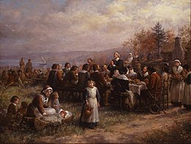
Thanksgiving (United States)
Fourth Thursday in November (Thursday 23rd this year)
Mark a feast between Wampanoag people and the Mayflower Pilgrims after first harvest in 1621
Modern pushes for reframing holiday away from its historical roots given experiences of indigenous populations.
Thanksgiving at Plymouth by Jennie Augusta Brownscombe (1925)
Created by: Erin Hirtzel

Slide 2
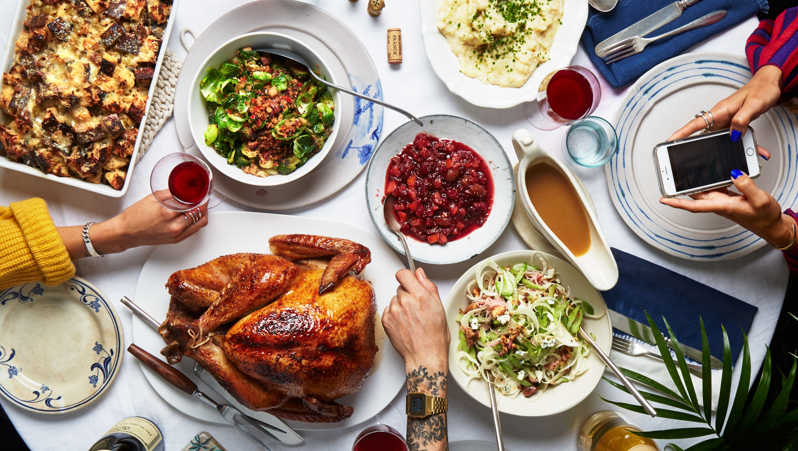
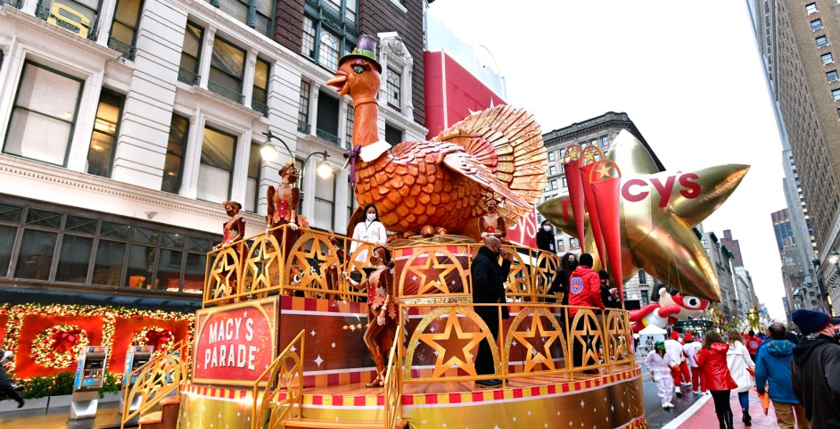
Thanksgiving (United States)
Large feast, traditionally containing:
Turkey
Stuffing
Mashed potatoes
Corn or green beans
Cranberry sauce
Pie (often pumpkin)
Families often have their own personal traditions for food
More modern traditions have arisen, including:
Macy’s Thanksgiving Day Parade
National Dog Show
NFL Thanksgiving Day Game
Black Friday Shopping
Photos courtesy of: [1] Bon Appetit [2] Billboard

