Slide 1
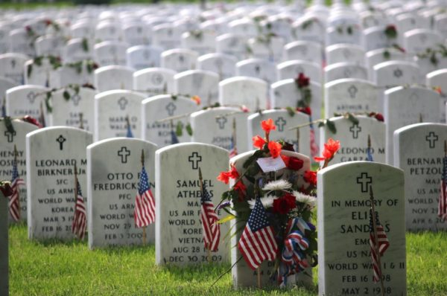
Memorial Day (United States)
Observed on the last Monday in May (5/27/24)
Honors and mourns those who died while serving in the U.S. Armed Forces
Visit cemeteries and hold ‘memorials’
Arlington National Cemetery (Washington, DC)
> 1,000 volunteers place flowers, plant flags, and decorate headstones
Photo courtesy of ARL now
Created by: Zac O’Dell (Temple | Willets)

Slide 2
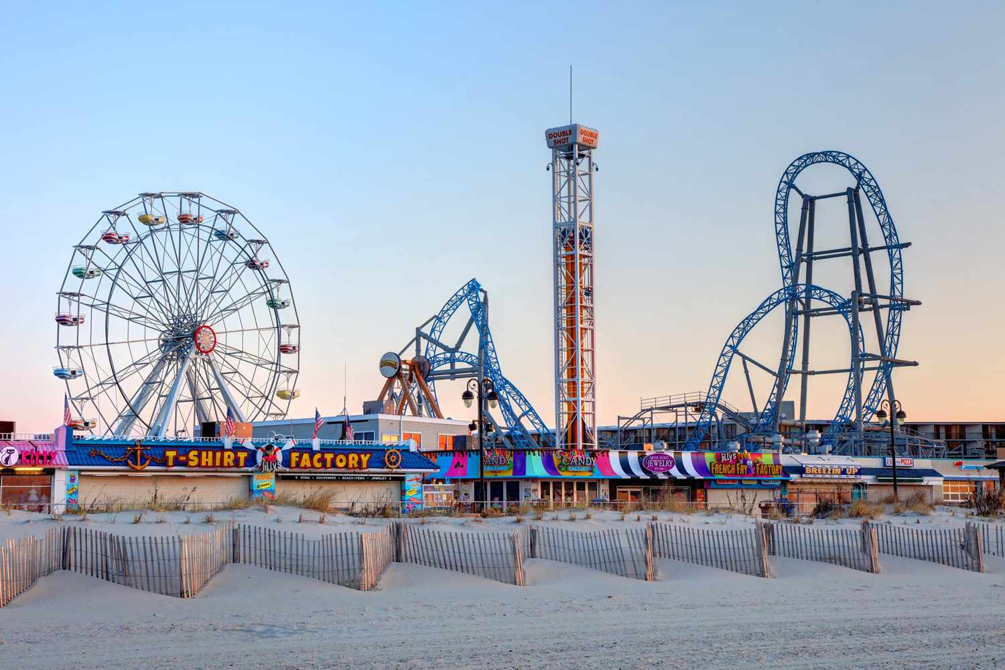
Memorial Day Weekend (United States)
3-day weekend: unofficial start of summer!
Northeast – weather gets nice. Outdoor parties & barbeque. Fireworks?
Go to the lake or ‘down the shore’
Ocean City Boardwalk (New Jersey)
Photo courtesy of Travel and Leisure

