Slide 1
Center for Single-Entity Nanochemistry and Nanocrystal Design
All-Hands Meeting
November 2, 2022
Individual Development Plans & SMART Goals

Slide 2
Individual Development Plans
IDPs are tools that outline objectives that you (and ideally your mentor/supervisor) have identified as important for your professional development.
A review of your career goals and objectives throughout your graduate career provides constructive feedback that can help you become an independent investigator.
Helps to build your CV!
Brings your goals and team goals in alignment.

Slide 3
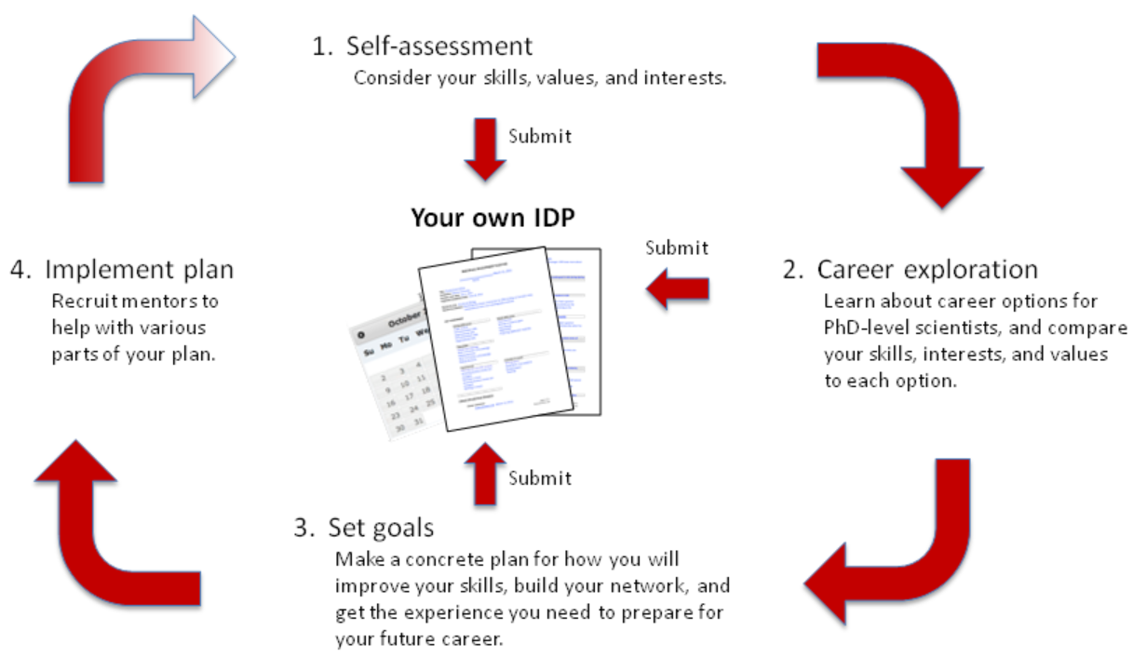
Individual Development Plans
https://myidp.sciencecareers.org/

Slide 4
Individual Development Plans
Career advancement goals to help you move forward in your career
Skills development goals to improve upon skill and knowledge areas in which you may be deficient
Project completion goals to help you stay on top of the various projects you are working on

Slide 5
SMART Goals
Specific – Is it focused and unambiguous?
Measurable – Could someone determine if you achieved your goal?
Action-oriented – Did you specify the action you will take?
Realistic – Considering difficulty and timeframe, is the goal attainable?
Time-bound – Did you specify a deadline?

Slide 6
SMART Goals
“I want to understand nano-DESI”
“I will make gold tetrahedra for the Willets group to analyze by Clock.”
Are these good SMART goals?

Slide 7
SMART Goals
Specific – Is it focused and unambiguous?
Measurable – Could someone determine if you achieved your goal?
Action-oriented – Did you specify the action you will take?
Realistic – Considering difficulty and timeframe, is the goal attainable?
Time-bound – Did you specify a deadline?
How will you hold yourself accountable?

Slide 8
SMART Goals
Specific – Is it focused and unambiguous?
Measurable – Could someone determine if you achieved your goal?
Action-oriented – Did you specify the action you will take?
Realistic – Considering difficulty and timeframe, is the goal attainable?
Time-bound – Did you specify a deadline?
What are the roles of others?

Slide 9
Individual Development Plans

