Slide 1
FAIR Data Standards
Findability
Accessibility
Interoperability
Reuse
The FAIR principles emphasize the capacity of computational systems to find, access, interoperate, and reuse data with none or minimal human intervention.
www.go-fair.org
https://www.nature.com/articles/sdata201618

Slide 2
Findability
The first step in (re)using data is to find them. Machine-readable metadata are essential.
(Meta)data are assigned a globally unique and persistent identifier.
Metadata is a set of data that describes and gives information about other data.
Identifiers are an internet link – many data repositories automatically generate these identifiers and guarantee that the link will persist.
Example: orcid.org
Data are described with rich metadata
Context, quality and condition, or characteristics of the data so automatic sorting and prioritization can be achieved.
Metadata includes the identifier of the data they describe.
(Meta)data are registered or indexed in a searchable resource.

Slide 3
Accessible
Once the user finds the data, they need to know how the data can be accessed.
The (meta)data are retrievable by the identifier using standard, open, and free protocols.
Metadata should be accessible even when the data is no longer available.
Datasets can degrade/disappear with time because of the cost to maintain, but metadata is easier and cheaper to maintain and can be useful even when data is missing for replication studies.

Slide 4
Interoperable
Data need to interoperate with applications or workflows for analysis, storage, and processing.

Slide 5
Reusable
The ultimate goal of FAIR data standards is to make the reuse of data facile. Thus, meta(data) should be well-described so that it can be replicated or combined in other uses.

Slide 6
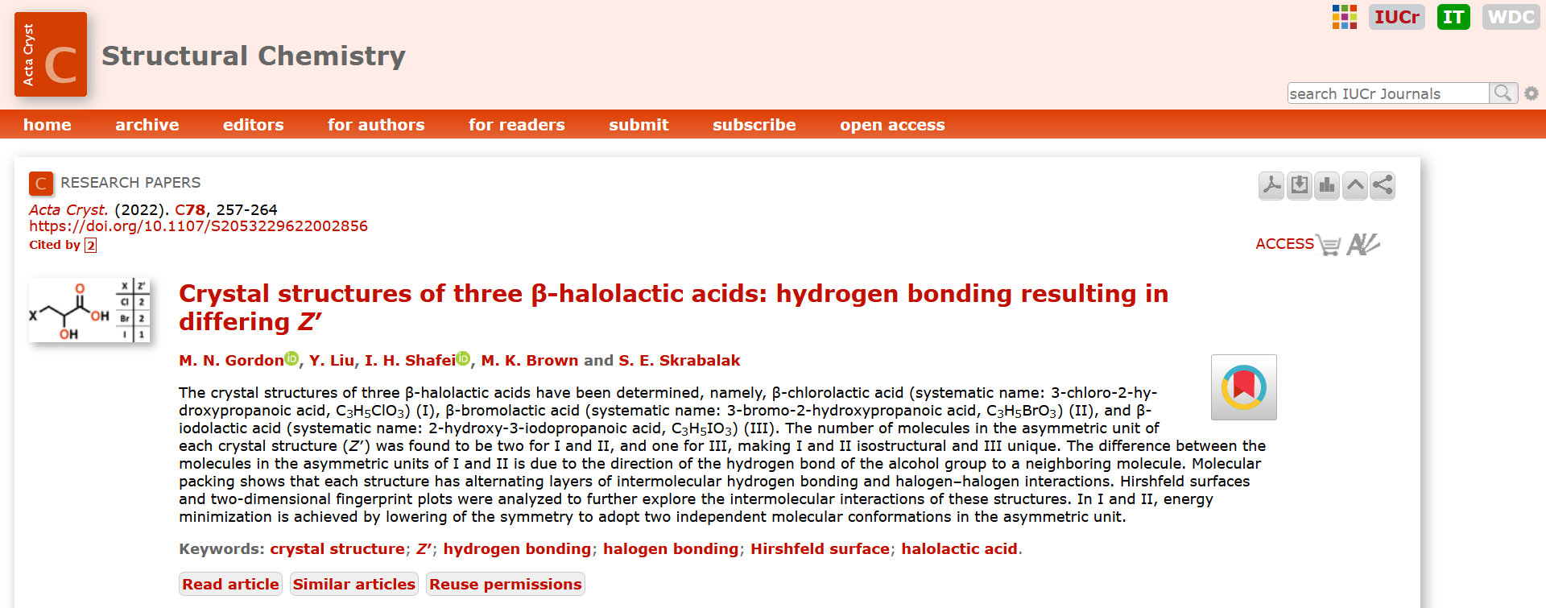
What does this look like? Example 1

Slide 7
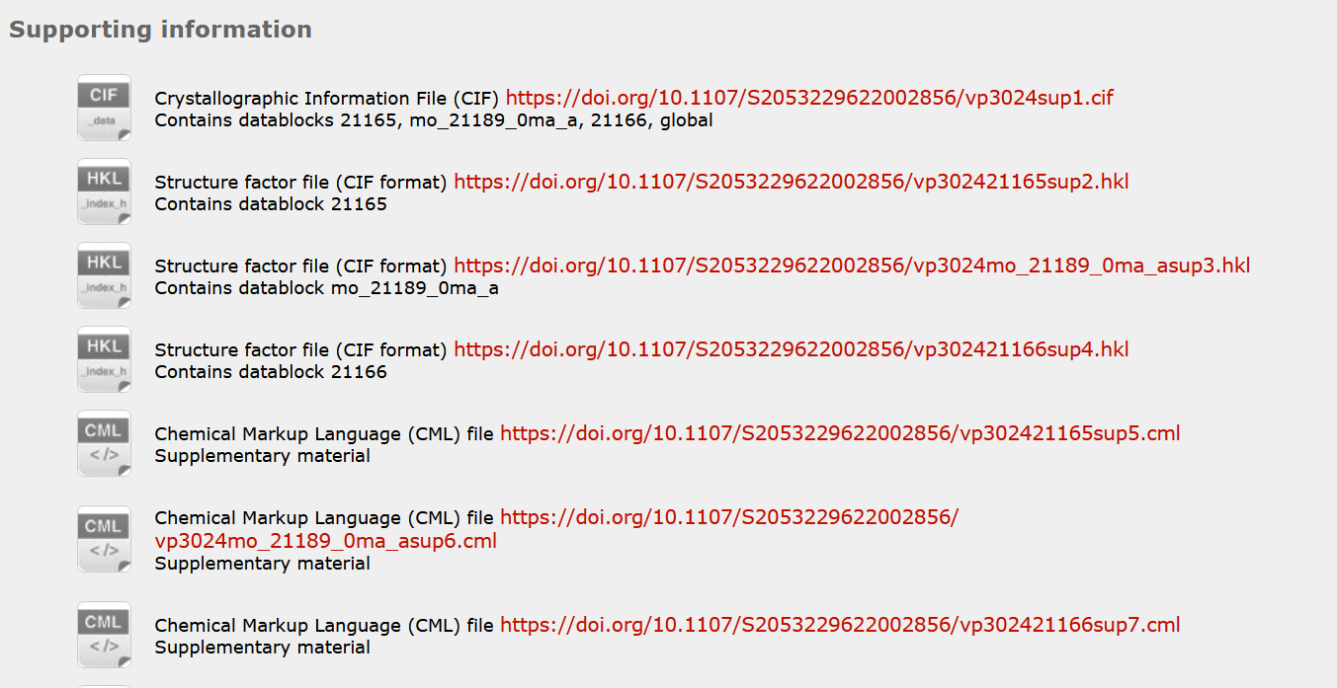
What does this look like? Example 1
Crystallographic Information File is a standard text file format for representing crystallographic information, promoted by the International Union of Crystallography.

Slide 8
What does this look like? Example 2
https://www.osti.gov/dataexplorer/
DDE is a Department of Energy repository for datasets from DOE sponsored research. Its contents include numeric data, computer simulations, figures and plots, interactive maps, multimedia, and scientific images The repository can be searched by keywords or browsed by title, content type, DOE data center, DOE user facility, host Website, sponsor, or subject category.

Slide 9
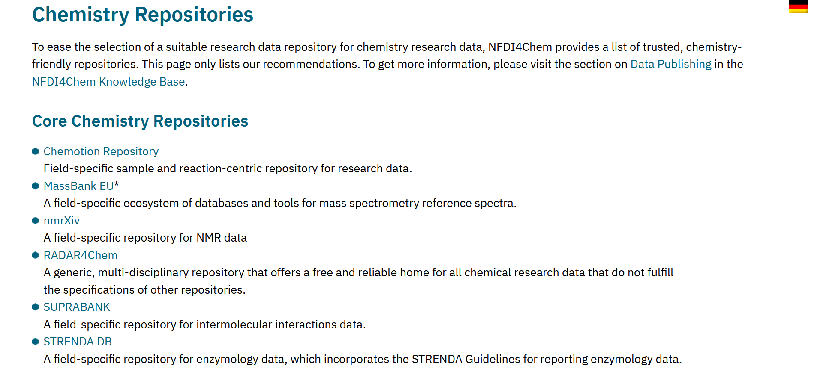
What databases/repositories exist?
https://www.nfdi4chem.de/repos/

Slide 10
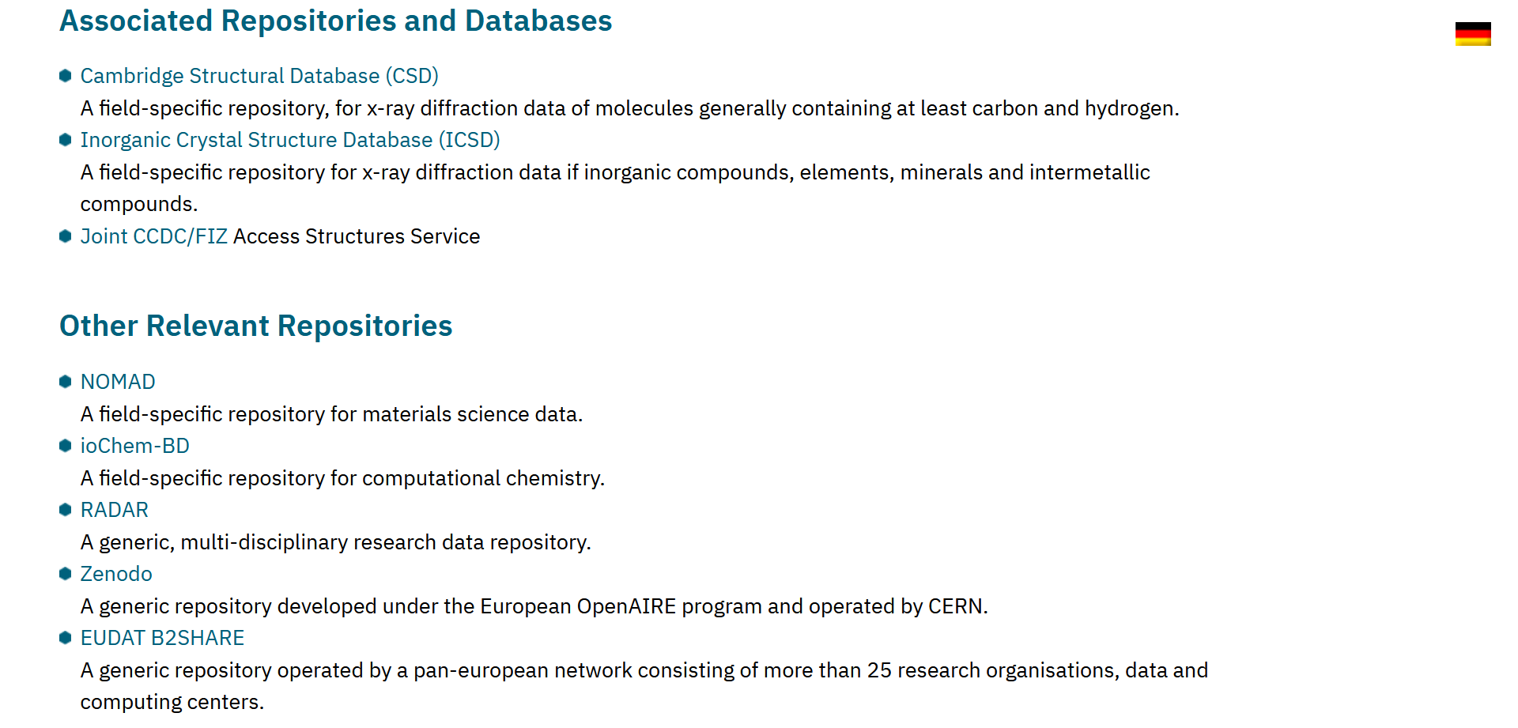
What databases/repositories exist?
https://www.nfdi4chem.de/repos/

Slide 11
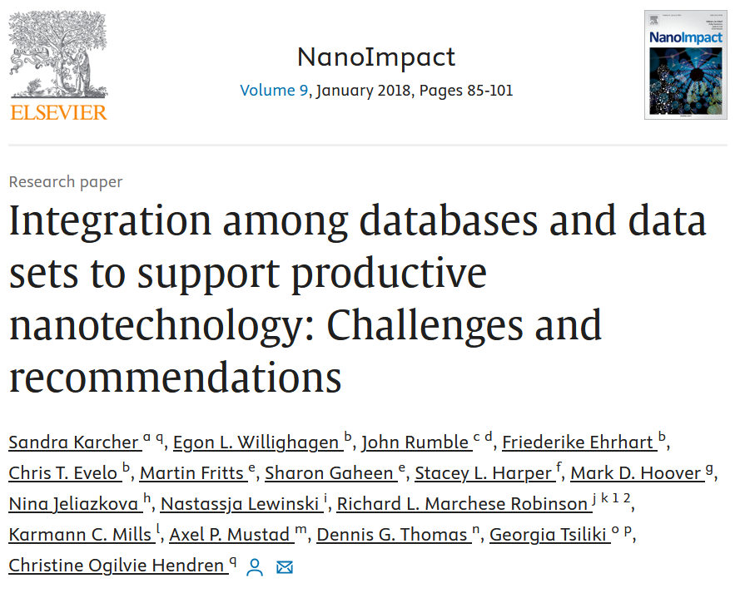
What databases/repositories exist?
For nanomaterials, largely focused on environmental and biological, with variable level of data curation and integration.

