Slide 1
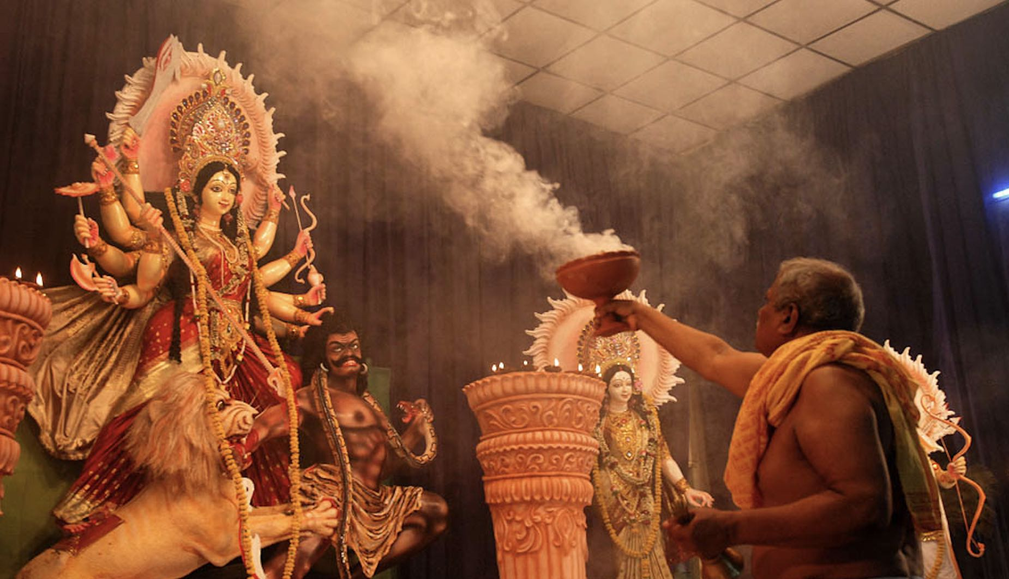
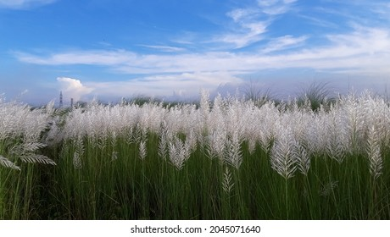
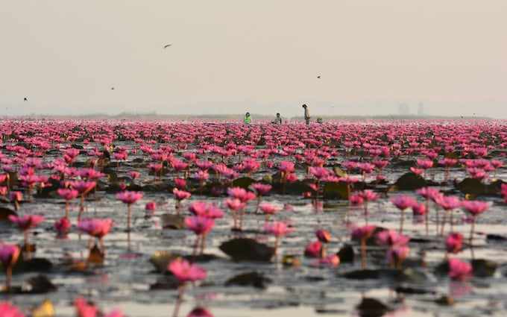
Durga Puja
Image taken from: The Millennium old 16-day Durga Puja in Odisha
Celebrated around Sept/Oct (month of Ashwin in the Indian calendar), mainly in Eastern India and around other parts of India among the Bengali diaspora
Around the same time, the rest of India celebrates Navaratri (9 nights)
Celebrates the victory of good (goddess Durga) over evil (asura prince)
The divine goddess represents the embodiment of feminine power, courage and the destroyer of evil force
This is festival of homecoming too!
Created by: Nilotpal Kapuria

Slide 2
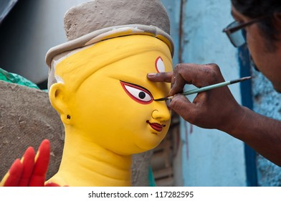
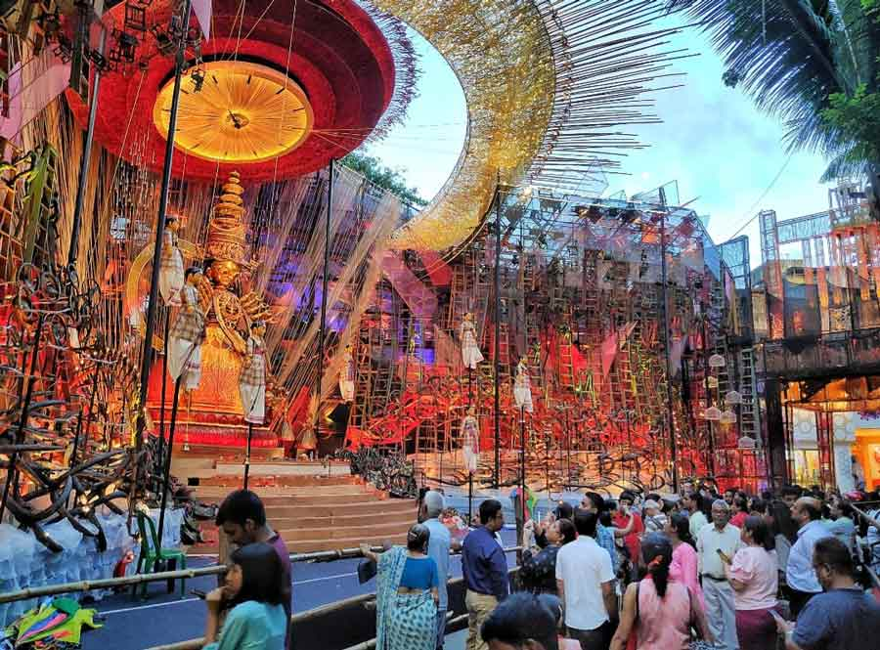
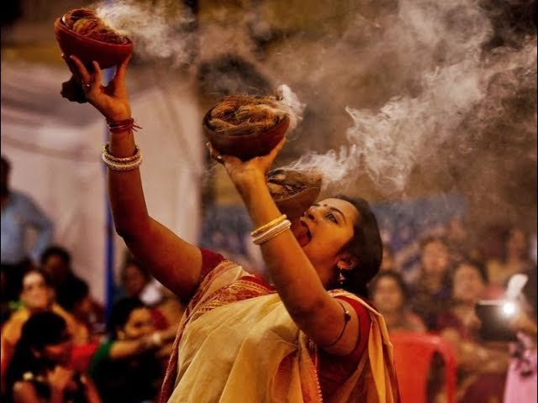
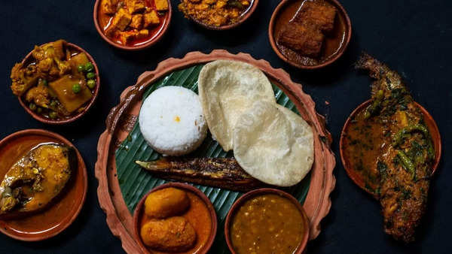
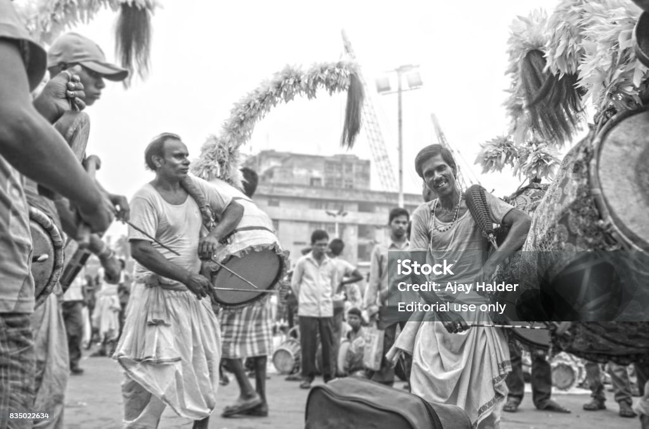
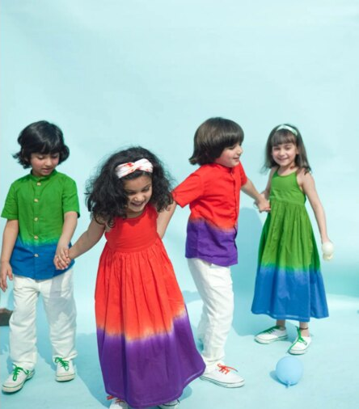
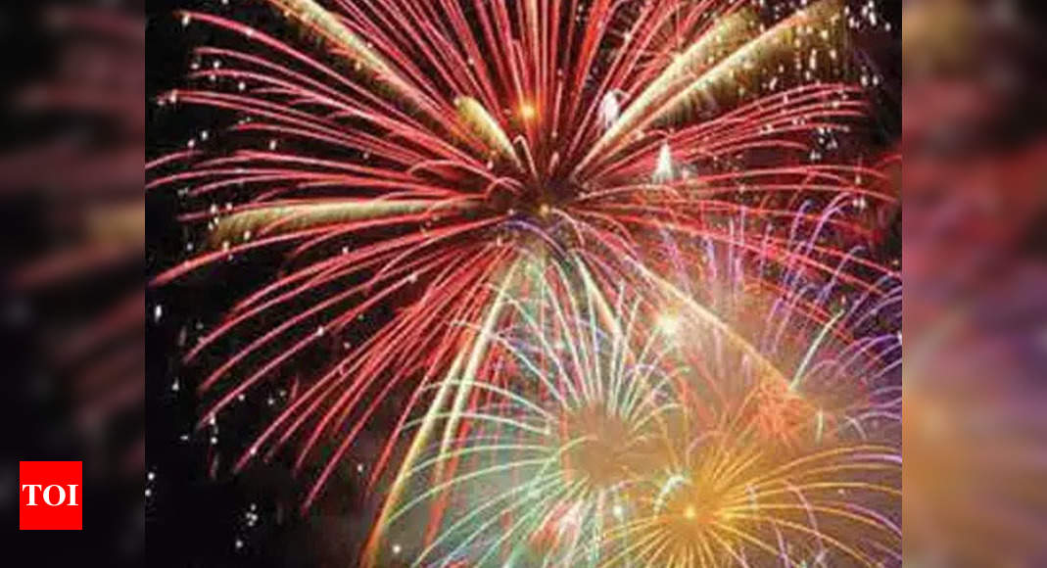
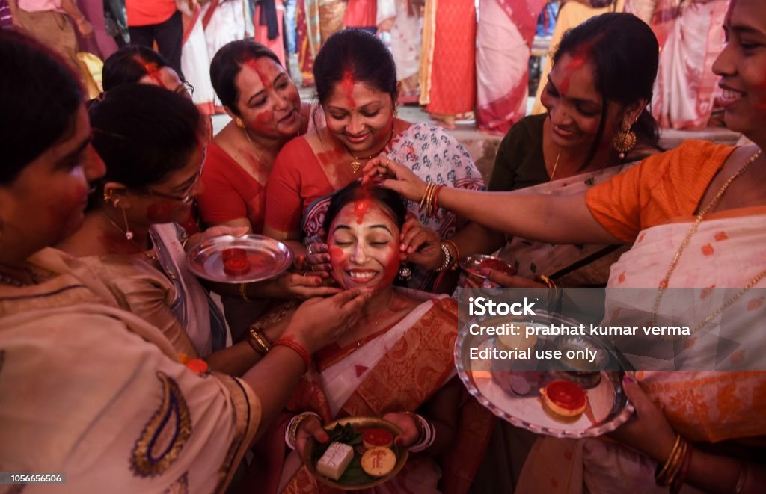
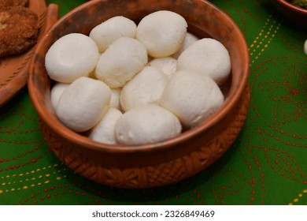
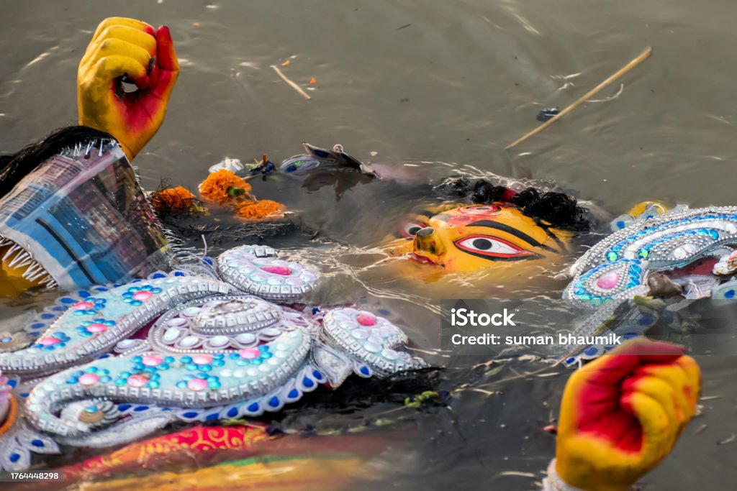
Traditions and Celebrations
1st day (Mahalaya)…….
a
b
c
d
e
The grandest festival of the year, with idol preparation (a), elaborately crafted pandals, grand processions, pandal hopping (b), dance (c), foods (d), music (e), fashion (f), fireworks (g), the celebration of womanhood (h), paying respect (i) and bidding goodbyes (j)
……..10th day (Vijayadashami)
f
g
h
i
j
Picture credit: Times of India, Shutterstock, The Telegraph

Slide 3
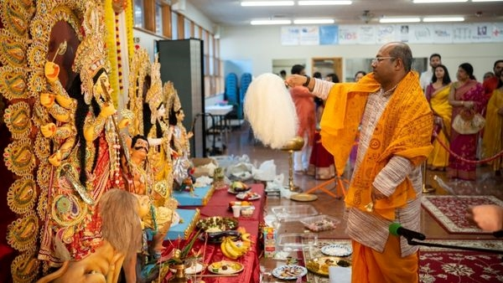
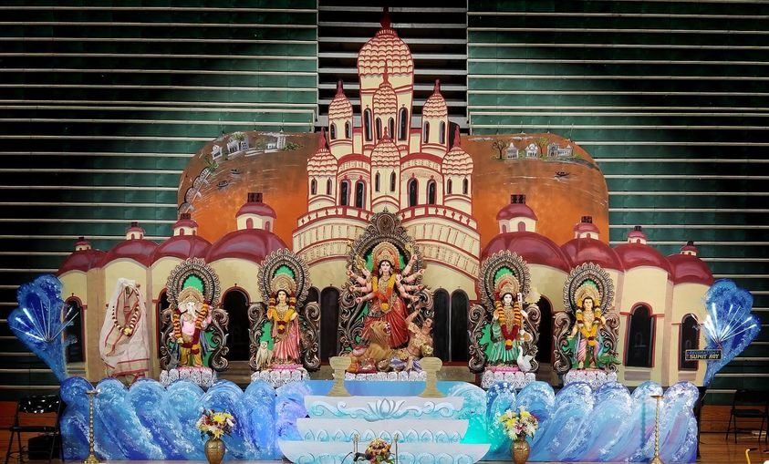
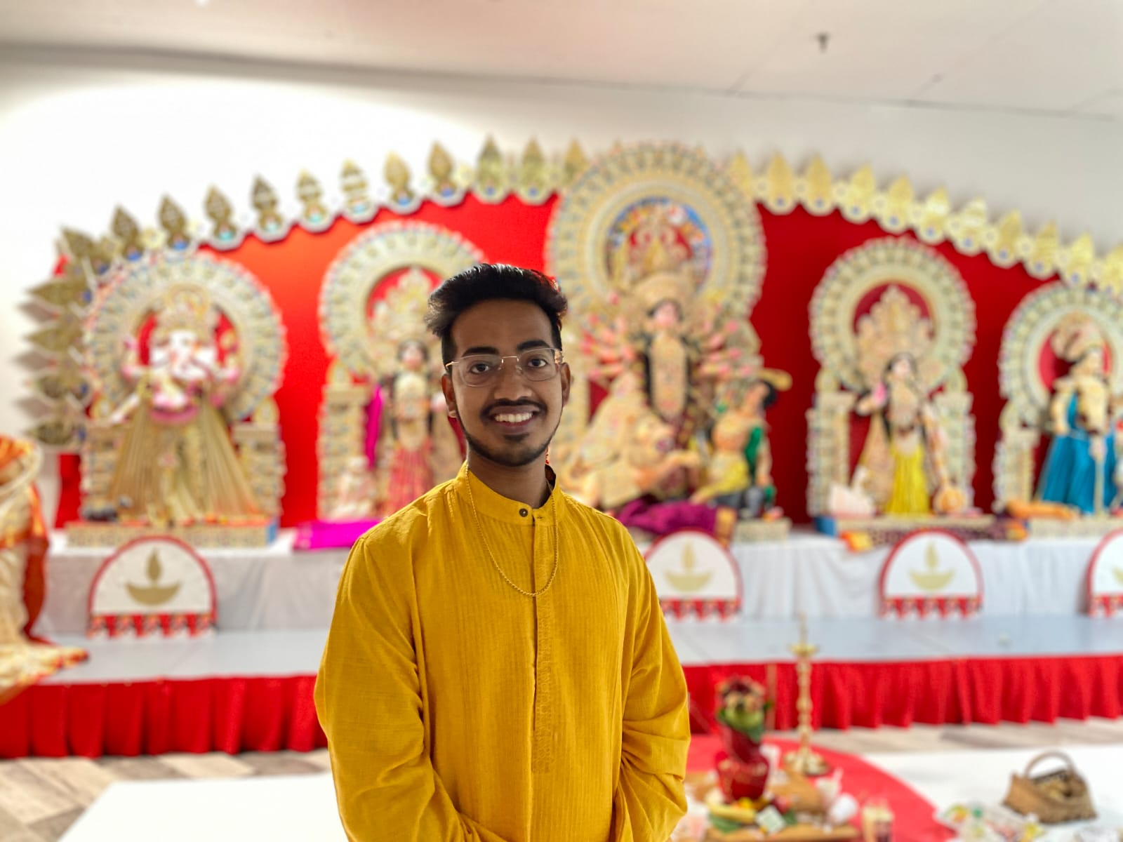
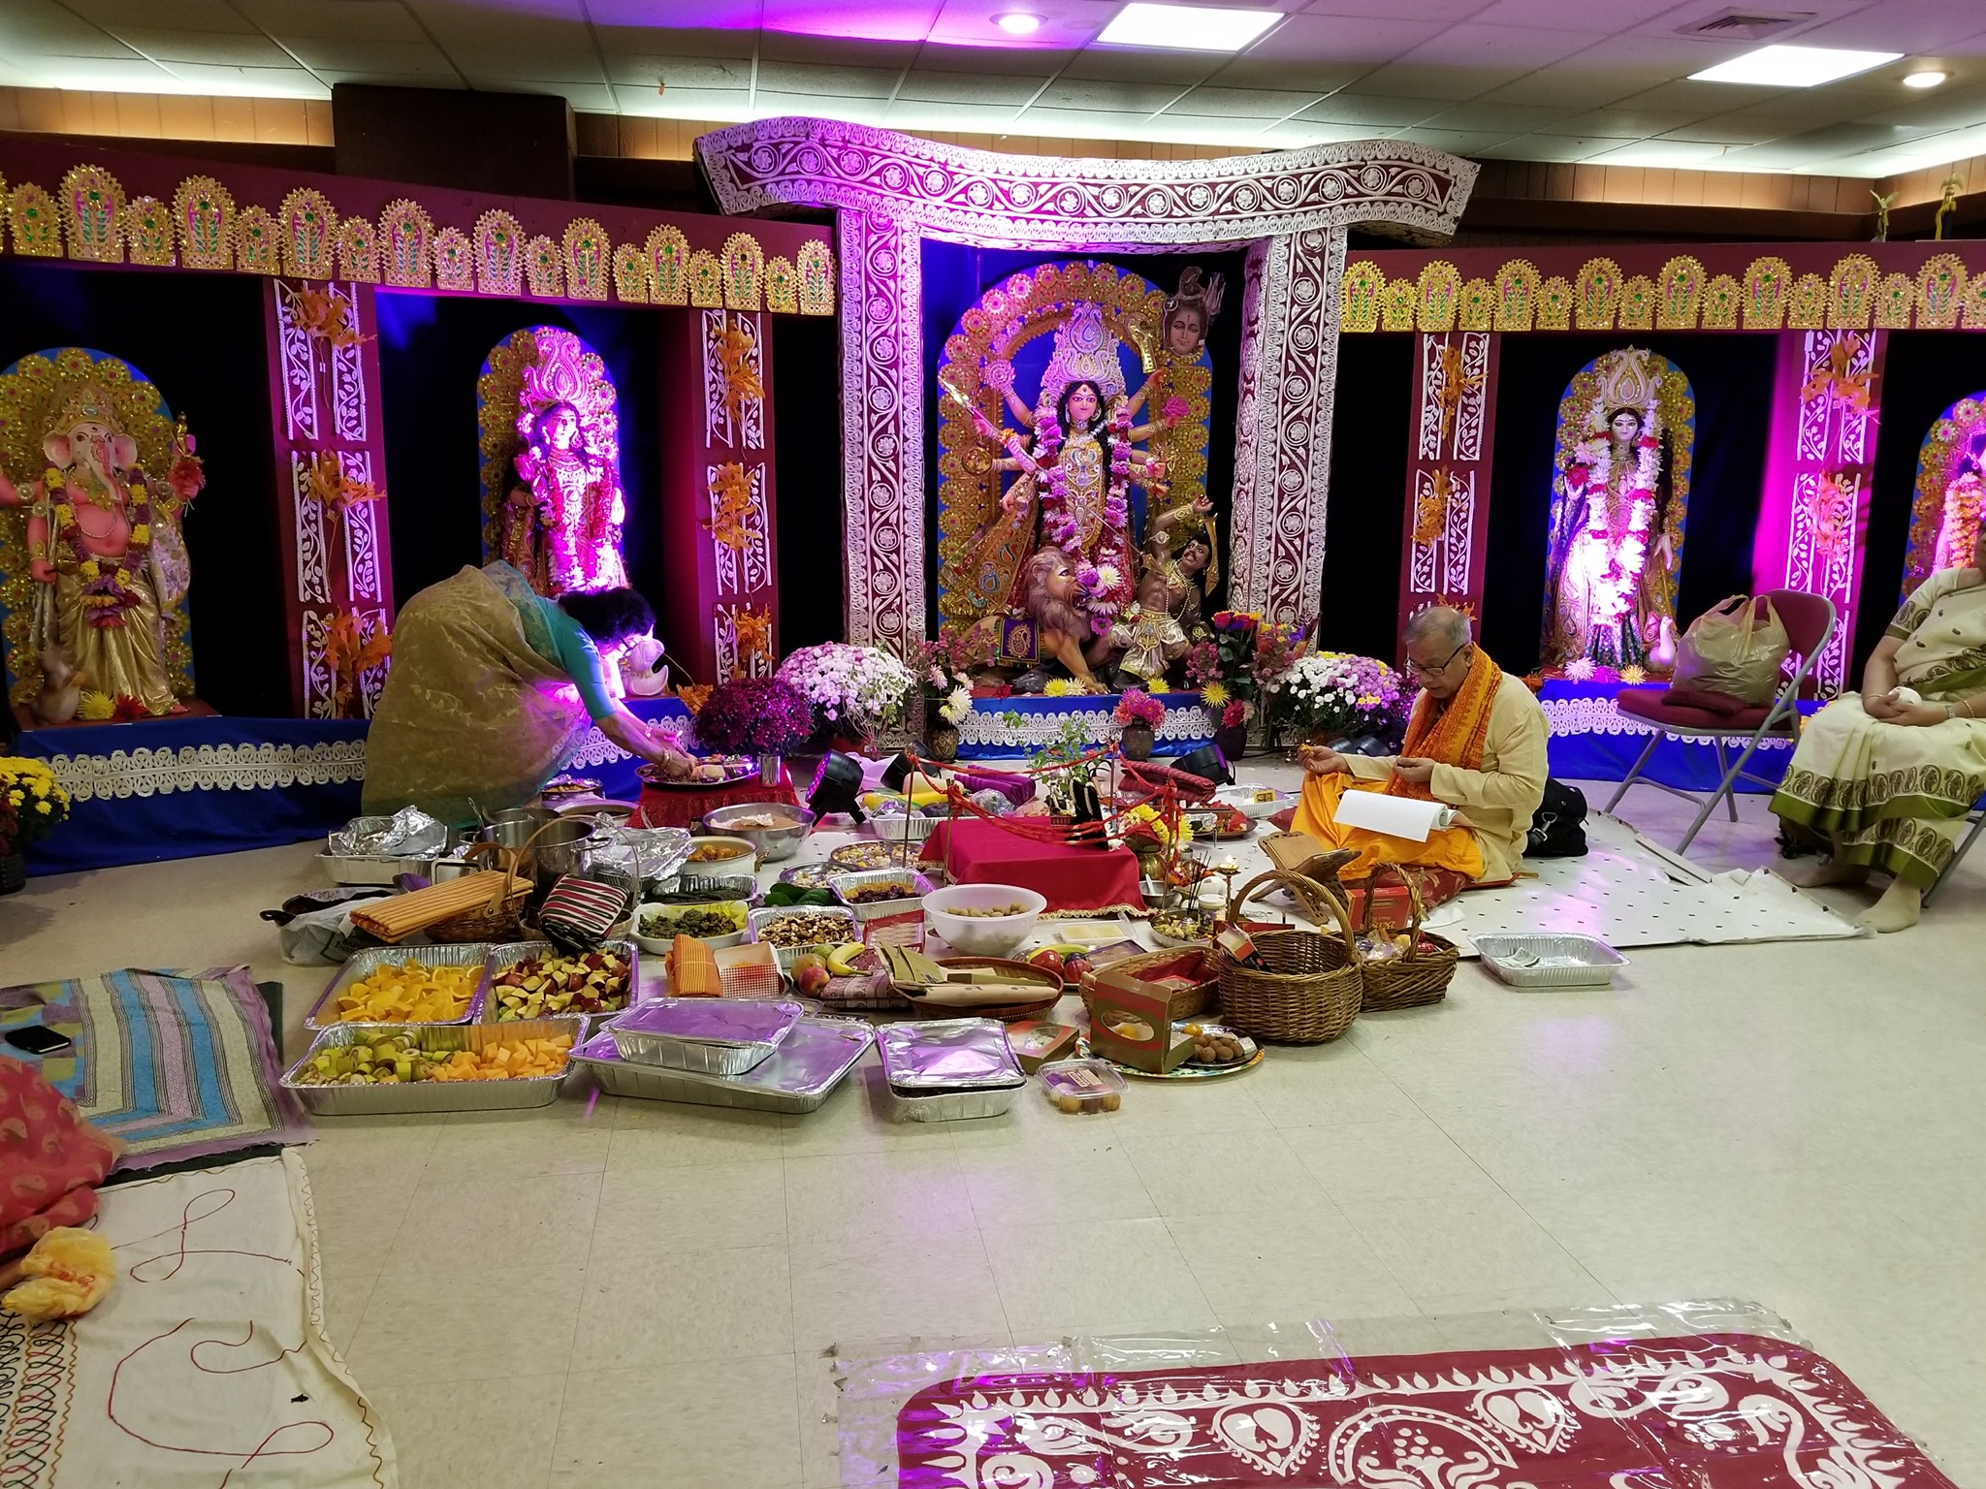
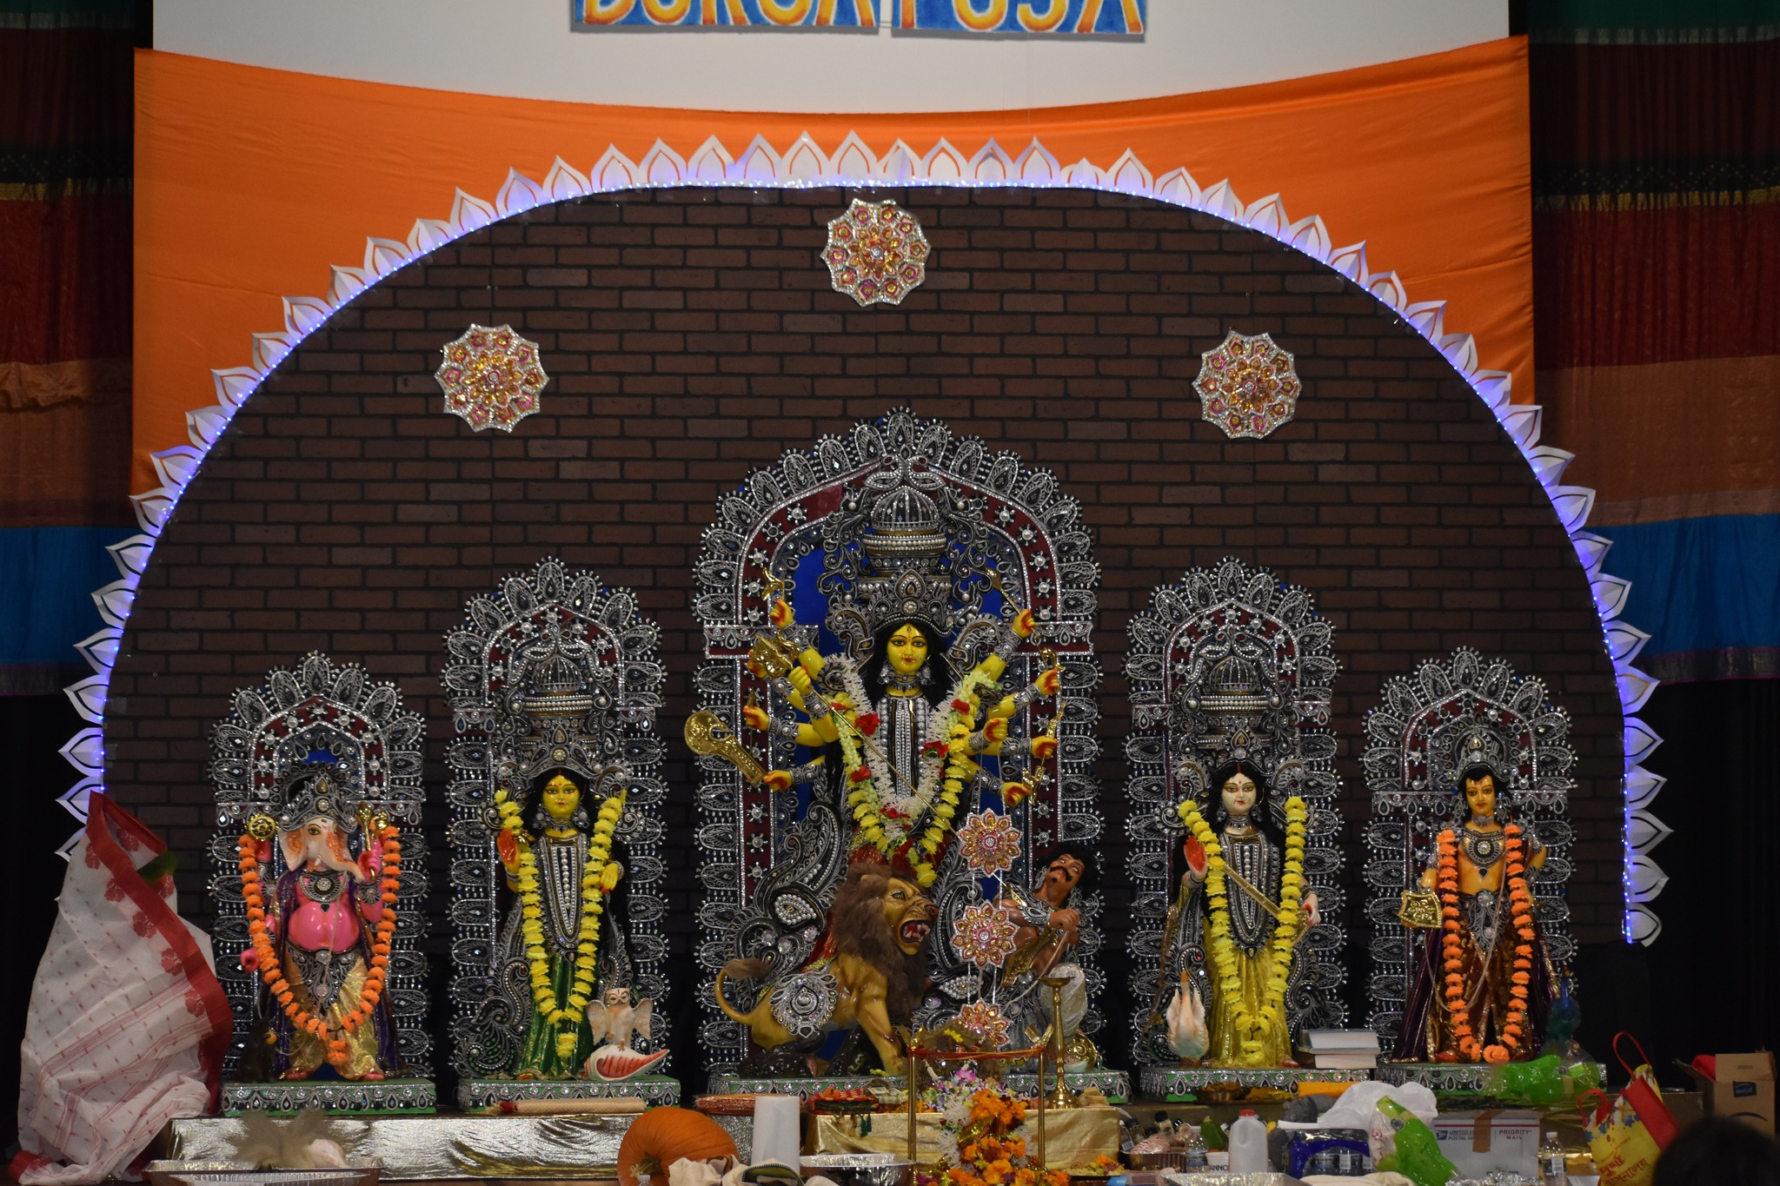
Durga Puja in USA
Moitri Seattle
BAGC, Chicago
Indianapolis
NYSDPC, New York
Wlafpuja, West Lafayette

