Slide 1
Center for Single-Entity Nanochemistry and Nanocrystal Design
All-Hands Meeting
March 8, 2023
Diverse Teams Matter

Slide 2
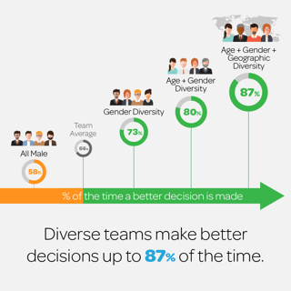
Diverse Teams Matter
Erik Larson, Cloverpop, Sept. 2017

Slide 3
What is diversity?
Existence of variety within a group.
The variety may come from differences in gender, race, ethnicity, nationality, sexual orientation, disability status, socioeconomic status, and other factors.
According to the NSF, the STEM workforce is 89% white and 53% male. STEM fields do not reflect the diversity of our country.

Slide 4
Diverse Teams Matter
A more diverse team is more likely to outperform a more homogeneous team, even when the homogeneous team is considered to have “relatively greater ability” as individuals than the more diverse group.
Diverse teams produce more novel and higher-impact scientific ideas.
Why?
Yang Yang, Tanya Tian, Teresa Woodruff, Benjamin Jones, Brian Uzzi PNAS, 2022, 119, e22000841119.
Lu Hong and Scott Page, PNAS, 2004, 101, 16385.

Slide 5
Diversity of Perspectives
Complex problems aided by examining from different angles.
Diversity of thoughts, opinions, and ideas come from different backgrounds, experiences, and education.
Lu Hong and Scott Page, PNAS, 2004, 101, 16385.

Slide 6
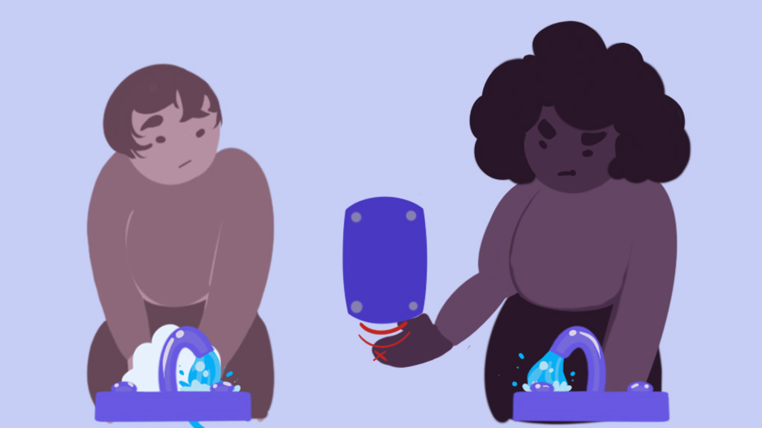
Bias in Technology
Taylor Synclair Goethe, Reporter, March 2019.
Soap dispenser: near-IR tech detects hand motions by reflecting back light but darker skin absorbs more light.
Photography, facial recognition tech, and more…

Slide 7
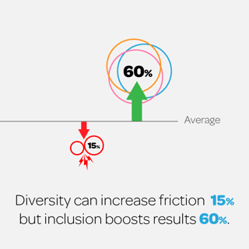
Friction versus Inclusion
Inclusion: a set of behaviors (culture) that encourages team members to feel valued for their unique qualities and experience a sense of belonging.
Erik Larson, Cloverpop, Sept. 2017

Slide 8
CSENND and Diversity
Our scientific objectives will only be met through diversity and inclusion.
NSF requires a “Center-wide plan to ensure a diverse and inclusive center environment, including researchers at all levels, leadership groups, and advisory groups.”
CCIs integrate research with… broadening participation (center-wide plans for increasing engagement by underrepresented groups).

