Slide 1
Center for Single-Entity Nanochemistry and Nanocrystal Design
All-Hands Meeting
July 12, 2023
Cultural Competency & Humility

Slide 2
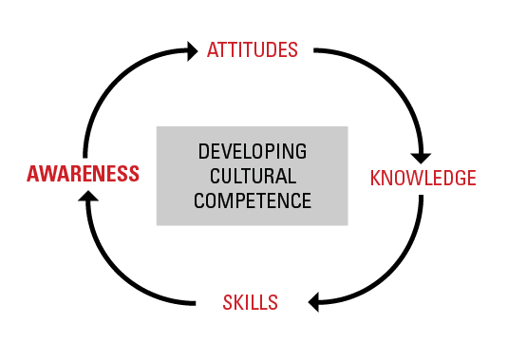
Cultural Competency & Humility
Cultural competence is the ability to understand, communicate with and effectively interact with people across cultures. Cultural competence encompasses, being aware of one's own world view, developing positive attitudes towards cultural differences, gaining knowledge of different cultural practices and world views.

Slide 3

Cultural Competency & Humility
https://youtu.be/c_wOnJJEfxE

Slide 4
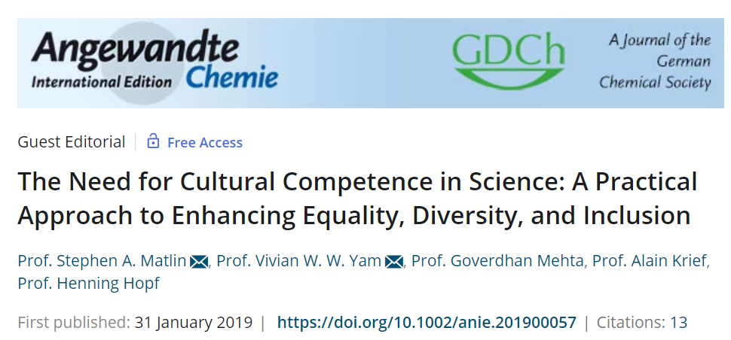
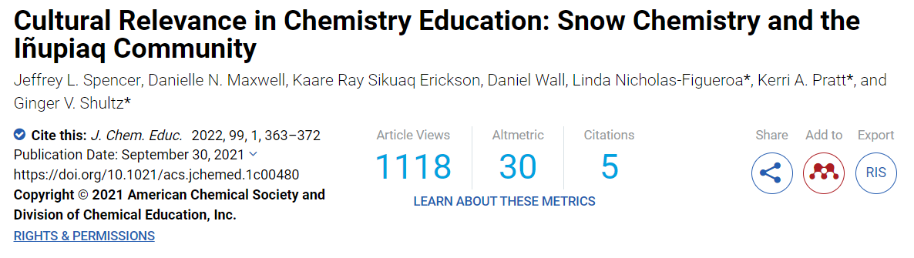
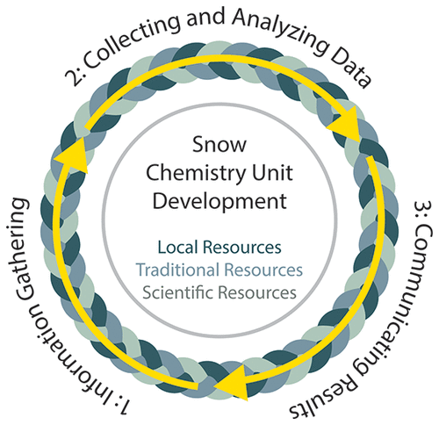
Cultural Competency & Humility
However, cultural competence in chemistry has received extremely little specific attention. Chemistry can play a leading role in demonstrating this pathway, both to enhance its own capacities to serve as a central science and also to provide a model of good practice for other science disciplines. Individuals, departments, institutions and professional bodies can all play their part. Now is a good time to start.

Slide 5
CSENND & Cultural Competency & Humility
Action Item #1: Update CSENND website to include bio
Action Item #2: Each all-hands meeting moving forward will include a team member introducing themselves
Action Item #3: Brainstorm ways that we can build cultural competency within the center and teach about nanoscience in culturally relevant ways – BREAKOUTS!

