Slide 1
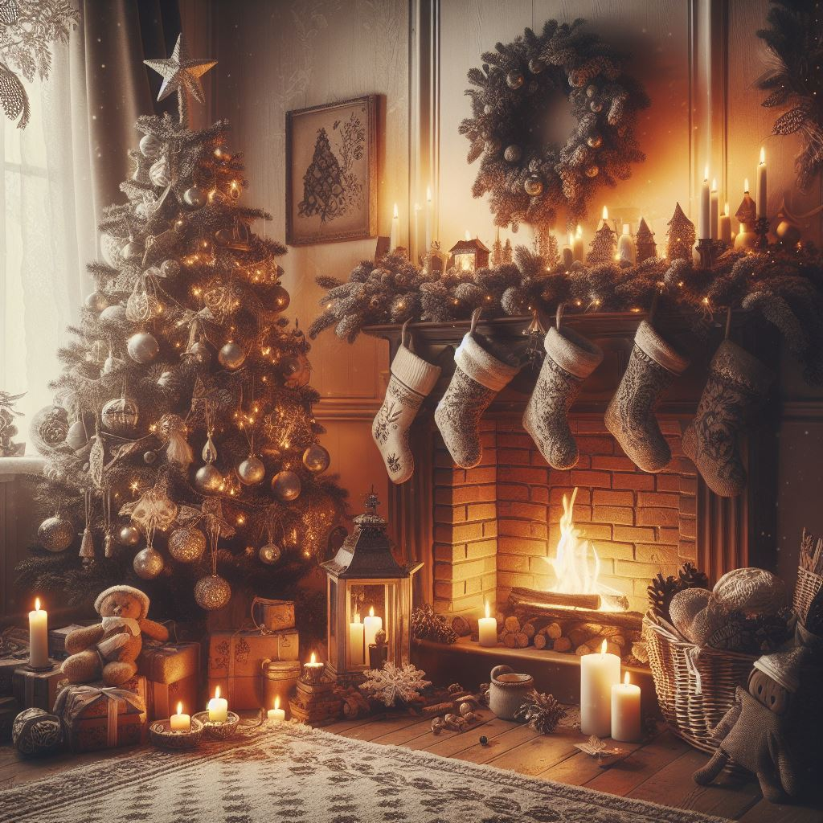
Christmas
Natale
Navidad
Noël
Celebrated: December 25
Sacred Religious Holiday and Commercial Phenomenon
Birth of Jesus (date not mentioned in the Bible)
  Chosen to be Dec. 25th
  Adopt and absorb pagan festivities
  Increased embrace of Christmas
Information: History.com
Created by:
Madison Edwards
Photo generated by Bing AI

Slide 2
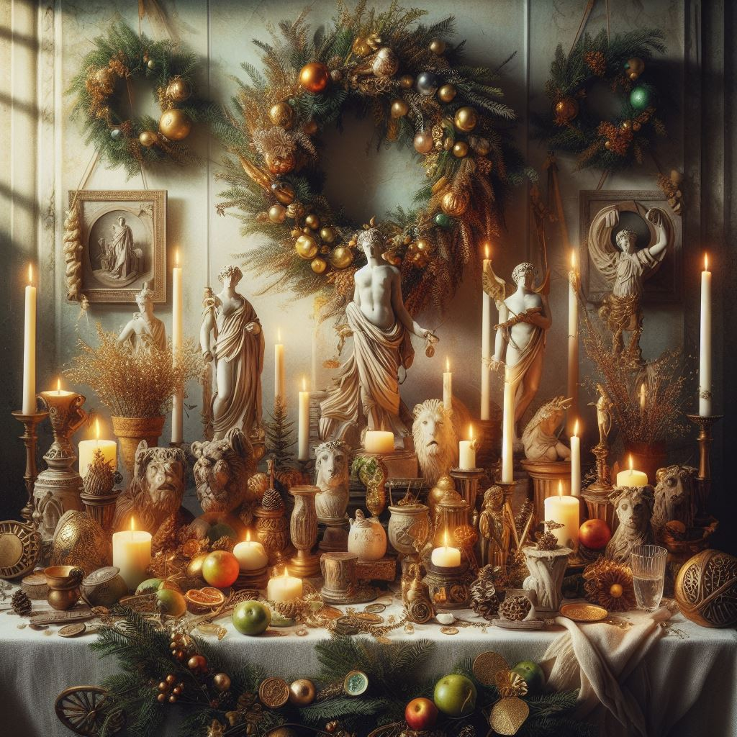
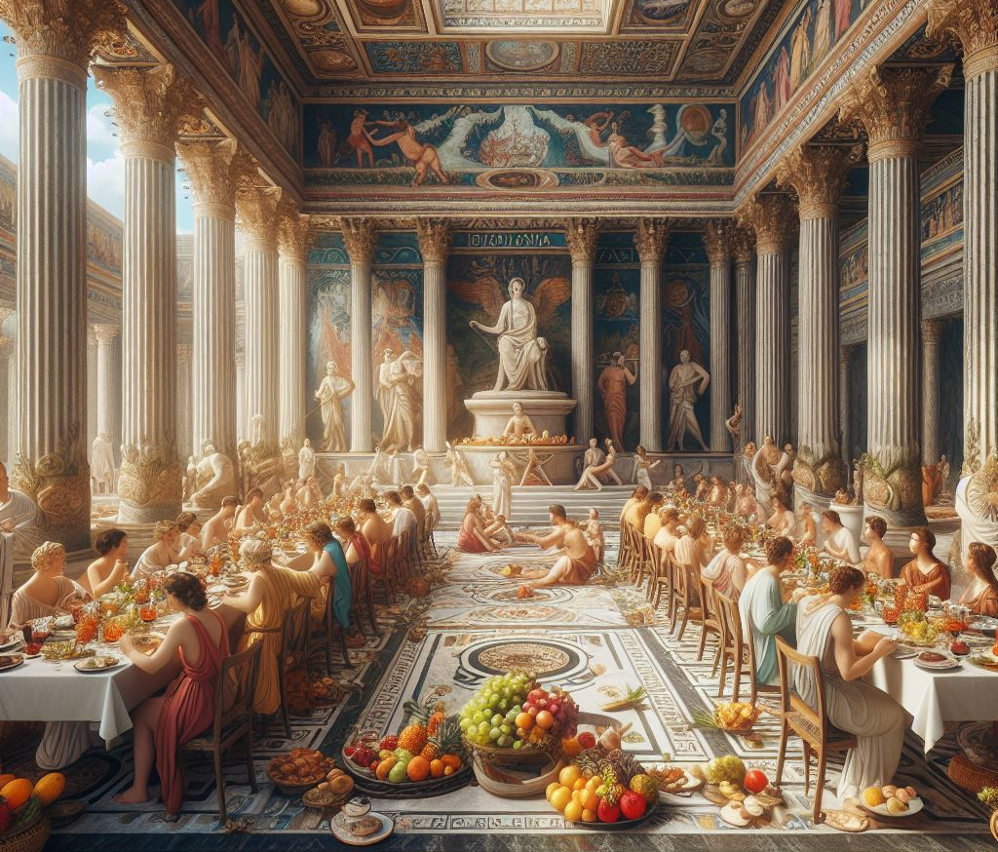
Previous Celebrations in Winter
Winter Solstice
  Celebration of light and birth
  Look forward to longer days and more hours of sunlight
Norse celebration “Yule” (Dec. 21)
  Return of the sun
Germans honored Oden
  Feast of the winter solstice
Saturnalia
  Honor Saturn, god of agriculture
  Business and schools closed
  Enslaved people given freedom
Juvenalia (Dec. 25)
  Feast honoring the children of Rome
Information: History.com
Photos generated by Bing AI

Slide 3
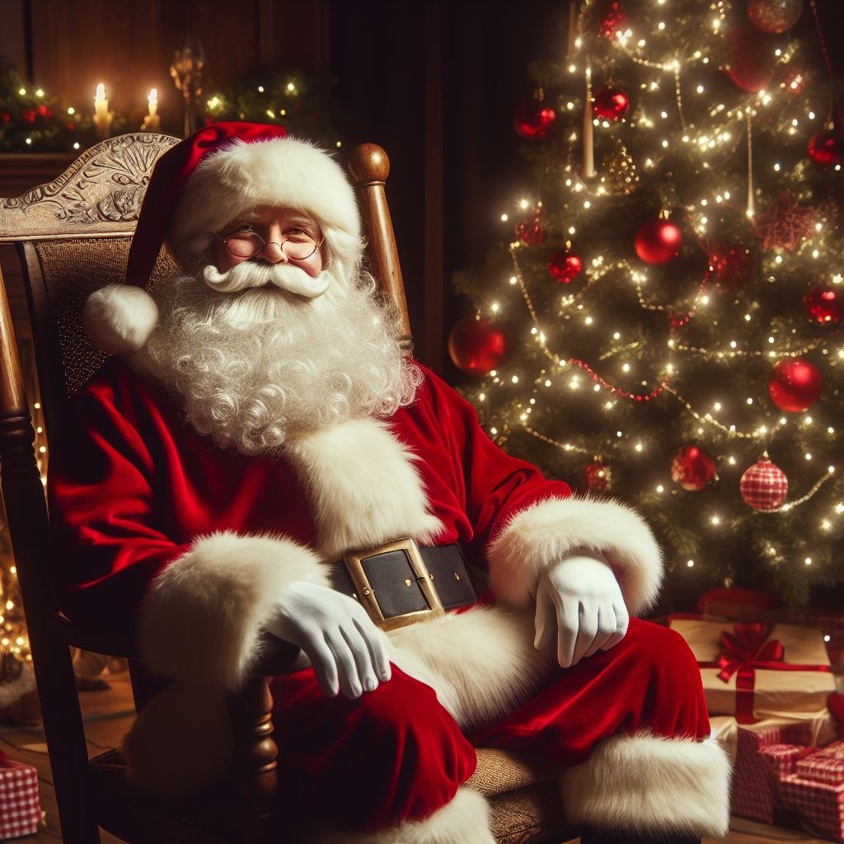
The Celebration (United States)
Family gatherings
Decorating trees
Sending holiday cards
Gift-giving (3 Magi gifts)
Religious celebrations
  Midnight (evening) candlelight services
Santa Claus
  St. Nicholas, Turkey, 280 AD
  Gave everything away
  Helped the sick and poor
  Poem by Clement Clarke Moore depicted the Santa we know today
Information: History.com
Photo generated by Bing AI

