Slide 1
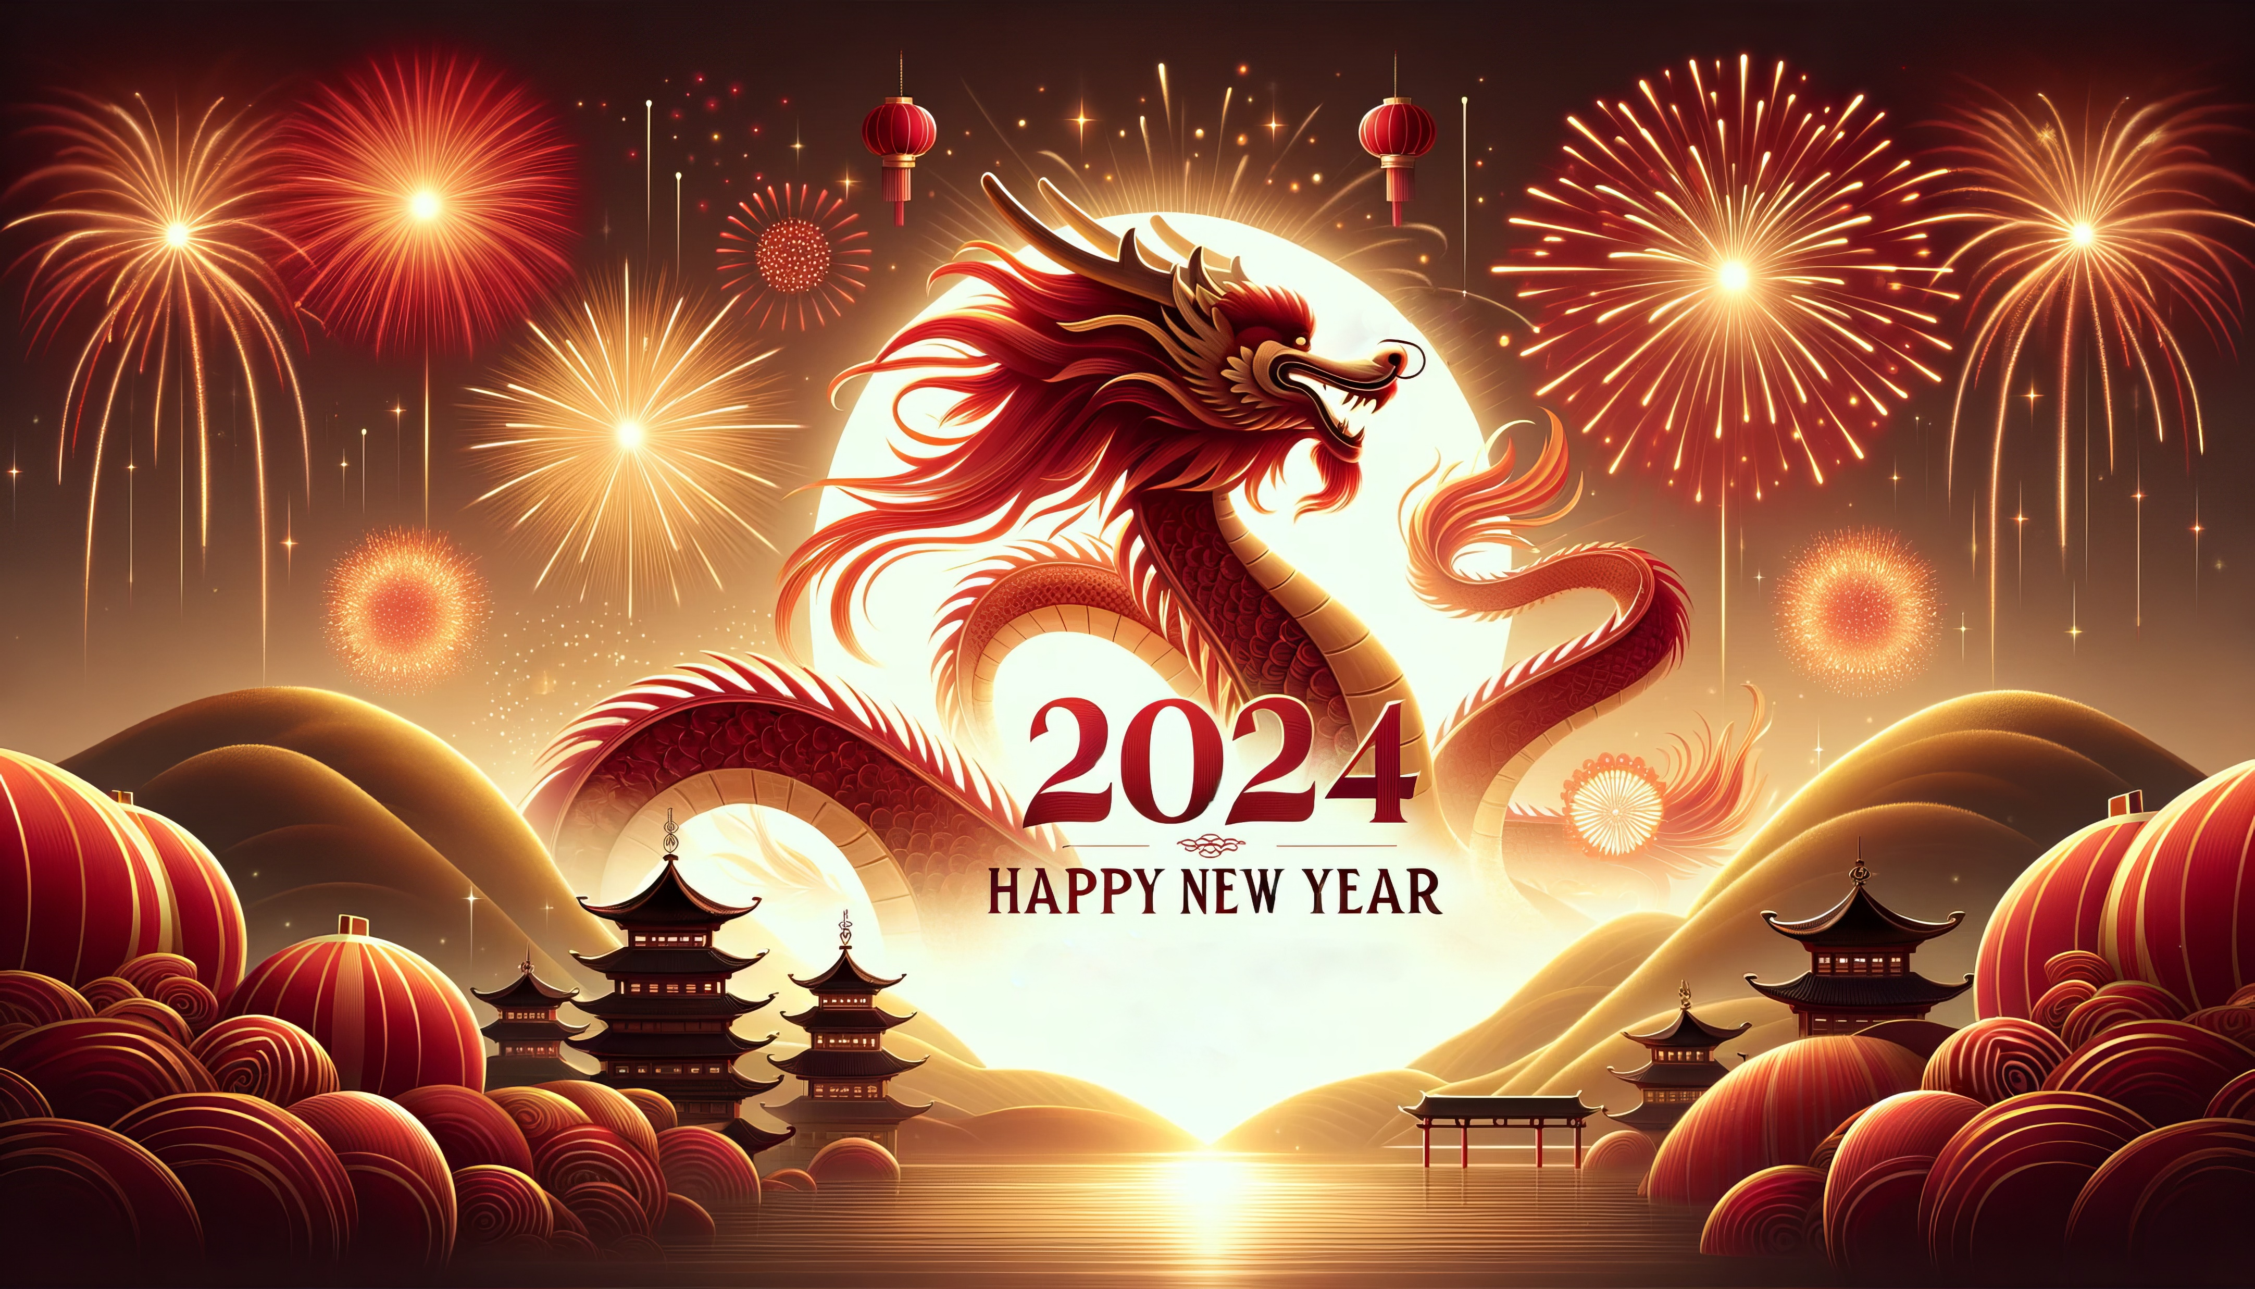
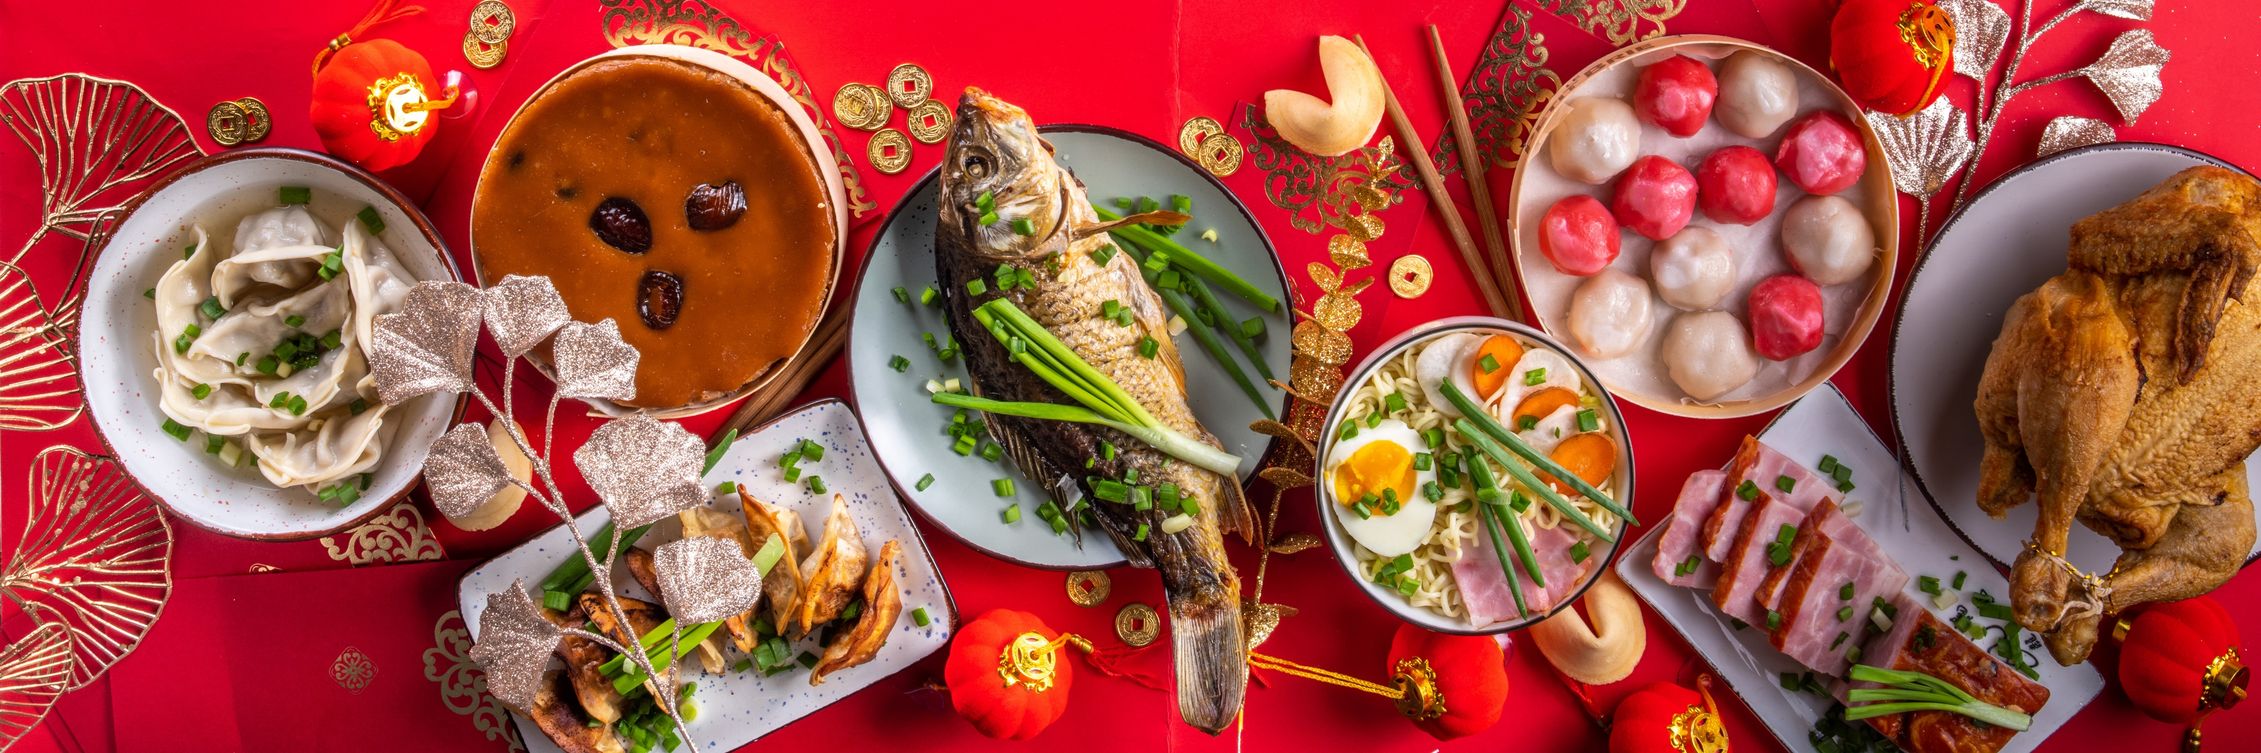
Chinese Spring Festival (春节)
Dates: The beginning of Lunar New Year.
Holiday significance
Family Reunion: It's a time for families to come together.
Feasting: Special foods like dumplings and fish are eaten.
A variety of events: good fortune or happiness, wealth, and longevity.
Credits: Adobe Stock
Created by: Chuanliang Huang

Slide 2
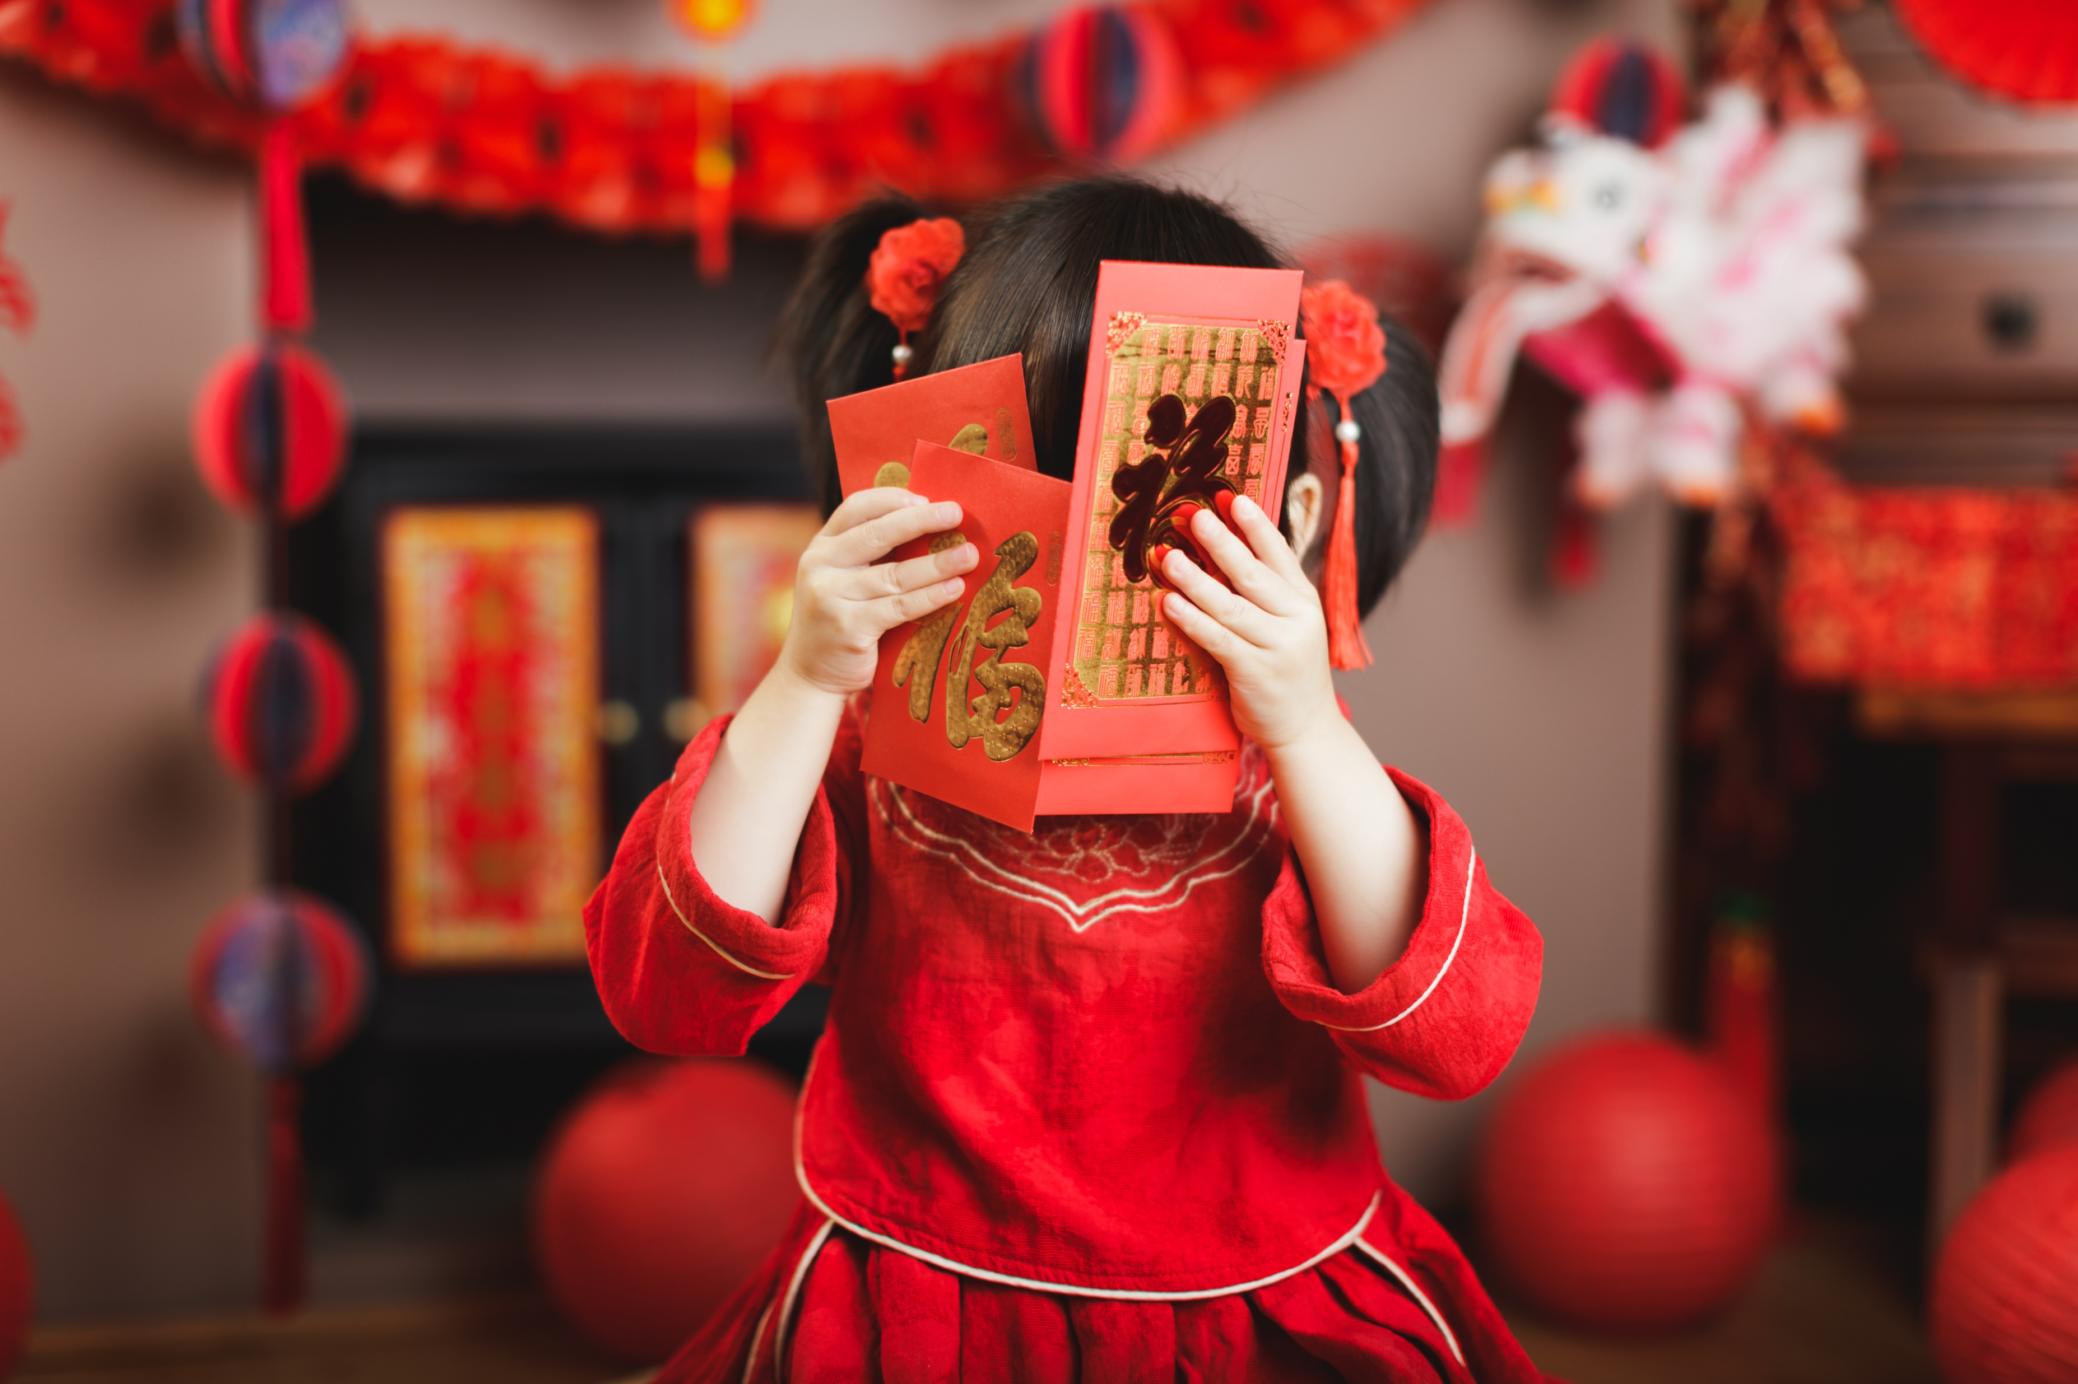

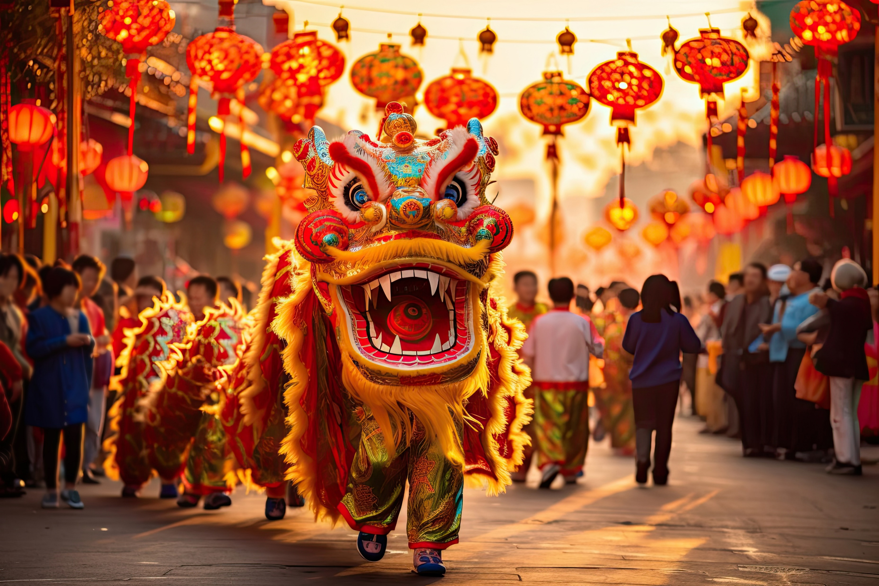

Chinese Spring Festival (春节)
Red Color: Symbolizes good luck and joy. Red decorations, clothing, and envelopes with money (红包) are common during this time.
Fireworks and Dragon Dances: Traditional performances to ward off evil spirits.
Credits: Adobe Stock

Slide 3
Chinese Spring Festival (春节)
Zodiac Animal: Each year is associated with an animal from the Chinese zodiac. For example, 2024 is the Year of the Dragon.
Credits: Adobe Stock

