Slide 1
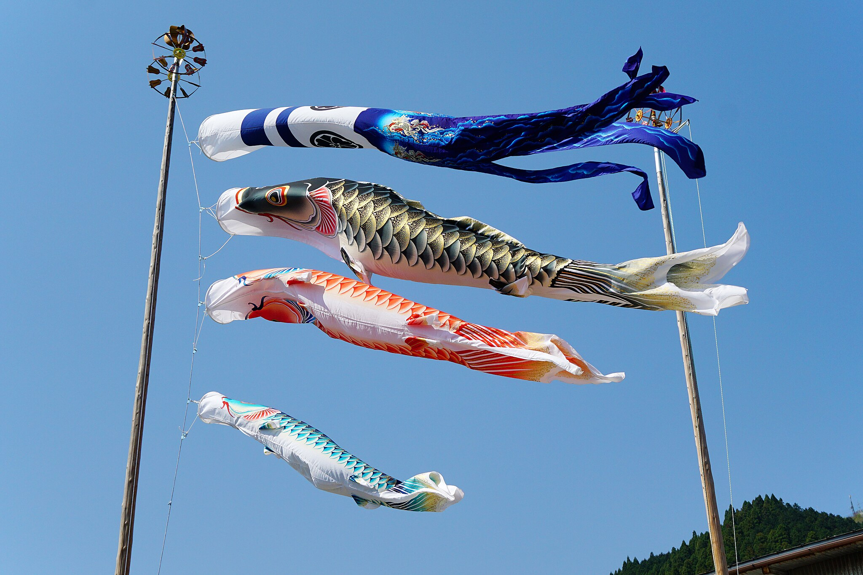
Children’s Day (Japan)
Observed on May 5th
A public holiday since 1948 to “celebrate the personalities and happiness of children”
Marks the end of the “Golden Week” holiday season
Koinobori (Carp streamers)
by 663highland, CC BY-SA 3.0, via Wikimedia Commons
Created by: Satoshi Ohtsuka

Slide 2
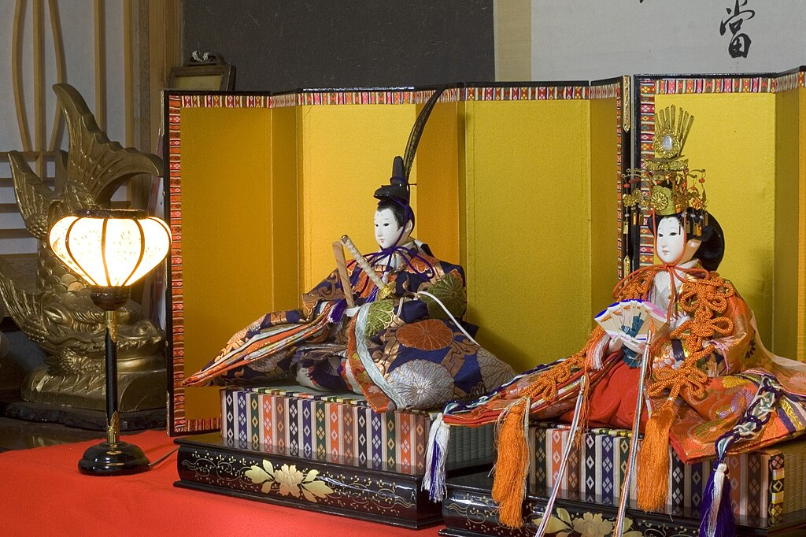
Children’s Day (Japan)
Traditionally,
March 3rd: Girls’ day (Hinamatsuri)
May 5th: Boys’ day (Tango no Sekku)
Both came from ancient Chinese festivals and developed in Japan
Hinamatsuri began as girls’ play in the 11th century; Hina dolls were displayed by the 17th century
Hina dolls
by tab2_dawa, CC BY-SA 3.0, via Wikimedia Commons

Slide 3
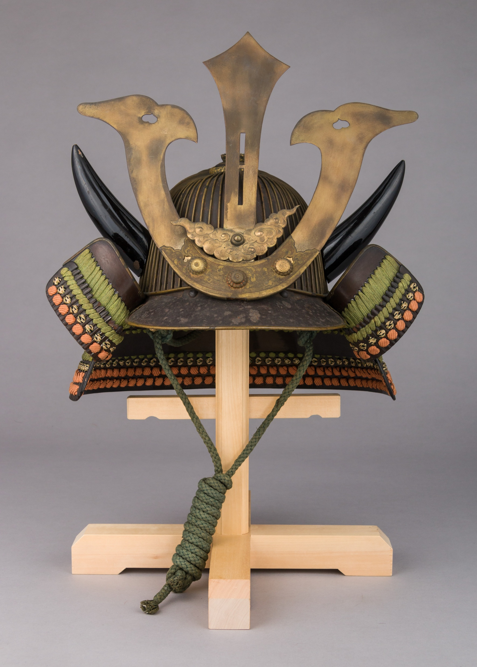
Children’s Day (Japan)
Tango no Sekku became linked to samurai culture in the 12th century, celebrating boys’ growth and strength
May 5th became a public holiday in 1948
Many families go out as parks offer free admission and child-friendly events
Kabuto (Samurai helmet)
by The Metropolitan Museum of Art, public domain

Slide 4
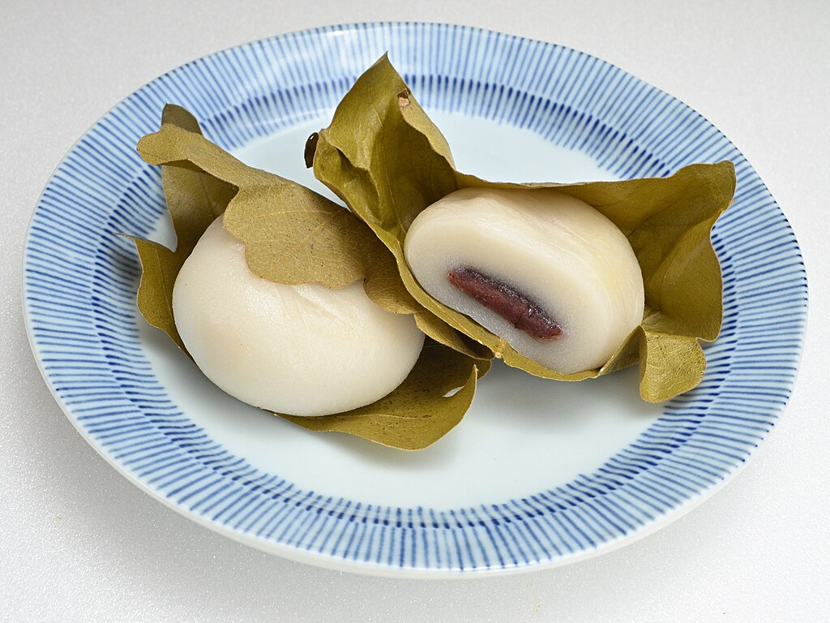
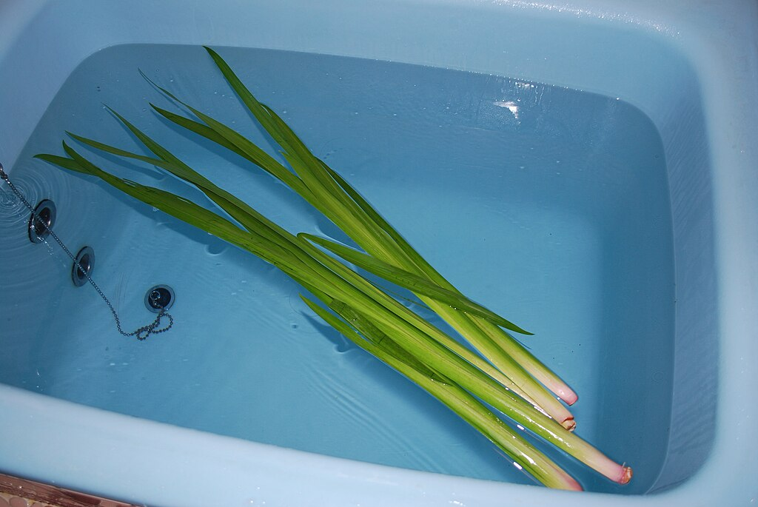
Children’s Day (Japan)
Shobu-yu (Sweet-flag bath)
by katorisi, CC BY-SA 3.0, via Wikimedia Commons
Kashiwa-mochi
(Oak leaf rice cake)
by Jiangang Wang, public domain, via Wikimedia Commons

